Slide 1
Communicating With Respect
Family Development Resources, Inc.

Slide 2
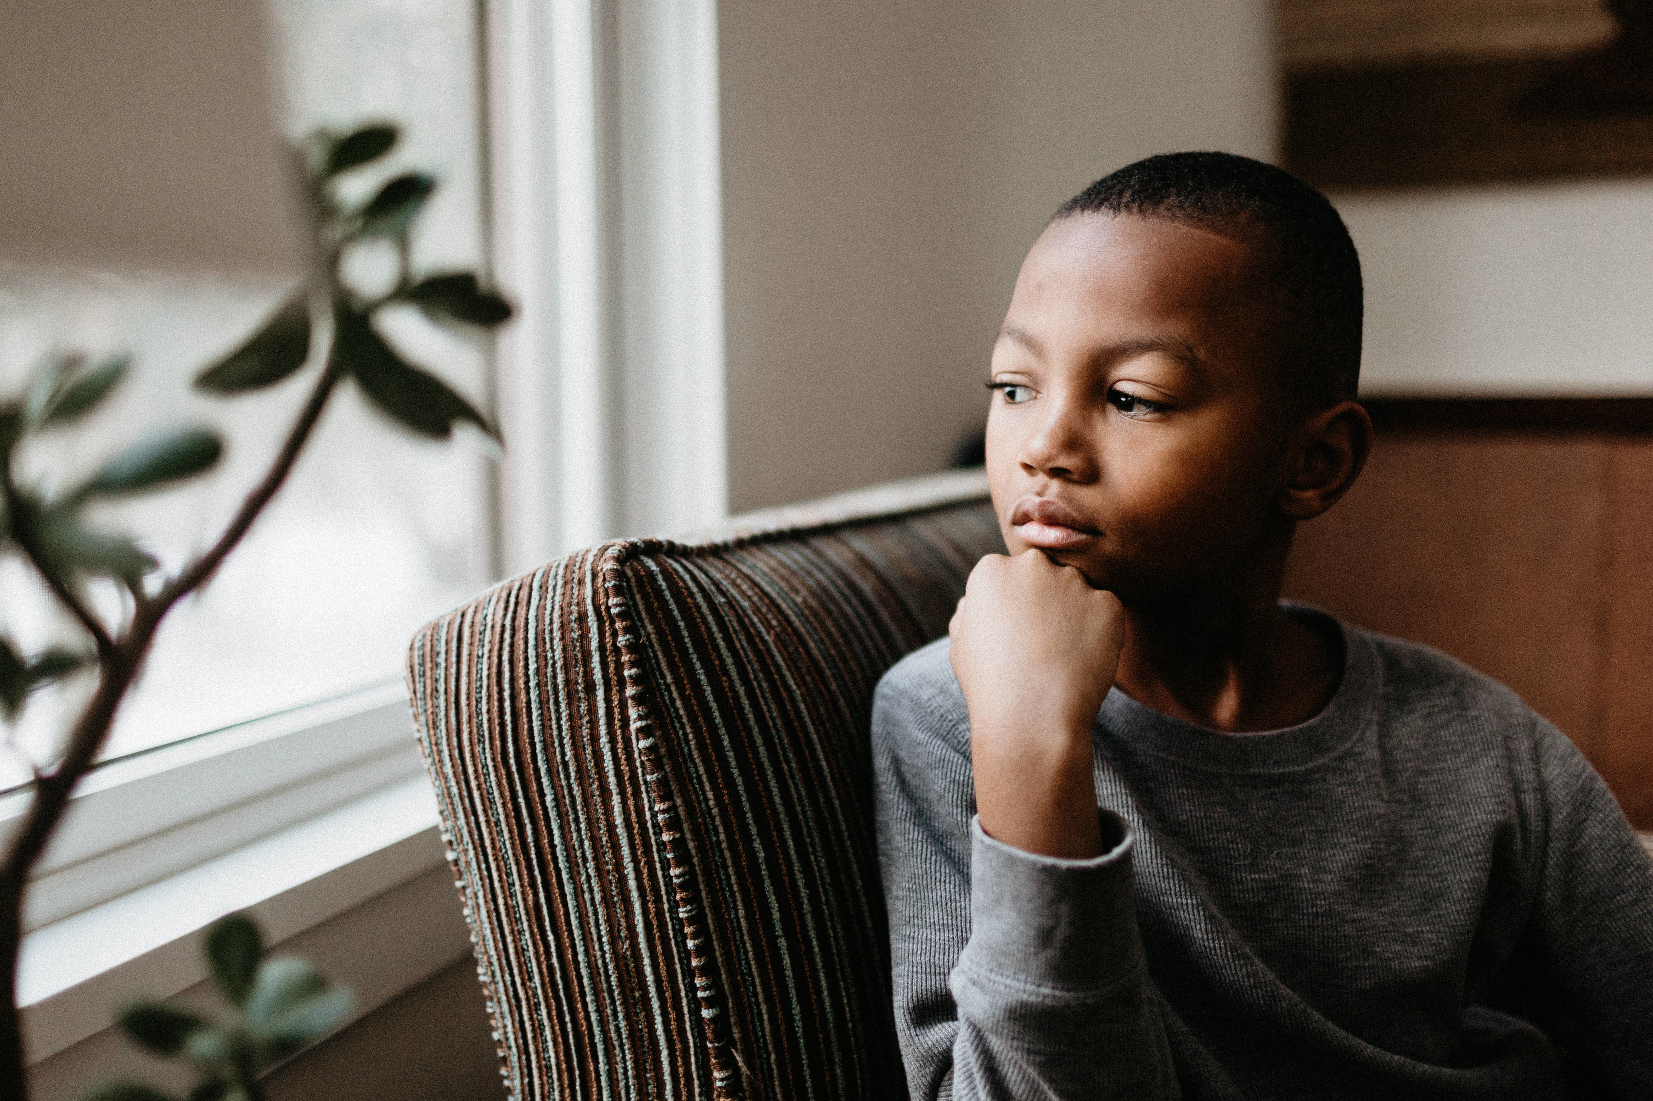
Communicating With Respect
The key to healthy communication is to communicate your thoughts and feelings to your children in a manner that does not hurt them or cause them to think less of themselves.

Slide 3
You Make Me This, You Make Me That…
There is a problem when you begin any communication with “You make me…”
“You make me” is blaming.
“You make me” is powerlessness.
Blaming children for the way the parents feel:
Shows parents have less power and children have more power in determining how and what parents feel.
Blaming causes your child to have more responsibility than is appropriate.
Blaming can cause children to become people pleasers

Slide 4
You Make Me This, You Make Me That…
Blaming sends the message you can not handle your own feelings.

Slide 5
You Make Me This, You Make Me That…
We are responsible for the way we feel in the same manner we’re responsible for our personal hygiene.

Slide 6
Taking Responsibility for Our Feelings
I-Statements are statements about me. These expressions focus on:
How I feel.
What I need
What I think

Slide 7
Taking Responsibility for Our Feelings
You Messages are about someone else. They are your perceptions of:
How someone else feels
What someone else needs.
What someone else thinks.

Slide 8
Taking Responsibility for Our Feelings
The main difference between I-Statements and You Messages centers on ownership.
When used appropriately, I-Statements convey ownership of feelings, thoughts and needs.

Slide 9
Taking Responsibility for Our Feelings

Slide 10
Appropriate Use of I-Statements
I-Statements are appropriate when you want to send a message about yourself:
“I am angry because the room is not clean.”
“I need to spend some time by myself in order to unwind.”

Slide 11
Inappropriate Use of I-Statements
“You never clean your room. If you cared about me at all, you would help me out around here.”
“If you don’t do it my way, I will get a headache.”
These statements are manipulative. Their intent is to control someone else’s behavior.

Slide 12
Communicating I-Statements
The following formula is presented as a guide to help us take responsibility for our feelings.
I feel (describe feeling)
when (describe exact behavior)
because (reason for your feeling).
What I want is (describe exact behavior).

Slide 13
Appropriate use of “you” messages
To give choices
To give praise
To ask questions
To reflect feelings
To gain clarification

Slide 14
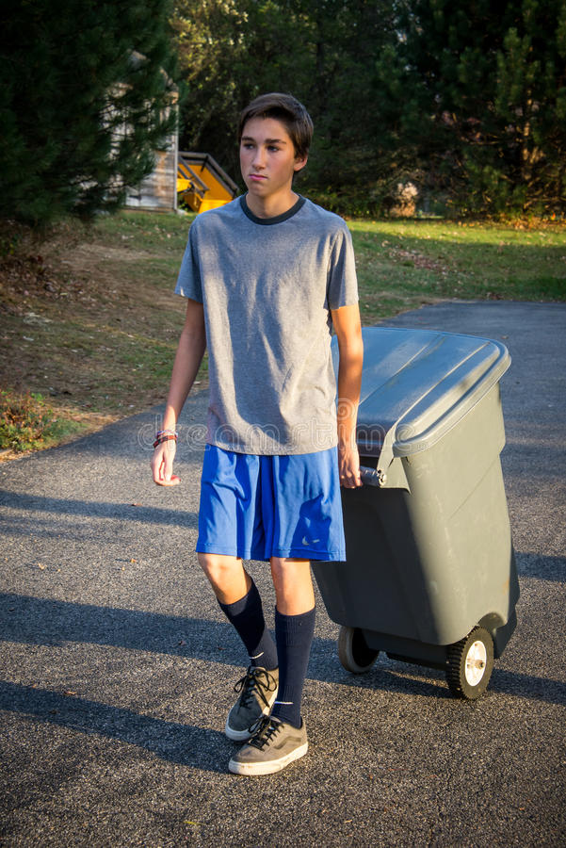
Appropriate Use of You Messages
To Give Choices
“Carson, you have a choice. You can take out the trash now, or you can do it later. However, if the trash it not taken out by 7:00 p.m., you can’t watch TV tonight. It’s your choice.”

Slide 15
Appropriate Use of You Messages
To Give Praise
You Messages work well when praising:
Carson, I was impressed that you remembered to take the trash out on time, AND that you did a great job cleaning up the area around the trash can.”

Slide 16
Appropriate Use of You Messages
To Ask Questions
Asking questions is a natural and appropriate way of using You Messages:
“Are you hungry?”
“Do you like this movie?”
“Did you notice if we needed more trash bags?”

Slide 17
Appropriate Use of You Messages
To Gain Clarification
When a You Message requests clarification, we are essentially asking, “Are my perceptions right or wrong?”
“You seem to be really angry.”
“You don’t seem to like the movie.”
“You appear sad.”
“You seemed really upset about taking out the trash. Am I reading that right?”

Slide 18
Appropriate Use of You Messages
To Reflect Feelings
Reflecting feelings gives children a chance to identify how they might be feeling, or an awareness that they know you understand their feelings.
“Maggie, you seem to be feeling very sad.”
Carson, thanks for sharing with me. I hear that you are annoyed that you have to take out the trash by 7:30 every night. I’d like to hear if you have an different idea.”

Slide 19
Let’s practice!
CHILD SAYS
You never let me do anything!
I just don’t feel like doing anything today.
I made the basketball team today!
I wish I could swim like Mary.
The teacher gives us too much homework and I can’t do it.
I’m no good at school.
CHILD FEELS
Irritated
PARENT’S RESPONSE
You feel irritated that I won’t let you go to a friend’s house.

Slide 20
Inappropriate Use of You Messages
When we have feelings of discomfort, it’s often difficult to take full responsibility for the feelings.
It’s easier and much safer to blame someone else for the way we feel.

Slide 21
Inappropriate Use of You Messages
Statements like:
“You made me angry.”
“You made me lose control.”
are good examples of You Messages that are blaming.
They are the adult version of the child’s “He made me do it.”

Slide 22
Let’s practice!
Sarah, 11, keeps leaving her glasses at school.
You Message: “I’ve told you repeatedly to bring home your glasses! Why can’t you ever remember anything!
I-Statement:
Bill, 16, has been on the computer too long and no one else can use it.
You Message: “Get off the computer! You have tied it up long enough. You don't even care about how the rest of us feel!”
I-Statement:

Slide 23
Let’s practice!
Jose, 7, and his friends are playing loudly, which is making it difficult for the parents to have a conversation.
You Message: “Why can’t you kids just shut up! Can’t you see we are trying to talk in here?”
I-Statement:
Angela, 14, promised to clean her room before going to a friend’s house, but she never got it done.
You Message: “You do everything you want to do, but you never do anything for me.”
I-Statement:

Slide 24
Constructive Communication
Essentially, we have two choices when we have to tell another person something about them that need improvement.
The first choice is to say what we have to say to the other person without regard for the other person’s feelings.

Slide 25
Constructive Communication
The second choice is to say what we have to say to the other person with regard for the other person’s feelings. This style is referred to as Caring Confrontation.

Slide 26
What’s wrong with criticizing others?
Criticism hurts.
Criticism destroys.
Criticism blames.
Criticism closes people up.
Criticism creates anger in others.

Slide 27
Confrontation: It Feels So Good!
Caring Confrontation is a process by which you tell your child or anyone else how you feel, or what you need, or want or observe, without tearing them down.
To respectfully confront others is to let them know your thoughts and feelings in a way that communicates respect for them as people.

Slide 28
Confrontation works better than criticism
Confrontation communicates respect for the other person.
Confrontation helps people listen.
Confrontation provides useful information.
Confrontation generally promotes a friendship.
Confrontation promotes change.
Confrontation is based out of respect.

Slide 29
Negotiation and Compromise
Not always agreeing on things is normal.
A nurturing family will attempt to work out their differences – not fight over them.

Slide 30
Negotiation and Compromise
There is no magic formula to getting everyone to agree on everything all the time.
There is a way of trying to achieve a solution to opposing views.
This process is called Negotiation.

Slide 32
Steps for Negotiation and Compromise
When asking for something or stating a view, first determine if there is a difference of opinion between you and your child.
State your views and what you think the views of your children are. Remember to confront and not be critical.

Slide 33
Steps for Negotiation and Compromise
Ask your child if your impression of the problem and your understanding of their views are accurate.
Offer a compromise. Be sure to take into account their views, as well as your own.

Slide 34
Negotiation example – step 1
Listening and talking during negotiations
Actively listen to your child’s views first without interrupting.
Express your views, and ask your child to tell you more about theirs.
Take a break if things get tense or you can’t reach a compromise.
.

Slide 35
Negotiation example
Reaching decisions you can both accept
Be clear about what is and isn’t negotiable.
Think of a range of options
Show that you’re willing to compromise and that you want to agree on something that you can both accept.
.

Slide 36
Negotiation example
When you’ve reached a decision: next steps
Clearly state the decision that you and your child have agreed on
Discuss and agree on the consequences if the agreement is broken.
End on a positive note even if the negotiation wasn’t perfect.
Notice when your child sticks to the agreement and praise them
.

Slide 37
Compromising Your Values
Family values are not issues you want to compromise.
If you compromise what you believe in, ultimately your anger will come through.

