Slide 1
Brain Development in Children and Teens
Family Development Resources, Inc.

Slide 2
Children's Brain Development
How children’s brains develop depends on how the genes they’re born with interact with the experiences they have.

Slide 3
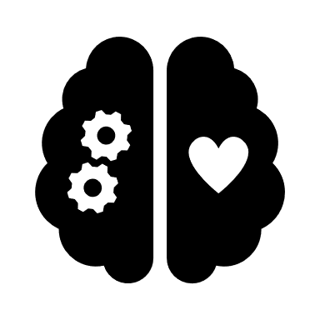
Brainstem
Midbrain
The brainstem is fully developed at birth.
It is responsible for survival functions such as:
Blood pressure.
Heart rate.
Body temperature.
The midbrain controls:
Sleep.
Arousal responses.
Appetite.
Motor movements such as running and skipping.
Cerebellum
Limbic System
The cerebellum controls a person’s automatic movements and balance such as:
Dancing.
Kicking a football.
Bringing a cup to the lips to drink.
The limbic system controls emotions and long-term memories.
A part of the limbic system is involved in attaching emotions to memory.

Slide 4
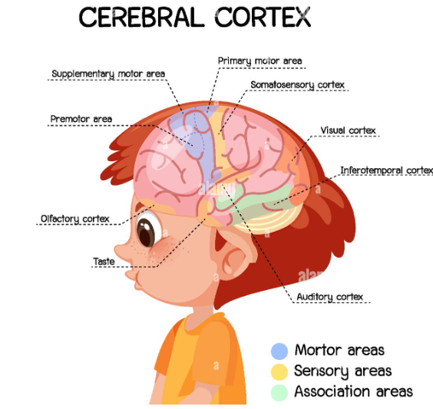
Cortex
The different regions of the cortex are responsible for processing:
Vision.
Touch.
Hearing.
Speech.
Language development.
Problem solving.

Slide 5
DISCUSSION
Recall a time when you acted on pure emotions even though you knew that rationally you were making a bad choice.
Share the battle that went on between your thought and feelings.
Why do feelings often win over rational thinking?

Slide 6
DISCUSSION
Now recall a time that your emotions were held in check by your rational thinking.
What was difference about this experience from the time your emotions took over?
Relate your answer to the battle children and teens have in controlling emotions and making wise choices.

Slide 7
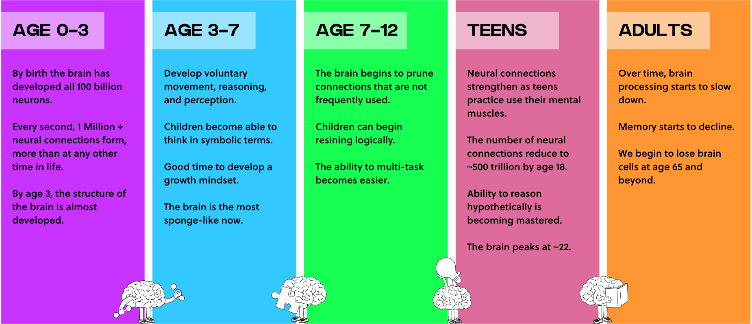
How Children’s Brains Develop

Slide 8
Effects of Violence and Stress on Kids’ Brains
Abusive experiences can increase the risk of developing behaviors ranging from:
Diabetes.
Asthma.
Epilepsy.
High blood pressure.
Immune system dysfunction.
Aggression.
Failure.
Language.
Depression.
Mental disorders.

Slide 9
Effects of Violence and Stress on Kids’ Brains
Abusive experiences organize the millions of constantly active connections between brain cells into diseased networks.
Bad experiences affect the brain primarily through stress hormones.
When these hormones are overactive as a result of persistent stresses, the terrorized genes set up irregular networks of connections between brain cells.

Slide 10
Effects of Violence and Stress on Kids’ Brains
Notes:
.

Slide 11
discussion
What do you think children need from parents to promote brain development?

Slide 12
What Every Child Needs
To promote children's brain development, every child needs:
Interaction.
Touch.
Stable relationships.
Safe, healthy environments.
Self-esteem.
Quality care.
Play.
Communication.
Music.
Reading.

Slide 13
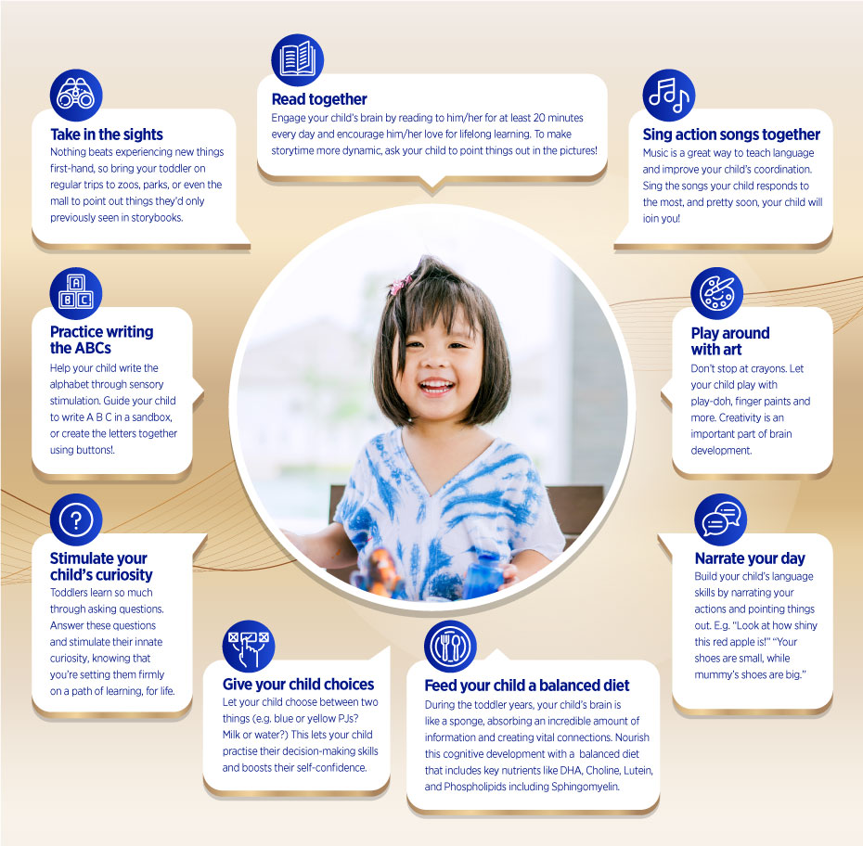

Slide 14
Teen’s Brain Development
The biggest changes in teen brains are occurring in the brain’s prefrontal cortex, located right behind the forehead.
The prefrontal cortex governs “executive” thinking (our ability to use logic, make good decisions and size up potential risks).
The pruning of these connections are very important in brain development as what teens do or not do can affect them for the rest of their lives.

Slide 15
Teen’s Brain Development
Changes to the logic center of the brain explains why teens sometimes make poor decisions.
Brain studies show the frontal lobe — which is responsible for decision-making, impulse control, sensation-seeking, emotional responses and consequential thinking — does not finish developing until our early-to-mid 20s.
The relationship between brain development and the risk of making poor choices, particularly during hot situations, is referred to as psychosocial maturity.

Slide 16
Teen’s Brain Development
Research has shown youth aged 12 to 17 years are significantly less psychosocially mature than those aged 18 to 23 years who are also less psychosocially mature than adults (24 and older).
Overall, teenagers' psychosocial immaturity makes them more likely to:
seek excitement and engage in risk-taking behavior
make choices on impulse
focus on short-term gains
have difficulty delaying gratification
be susceptible to peer pressure
fail to anticipate consequences of their choices

Slide 17
Teen’s Brain Development
In moments of high arousal, especially when around their friends, emotions often override logic.
Examples include:
Shoplifting even though the teen has money.
Driving drunk despite knowing the negative consequences.

Slide 18
Teen Brain: Emotional Development

Slide 19
Teen Brain: Emotional Development
Teen’s brains are still developing when it comes to being able to think about other peoples feelings.
Until the prefrontal cortex, the “executive functioning” develops, teens often have difficulty assessing and responding appropriately to the emotions of others.

Slide 20
Teen Brain: Emotional Development
Teens read the facial expressions of others differently than adults do.
Teens may not fully understand when a parent is looking angry or sad even though to the parent it may seem perfectly clear.
This can lead to confusion and communication difficulties.

Slide 21
What every teen needs
Adequate sleep
Sports, clubs, volunteer efforts and after school jobs are good for teens, in moderation.
Help your teen find a balance between school, activities, family time and personal time.

Slide 22
Teens and Sleep
Scientists have found that teens are in a constant state of sleep deprivation.
The average teen needs about 9½ hours of sleep a night but they only get about 7.
The chemical that governs sleep doesn't kick in until around 10:30.
Lack of sleep contributes to:
Teens having difficulty with grades in school.
Road accidents.

Slide 23
Teen’s Brain Development
While development during this time can be trying for both parents and teens, most teens make it into adulthood with only minor scratches.

Slide 24
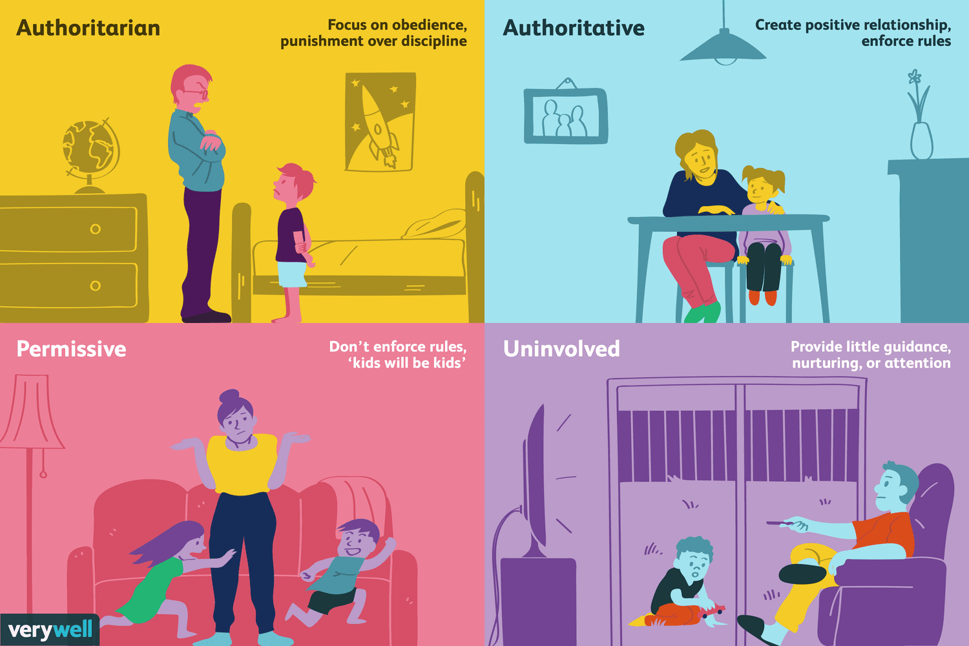
Parenting that supports brain development

Slide 25
Parenting that supports brain development
Authoritative parents:
Are warm, attuned, and nurturing.
Listen to the children.
Allow autonomy and encourage independence.
Reason with children instead of demanding blind obedience.
Establish clear rules for good behavior.
Consistently enforce boundaries.
Use positive discipline or reasoning instead of punitive, forceful measures to discipline.
Earn, not demand, children’s respect.

Slide 26
