Slide 1
Welcome to the Lansing School District
2018-2019School Year
New Hire Orientation

Slide 2
Welcome
Dr. Mark Coscarella Deputy Superintendent (517) 755-1020
Suzy Corbin Assistant Director of Human Resources (517) 755-2001
Notes:
http://www.lansingschools.net/departments/deputy-superintendent/

Slide 3
Human resources
HR Specialist (LEA, LSEA) Unaa' Holiness (517) 755-2010
HR Staffing Coordinator (LAES, CCLPI, AFSCME, LASA, M&C) Regan Henderson (517) 755-2011
Payroll Coordinator Steve Tapia (517) 755-2008
Payroll Coordinator Beth Farrand (517) 755-2013
HR Office Specialist Michael McClendon (517) 755-2003
HR Data Specialist Myrical Barton (517) 755-2007
HR Office Coordinator Tasia Clay (517) 755-2002
HR Office Specialist Kim Walker (517) 755-2014

Slide 4
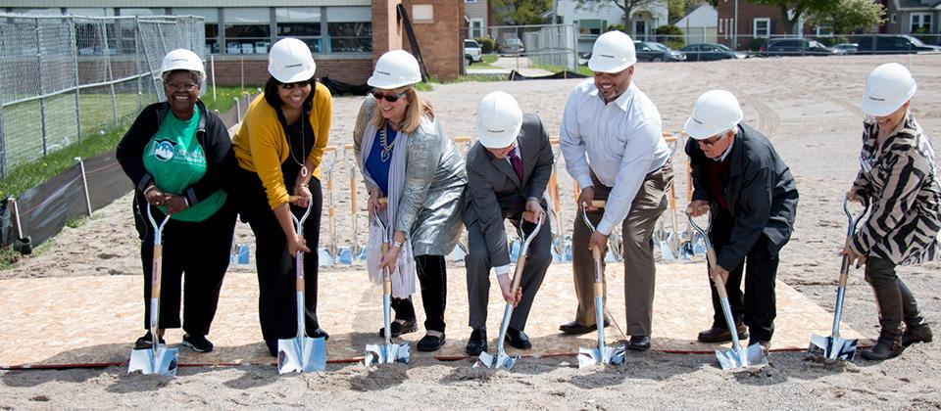
Our mission and vision
It is the mission of the Lansing School District to provide educational excellence in a safe and nurturing environment for all students
To accomplish our mission we will create a collaborative, high-preforming, safe learning environment that is integrated with out communities and focused on preparing students for global citizenship

Slide 5
setseg
Administrative Services Manager Cathy Hungerford chungerford@setseg.org
Account Manager Nicole Shook nshook@setseg.org
Plan Information
Employee Cost Share
Enrollment
Benefits Questions:
517-755-2066

Slide 6
Restraint & seclusion video
https://fileshare.setseg.org/?linkid=KZi4zr6VWWVfeWN6Jui6mJo7Sl+NTQOJ84DODS6ncAGbVD1enuLOJg

Slide 7
New hire paperwork
What we need:
Employee Information
Acceptance of Employment Offer
New Hire Orientation Acknowledgement
Criminal History Understanding
Notice of Arraignments or Convictions
Affidavit of Good Health
Direct Deposit Form & Voided Check
Unprofessional Conduct Disclosure Form
Certified Transcripts
If you do not have transcripts they can be sent to regan.henderson@lansingschools.net or unaa.holiness@lansingschools.net
Tax Card
I-9 Employment Eligibility Verification
Drivers License or Passport
Social Security Card or Birth Certificate
Highly Qualified Form (Teachers)
Notarized Teaching Certificate (Teachers)

Slide 8
Employee Leaves
All employees must complete a leave application for any absence greater than three (3) days.
A doctor’s note is required for any groups of absences five (5) or more consecutive days.
All leave requests and questions may be directed to Regan Henderson
(517) 755-2011
The Family Medical Leave Act
A federal law requiring employers to provide employees with job-protected and unpaid leave for qualified medical and family reasons.
Requirements:
12 months of service
1250 hours of service in the last 12 months
A qualified medical reason
Notes:
Leave applications can be found on the Lansing School District Website- Departments- Human Resources- Employee Leaves
FMLA- benefits protected

Slide 9
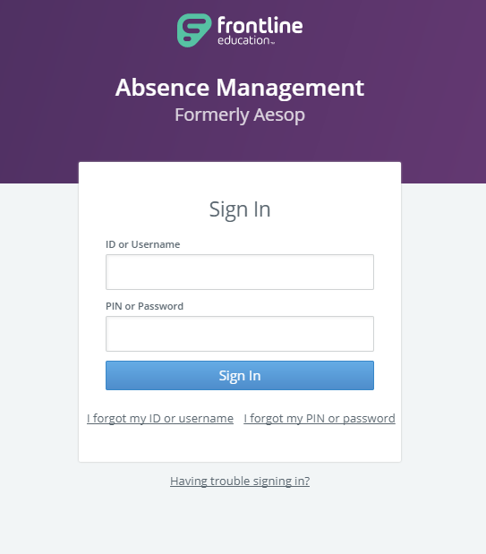
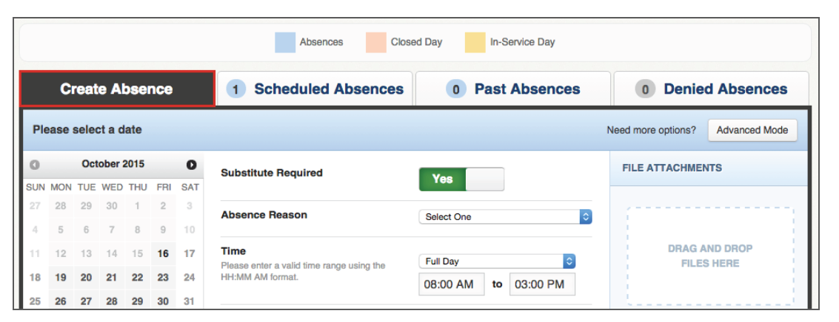
Absence management
Creating an Absence
Please contact Kim Walker with any questions regarding Absence Management
(517) 755-2014
(formerly called AESOP)

Slide 10
payroll
EAC = Employee Access Center
Update personal information
View information including pay vouchers, W-2’s, tax settings, absences, and leave banks
Payroll is bi-weekly
Vouchers are emailed to employees the night before payday
Paychecks are delivered to buildings on payday morning
Retirement
Detailed information available on website (michigan.gov/ors)
All employees participate in MPSERS regardless of status
Retirement plan is based on when employee first worked for public schools or universities

Slide 11
Lunch

Slide 12
Blood born pathogen video
https://lansingschools-mi.safeschools.com/courses/details/COURSE-BBP

Slide 13
The department of public safety
Chief of Operations Teresa Szymanski (517-755-3000)
Director of Public Safety Cordelia Black (517) 755-2031
Public Safety Supervisor Ortencia Martinez (517) 755-2032
Public Safety Dispatch Specialist Bruce Lankheet (517) 755-2033

Slide 14
State & federal Employment law video
State/Federal Laws
https://lansingschools-mi.safeschools.com/courses/details/X-COURSE-MI_LAWS

Slide 15
The office of school culture
Executive Director for Office of School Culture Dr. Karlin Tichenor (517) 755-2031
Student Services Specialist Shan Shaw (517)-755-2810
Student Services Coordinator Rose Taphouse (517) 755-2813
Student Services Specialist Clifton Foster (517)-755-2808
Students Attendance
Homelessness
Foster Care Support
Classroom Management
Importance of School Culture
Project PEACE

Slide 16
Technology
User Accounts
Computer/Network
Email
Synergy
EAC
Computer
Etiquette
Drives
ShorTel Phones
Help Desk
Director of Technology Jeff Vanderlaan (517) 755-2851
Assistant Director of Technology Kristina Tokar (517) 755-2822

Slide 17
Next steps
Complete your mandatory Drug Screen at WorkHealth within 24 hours.
840 E. Mt. Hope St.
Lansing, MI 48910
See Public Safety for instructions on your live scan finger printing & to retrieve your school ID badge.
Collect any additional paperwork needed by the Human Resources Department and return it as soon as possible.

Slide 18
Pathway promise
The Lansing Pathway Promise is a three-lane approach to the way we deliver college and career readiness programming.
Students and their families can choose their path and follow their passion for learning.
The Lansing Pathway Promise focuses on distinct offerings such as:
Visual and Performing Arts
New Tech High
International Baccalaureate
STEAM/STEM
Language Immersion.
Notes:
See handout

Slide 19
Union Affiliations
LSEA Union President Charles Alberts calberts@lsea.org
LEA Union President David Hockaday
LAES Union President Reed Kelley reed.kelley@lansingschools.net

Slide 20
Title ix
No person in the United States shall, on the basis of sex, be excluded from participation, or denied the benefits of, or be subjected to discrimination under any education program or activity receiving Federal financial assistance. 20 U.S.C. § 1681, et seq.
What to do
Contact your Principal or Supervisor
Principal/supervisor will Contact your Title IX coordinators (Mark and Suzy)
Take interim measures to protect alleged victim(s)
Communicate outcome
Put remedies in place with corrective action

Slide 21
Welcome center
Director of Special Populations and Programs Sergio Keck (517) 755-2945
Bilingual Education
Great Start Readiness Program
Adult Education
DAPA
Community Learning Center
Reading is Fundamental
Bilingual students represent 20% of Lansing School District population
English Learners represent 18% of the total student population
We have welcomed students from 70 different countries who speak 61 languages

