Slide 1
Reference Index
Quick Tips
How to put on a Requisition
My Requisition was returned how do I correct it?
What is the status of my requisition?
How to Approve a PO
How do I look up a vendor?
How much is left on my blanket PO

Slide 2
Quick Tips
Use Internet Explorer Vs. Chrome or Fire fox
* Is a wild card, this can be used before, after, partial name or in the middle of a search criteria. This will be useful when searching anything in this system. Below is an example of using the * in a search
* Used
* Not Used

Slide 3
CIMS
Sungard
CIMS account number Conversion to Sungard, this will assist if you know your CIMS account number and want to determine what your corresponding Sungard funding Account string will look like.

Slide 4
You can NOT intermingle Grant and Non Grant funds in the same Requisition / Purchase Order you must separate the request.

Slide 5
Purchase Order Approval Chains:
In CIMS your PO Approving chain was determined by the account number.
In SunGard its determined by the type of funding VS. physical Account numbers.
Each School will have 4 Approval Group chains to choose from when submitting a Requisition.
Definitions of each are below:
Non Grant Funded: General Funds are being used, this includes Trust and Agency accounts.
Non Grant Funded Equipment Software: General Funds, to include Trust and Agency Accounts to purchase equipment and / or software.
Grant Funded: Funding Account is a Grant, for general items (no Equipment/software allowed)
Grant Funded Equipment: Funding Account is a Grant, items being purchased are Equipment/Software items.
**Grant Funds *** - Please ensure you review what type of Grant(s) your utilizing, if its for a special grant (i.e.: Magnet, WIA, Adult ED) there is a separate purchasing chain set up.

Slide 6
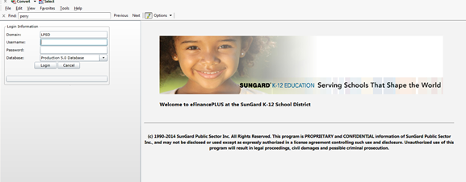
How to Put on a Requisition
1. Log in with assigned User name and password
http://admin-lanapp/gas2.32-SP1/homepage/index.html
*****Ensure if you are Practicing you select the TEST data Base and not the live data base*******

Slide 7
2. Applications → Purchasing → Requisition Processing → Requisitions→ Double Click
3. This is the screen that will come up once you double click Requisitions. Click New, found in the upper Left corner.

Slide 8
4. The following will be required to be filled in before adding Line items:
Requisition : Prefill, no action needed
Approval Group: Choose correct Approval Chain from drop down menu * see Quick Tip Slide for further clarification if needed
Ship To: Choose Building Location where items are to be shipped.
Vendor: type in or search vendor number*
Buyer: Person Entering Requisition
Attention: Person(s) or program the order is for, may be the same as buyer.
*Vendor: If you don’t know the vendor number, you can search by clicking the magnifying glass, the next slide will show you how to do a vendor search after clicking the magnifying glass.

Slide 9
After clicking the magnifying glass, the search Screen will appear as shown to the Left. You can search by one or more of the following: Vendor Name, Search Name (ie. DBA), Addresses, City, State, Zip, Phone or Fax or Contact info. Once you enter in criteria click find
Highlight the correct Vendor and click the green ok button in the upper left hand corner.
*note the use of the asterisk(*) before and after to assist in search
After clicking Ok, the vendor number will prefill on the requisition input screen, tab to the next text box.

Slide 10
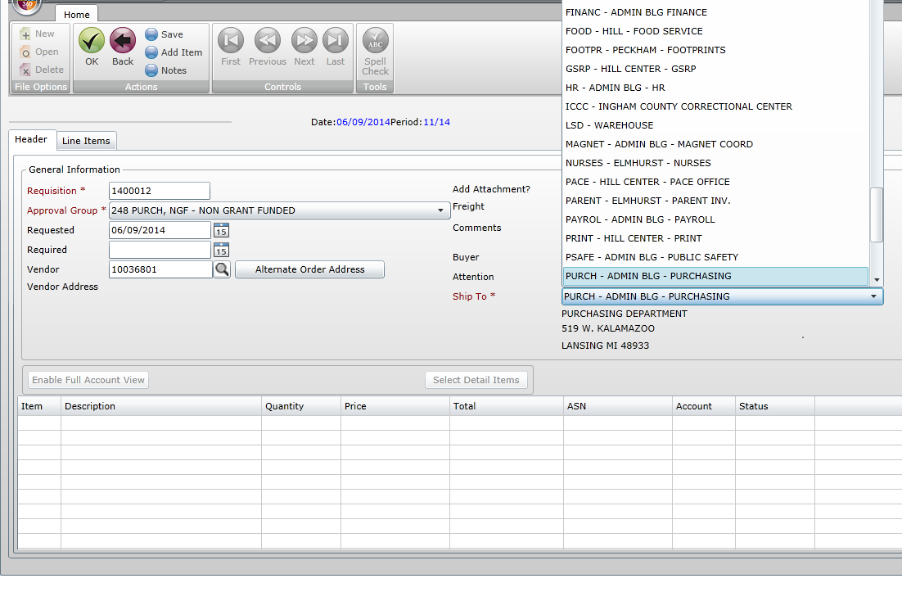
Once all the required fields are filled out, hit the green ok button in the upper left hand corner which will take you to the next step, adding line items.
You will be required to enter in a line item for each type of item you are purchasing, this includes a separate line item for shipping if applicable. There is a box (Blue arrow) that you will select when you want to enter in a shipping / handling charge. This will generate a new line item for you.
Required fields are as follows:
Review the Pricing box (red box) and fill in all that apply, ensure you enter in the type of measurement (IE box, each, carton…) , discounts if applicable, ensure you are tabbing through the sections and updating as appropriate.
Continue Tabbing until the box under the ASN is open and available to type in.

Slide 11
Blanket PO’s
Blanket PO’s are done the same as a line item. You will need to clearly state in the Description Field that you are requesting a Blanket Purchase Order.
You will still need to enter in the required information, you can enter it in several ways just ensure your total Price is correct.
Example a $750.00 DBI Blanket Request can have the following:
Quanity: 1 / Unit Price $750.00 or
Quanity 750 / Unit Price $1.00

Slide 12
You will either type in the ASN you wish to utilize for funding or you can search for an ASN just like you did a vendor by selecting the magnifying glass
Left: What the ASN Search field looks like after clicking the magnifying glass
Below Left: Example Searching by partial Name
Below Right: Example Searching by partial ASN numbers
Once you locate the correct ASN click the green OK button in the upper left corner
Tips:
Utilize the * key to assist in searching criteria, can be used before, after or in the middle
If you don’t locate the desired ASN when searching hit the red back button it will allow you to revise your search criteria
If you leave your search criteria blank you will pull up all the ASN’s you have been granted access to.

Slide 13
You will then need to enter in the Account associated with the selected ASN. Hit the search key if you are not familiar with the Account number associated with that particular ASN
You can search again by any one of the criteria's available, in this example I just hit find so I could see all that were associated. There were two options, highlight the appropriate selection and hit the green ok button

Slide 14
Once you have associated the ASN and Account number you will tab to the amount field, this is where you will put in the amount you want funded by that particular ASN & account number.
However, there are times when you may want to split funding. In this situation you would simply put the amount for that particular funding line and hit tab, this will bring you down to line 2 and you will proceed with the same processes of associating ASN & Account numbers and amounts until the line item is fully funded.
Photos below depict examples of this:
Top: Line item totaled $300, was funded by one line of accounting
Bottom: Line item again totaled $300, but funding for that item came from 2 separate funding sources.

Slide 15
1. Once you have funding completed hit the Green OK Button in the upper Left corner to advance to the next line item. If this is your only line item and there are no additional line items, please read step two before hitting the green ok button. The Green ok button will automatically take you to the next line item if applicable.
You will continue the process as before (adding Line items) until all your required items have been put in.
2. When there are no additional Items to be entered simply before hitting save, ensure you uncheck the continuous button (red arrow)
3. Click Save (blue arrow), a pop up box will appear “Do you want to save the changes you made?” Click Save.
*if you accidently hit OK or Enter before unchecking the continuous box and it advances you to a line that is not needed, you can simply hit the red back button and it will take you back to the header screen, where you can hit save.

Slide 16
You will know the requisition saved because you will see the red line across the bottom of the page stating the requisition updates have been saved, and the next available requisition number will be pre filled ready for you if you have additional requisitions to be placed.

Slide 17
The Purchase Requisition is now pending review at the purchasing office. Please ensure you are reviewing your email for further updates.

Slide 18
My Requisition was returned how do I correct it?
Applications → Purchasing → Requisition Processing → Requisitions

Slide 19
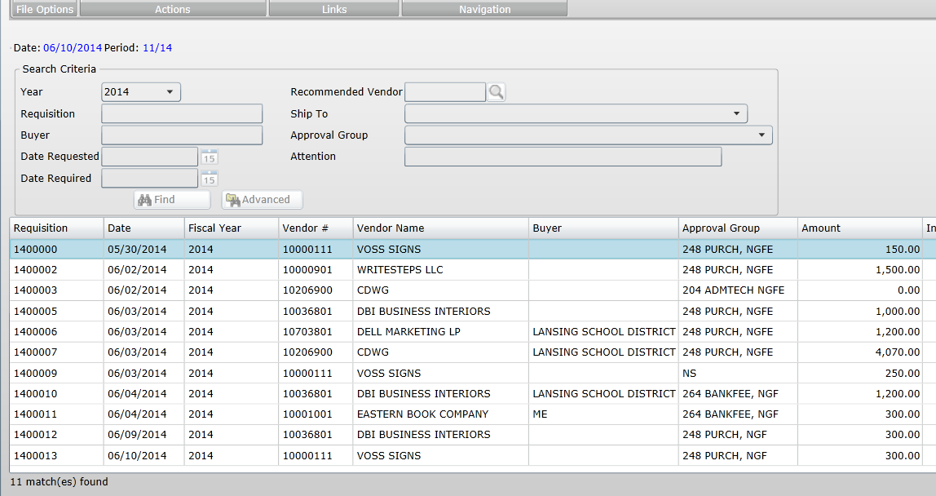
You can utilize the search criteria (recommended) or hit find and it will show all requisitions.
Locate the requisition you’re requesting a status on and hit the green ok button in the upper left corner of the screen.

Slide 20
Locate the Line item(s) on each line item, you will need to click the “approval Status” this will take you to the comment section advising why the line item was returned for correction.
As you can see this item was rejected/returned due to the funding item and Accounting lines associated with it. You will be able to see who rejected it and on what date.
Once you know the corrections needed, hit the red back arrow.

Slide 21
Once you have made the corrections on each line item, you would then hit save and ok, you will know changes were saved when you receive a message at the bottom of your screen stating requisition updates have been saved (see below).
Once it is saved, it will be rerouted back to the purchasing department for review again.

Slide 22
What is the status of my requisition
Applications → Purchasing → Requisition Processing → Requisitions

Slide 23
You can utilize the search criteria (recommended) or hit find and it will show all requisitions.
Locate the requisition you’re requesting a status on and hit the green ok button in the upper left corner of the screen.

Slide 24
Once you’re into the Requisition, it will bring you to the information screen.
Click the line item – see blue arrow
Look at the Status, (Red Box) you will see that the status on the requisition we put in has been converted to PO, you will also see the PO approval date and PO number just below the status.
This has now been converted to a PO, and is pending approval from the proper individuals based on the Approval Group Chain chosen in the initial requisition.

Slide 25
How to Approve a PO
Applications→ Purchasing → Purchase Order Processing→ Approve/Deny Purchase Orders

Slide 26
Double Click the Green OK button

Slide 27
Next you will see all Purchase Orders that are pending your review, you click to highlight the Purchase order you would like to review, once it is highlighted click the details button, this will take you into the purchase order itself (see below)

Slide 28
When you’re on the detail screen you can review any attachments, comments or notes.
You have to review each line, and assign a status to it. in this example there is only one line. You can change the status by selecting the line you would like to review, you can approve, deny or reject an item because it would need correction.
Once you have assigned a status (other than Open) to each line item within the Purchase Order you can hit the green ok button. This will take you back to the main screen where you can select another Purchase order needing review if Applicable (see below).

Slide 29
Once all the pending Purchase Orders have a status other than open (ie. approved, denied or needs correction), you hit the Green Ok Button, this is how you complete your approval processes, and either final approve the Purchase Order or send to the next individual within the approval chain.
A pop up box will appear, hit ok, and a report will generate

Slide 30
The photo above depicts what the report will look like, ensure you review this report as it contains information about what you approved.

Slide 31
How do I look up a vendor?
Applications→ Purchasing → Reference Tables → Vendor List

Slide 32
You can search by one or more of the following: Vendor Code, Vendor Name, Search Name (DBA), City, State or a combination of any of the above.

Slide 33
1. In this example, I Searched for the vendor by partial name only using the *. (note if I would have searched this without the * I would have zero results)
2. Hit Find
3. Your vendor should be listed, ensure you scroll down as some results will yield several.
---------------------------
If you did not find the vendor hit the red back button and revise your search, or it may be possible that the vendor is not in our data base.
1
2
3

Slide 34
How much is left on my blanket PO
Reports→ Purchasing → Purchase Orders by Organization

Slide 35
Place all information known (if any), and hit OK.
Remember to use the * key to help narrow down the search.
If all fields are left blank everything you have access to and have done for the year will show up.
After you hit the green OK button, a separate pop up box will appear, hit OK. This will generate a PDF report (shown in following slides)

Slide 36
This is an example of open PO’s and nothing paid against them.
Note the Amount and Balances are the same. I have highlighted them in the red box.

Slide 37
This is an example of partial payments/invoices against a PO.
Note the Purchase Order Total vs the current balance on each of these PO’s.
I have highlighted them in the red box.

Slide 38
This is an example of PO’s that have been fully exhausted. Note the Amount VS. Balance.
I have highlighted them in Red
**Please note for all Blanket PO’s that the system can not see any outstanding Invoices, please keep track of your purchase as well and do not exceed PO Amounts when ordering, remember to factor in Shipping, fees or misc. charges the vendor may charge when placing your order.

