Slide 1
Building Self-Worth in Children
Family Development Resources, Inc.

Slide 2
Objectives
To define self-concept, self-esteem, and self-worth.
To help you realize their ability to impact a child’s overall feeling of worth.
To learn ways parents can improve their children’s self-concept, self-esteem, and self-worth.

Slide 3
Building Self-Worth and Self-Concept
OUR SELF
Our “self” is a composite of all the aspects of life that give us an identity.
You can think of it as a puzzle made up of thousands of pieces all fitting together to make a picture.

Slide 4
Building Self-Worth and Self-Concept
OUR SELF-WORTH
Our self-worth is the value we give that picture.
That value can range from low to high and can vary during different times and circumstances of our life.

Slide 5
Building Self-Worth and Self-Concept

Slide 6
Children and Their Self-Worth
Three primary sources are responsible for strongly influencing self-worth.
Family
School
Community

Slide 7
Self-Worth and Life’s Experiences
A child’s overall feeling of self-worth is developed from the way the child is treated growing up.
The most significant time for children to develop self-worth are the early years when parents and other family members make the biggest impression and set the foundation for future growth.
Notes:
.

Slide 8
Self-Worth and Life’s experiences
Child
Self-Concept
Behavior
Self-Esteem
Experience

Slide 9
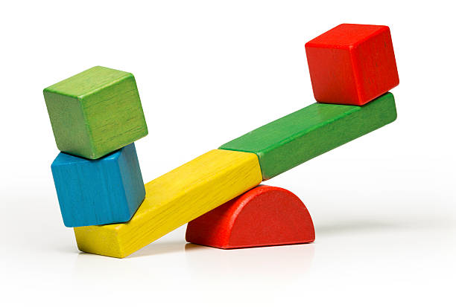
Self-Worth and Life’s Experiences
When experiences a child has are positive, the impact on the child’s self-concept (the way he or she thinks about him or herself) and self-esteem (the way he or she feels about him or herself) is positive.
When life’s experiences have been negative, the impact on the child’s self-concept and self-esteem is negative.

Slide 10
Why Maintaining a High Self-Worth is Important
People with a high self-worth generally treat themselves, others, and the environment with respect.
Others generally like to be around people who like themselves.
Parents who value their own worth can more easily value the worth of their children.

Slide 11
Self-Concept + Self-Esteem = Self-Worth
Self-Concept
Self-concept is what people think about themselves.
Self-Esteem
Self-esteem refers to the way people feel about themselves.
Self-Worth
Self-worth is the combination of self-esteem and self-concept. It is the way people think and feel about themselves.
It describes feelings about the self.
It can be positive or negative.

Slide 12
Self-Concept + Self-Esteem
I am a capable person.
I am loveable.
I am fun to be with.
I deserve to be treated with respect.
I am worth something.
I accept compliments and praise.
I am incapable of doing anything right.
No one could love me.
I am a bore.
I deserve to be hit.
I am worth nothing.
I reject compliments and don't like myself.
=
SELF-WORTH

Slide 13
Can We Improve Our Self-Worth?
Yes you can! The most important first step is identifying the labels we have for ourselves.
A personal label is like a name that, over time, becomes an identity.
When a negative label becomes an identity, it begins to eat away at our self-worth.

Slide 14
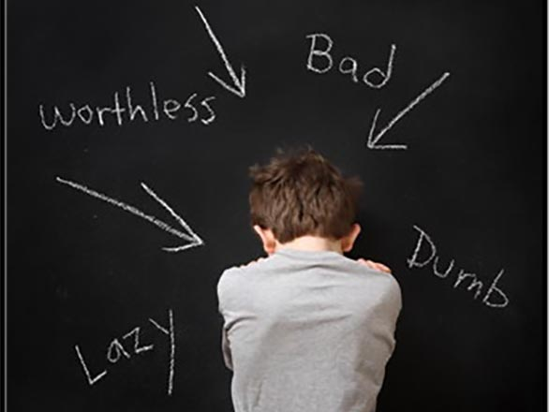
What’s in a Label?
The way adults label a child can have a lasting impact on how that child thinks of him or herself.
When a child has been labeled, that label will become a part of his or her identity. Labels often do more damage than good by putting children in boxes.
Helpful
Smart
Kind
Worthy

Slide 15
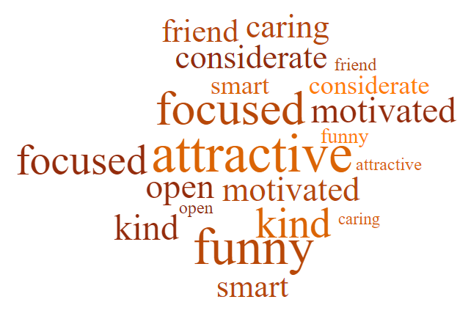
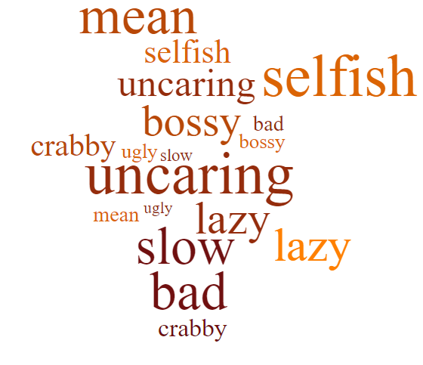
POSTIVE LABELS
negative labels

Slide 16
Ways to Improve a Child’s Self-Worth

Slide 17
Ways to Improve a Child’s Self-Worth
Practice how to reframe a possible label:
Instead of labeling a child as “a nice child” or “a helpful person” try to say “you are being kind” or “he was very helpful.”
Instead of saying “you are shy” or “don’t be shy,” try statements such as, “it takes a little while for you to feel comfortable with new people,” or “you are talkative with people you know well.”
Instead of labeling a child as a “whiner,” “cry-baby” or “selfish,” use descriptive, more positive words such as "tenderhearted" and "aware of their own feelings."
Instead of saying "ugh, you are so picky!" say, "that's okay if you don't want to try it this time." Avoid limiting a child by labeling them unintentionally.

Slide 18
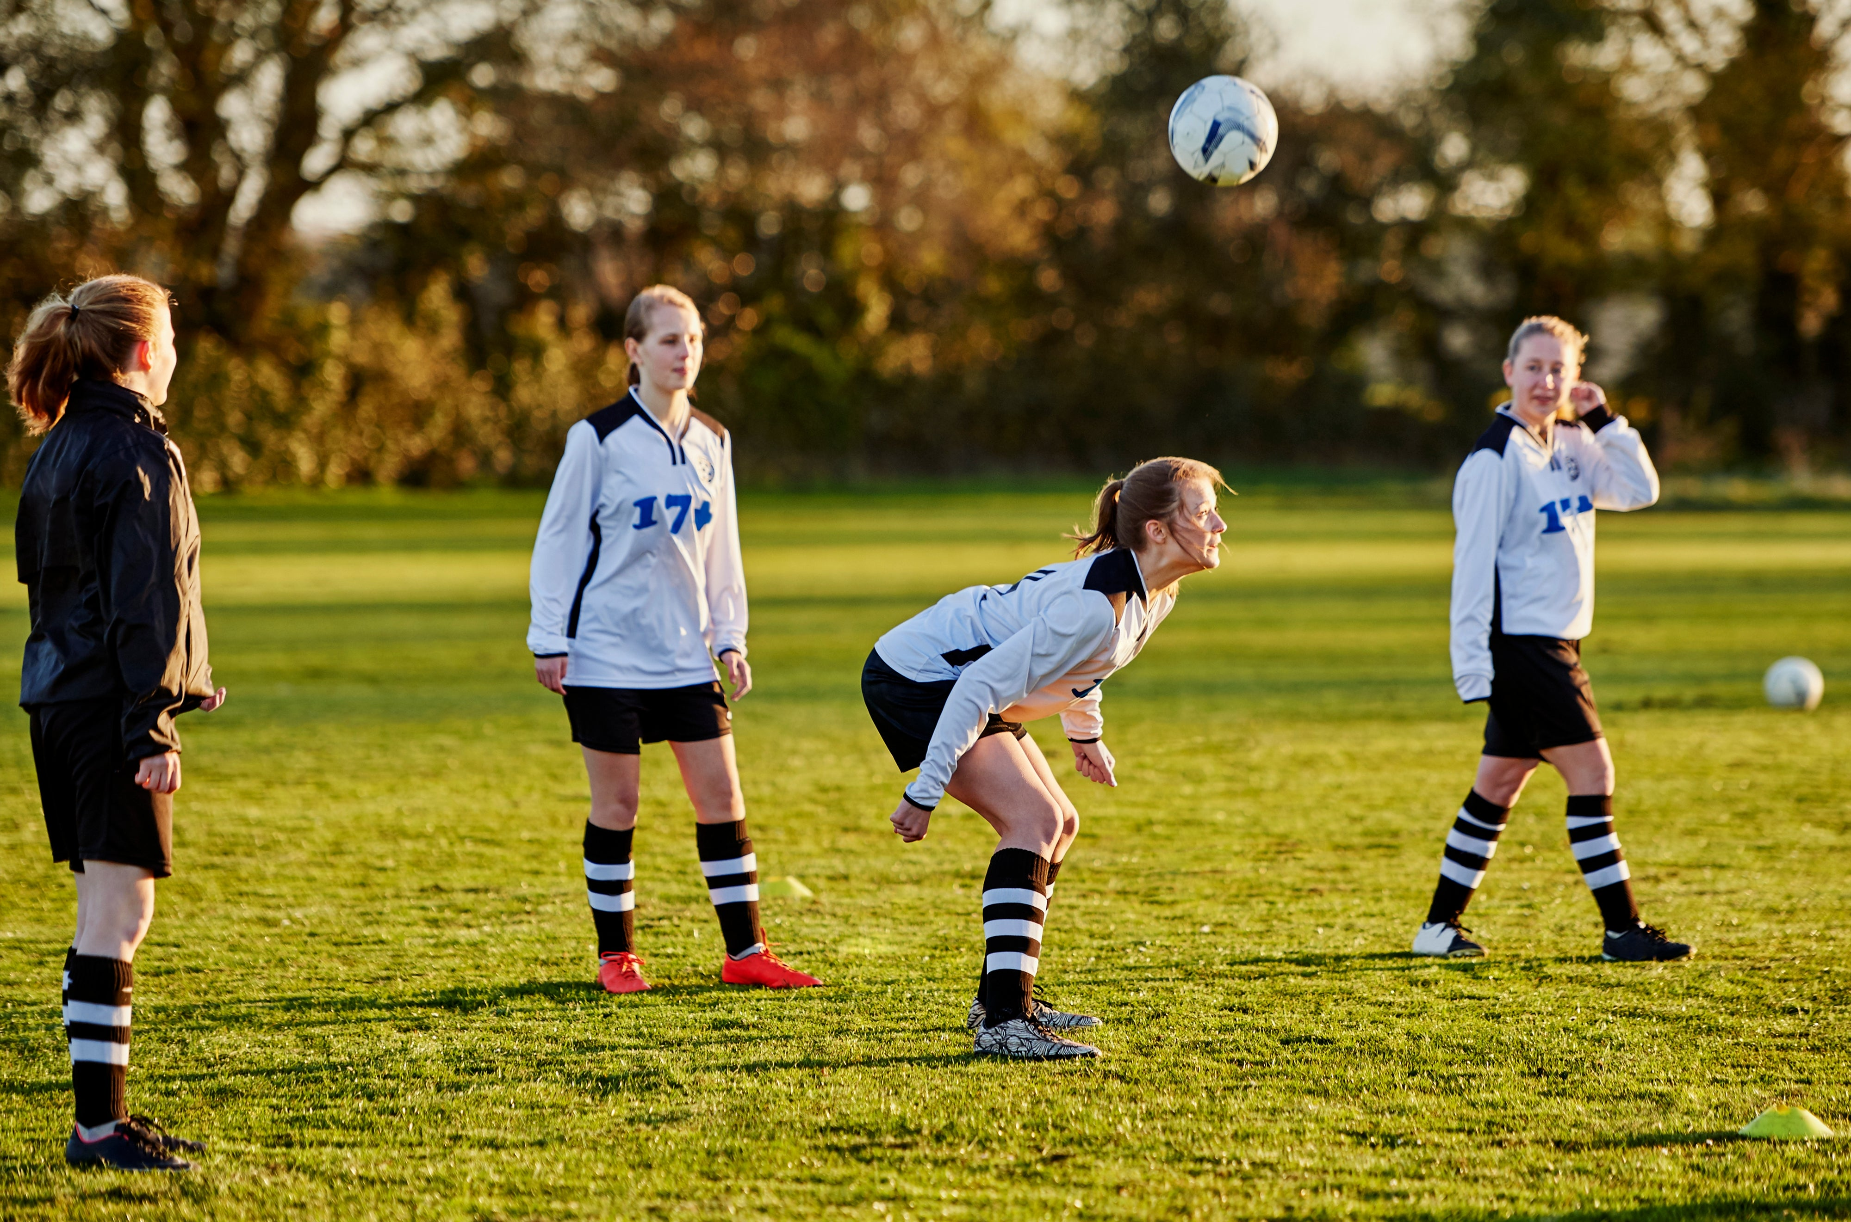
Ways to Improve a Child’s Self-Worth
Help your child learn to do things. At every age, there are new things for kids to learn. Even during babyhood, learning to hold a cup or take first steps sparks a sense of mastery and delight. As your child grows, things like learning to dress, read, or ride a bike are chances for self-esteem to grow.

Slide 19
Ways to Improve a Child’s Self-Worth
When teaching kids how to do things, show and help them at first. Then let them do what they can, even if they make mistakes. Be sure your child gets a chance to learn, try, and feel proud. Don't make new challenges too easy — or too hard.
Put children in situations where they can succeed at doing what you want them to do.
If your child does not succeed in a specific situation, problem solve and determine what is undermining the child's attempts at success.

Slide 20
Ways to Improve a Child’s Self-Worth
Praise your child, but do it wisely. Of course, it's good to praise kids. Your praise is a way to show that you're proud. But some ways of praising kids can actually backfire.
Don't overpraise. Praise that doesn't feel earned doesn't ring true. For example, telling a child he played a great game when he knows he didn't feels hollow and fake. It's better to say, "I know that wasn't your best game, but we all have off days. I'm proud of you for not giving up."

Slide 21
Ways to Improve a Child’s Self-Worth
Praise effort. Avoid focusing praise only on results (such as getting an A) or fixed qualities (such as being smart or athletic). Instead, offer most of your praise for effort, progress, and attitude. For example: "You're working hard on that project," "You're getting better and better at these spelling tests," or, "I'm proud of you for practicing piano — you've really stuck with it." With this kind of praise, kids put effort into things, work toward goals, and try. When kids do that, they're more likely to succeed.
Remind children of times when they had a success! “Rashad, it sounds like you are worried about your math test. Do you remember the time that you struggled with that math assignment, and then got an A on the test?”

Slide 22
Ways to Improve a Child’s Self-Worth
Comment on desired behavior. “Bella, I appreciate that you put your coat and shoes away when you got home.”
Remind children of times when they had a success! “Rashad, it sounds like you are worried about your math test. Do you remember the time that you struggled with that math assignment, and then got an A on the test?”

Slide 23
Ways to Improve a Child’s Self-Worth
Make sure your child hears you be proud of them to others. Tell someone else how the child is succeeding and make certain the child can hear you.
“Haven has remembered to take out the trash every night this week. He’s been a big help!”
“Wow, that’s great. I’ve noticed he has been responsible lately.”

Slide 24
Ways to Improve a Child’s Self-Worth
Be a good role model. Your child learns by watching you. If they see you trying and doing, they will do the same.
Modeling the right attitude counts too. When you do tasks cheerfully (or at least without grumbling or complaining), you teach your child to do the same. When you avoid rushing through chores and take pride in a job well done, you teach your child to do that too.

Slide 25
Ways to Improve a Child’s Self-Worth
Negative Self-Talk
I don’t know how to do it
Positive Self-Talk
I can learn
I’ll mess up
I don’t have what I need
It won’t work
I tried and it didn’t work
I’m not enough
I’ve can do hard things
I’m always improving
I can ask others for help
I can practice
I know I can succeed
Model! Be sure that your children hear you talking about yourself in a positive way!

Slide 26
Ways to Improve a Child’s Self-Worth
Ban harsh criticism. The messages kids hear about themselves from others easily translate into how they feel about themselves. Harsh words ("You're so lazy!") are harmful, not motivating. When kids hear negative messages about themselves, it harms their self-esteem. Correct kids with patience. Focus on what you want them to do next time. When needed, show them how.

Slide 27
Ways to Improve a Child’s Self-Worth
Focus on strengths. Pay attention to what your child does well and enjoys. Make sure your child has chances to develop these strengths. Focus more on strengths than weaknesses if you want to help kids feel good about themselves. This improves behavior too.
Visualize your child as already being the new positive label, and then relate to the child with the new label.

Slide 28
Ways to Improve a Child’s Self-Worth
Show respect for your child.
Their feelings and opinions matter and are important, even though you might not understand or agree with them.
“I can understand how you might feel that way. I’m glad you shared with me, even when you knew I might not agree.”

Slide 29
