Slide 1
Ages and Stages: Infants and Toddler development
Family Development Resources, Inc.

Slide 2
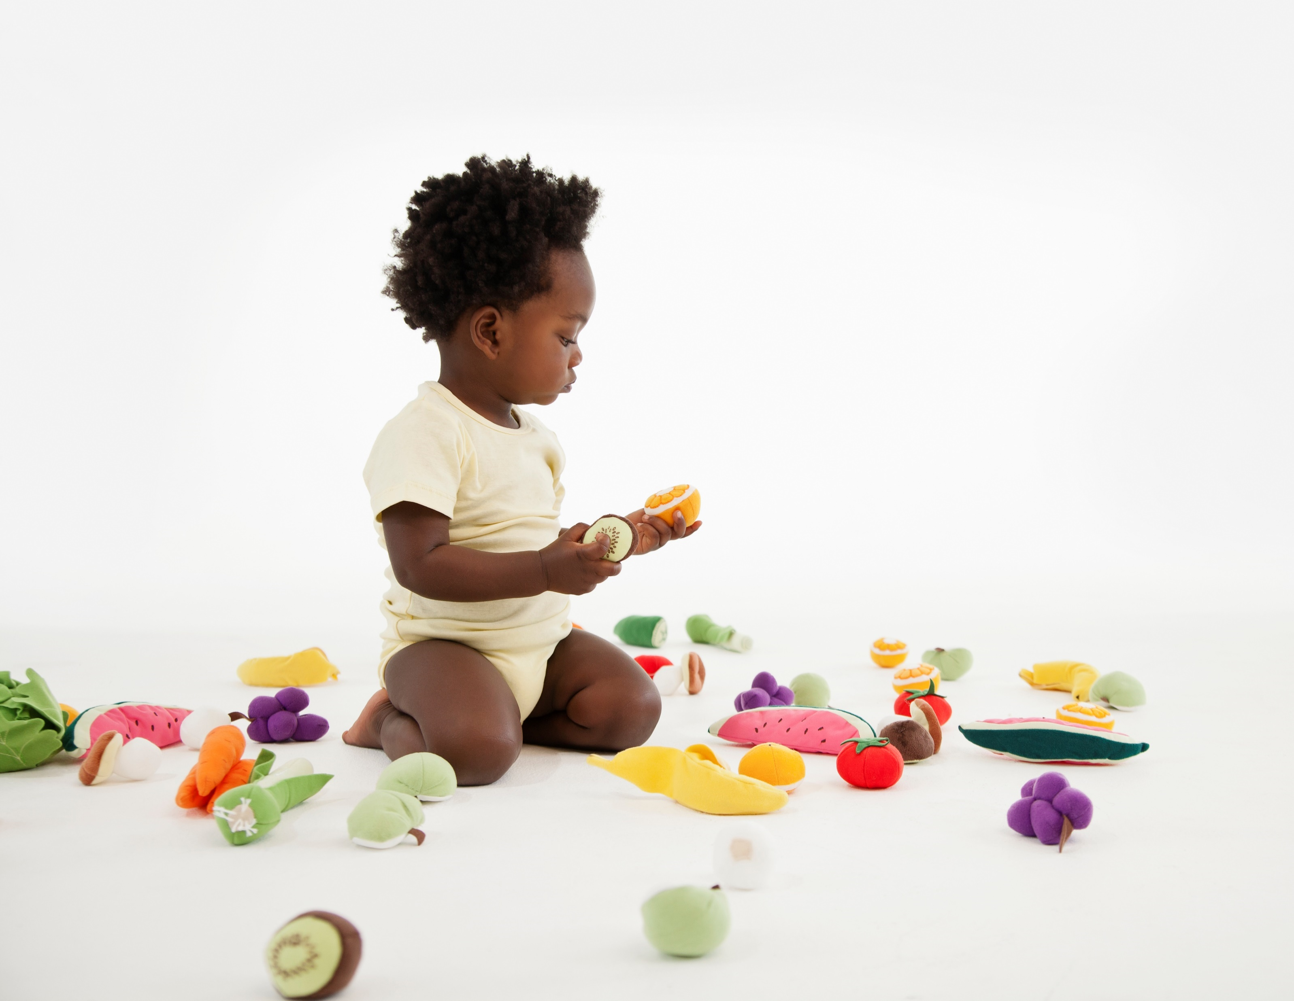
Why Learn About Developmental Stages?
To become the best parents we can!
When parents have information about their child’s development, it helps form appropriate expections for children.
Having appropriate expectations helps set out kiddos up for success, improving their own self-esteem and making life less stressful for everyone.

Slide 3
Developmental Stages
There are four things we know about child development:
The brain of young children is still developing.
Each stage has certain tasks that must be accomplished to move on to the next stage.
The expectations we have for children determines whether childhood will be a nurturing experience.
Children are unique and each child has individual capabilities.

Slide 4
Primary Areas of Development
Physical Development
As children grow their gross motor and fine motor skills increase.
Intellectual Development
Children learn more the older they get.
Stimulation is necessary to help children’s brains develop.
Without stimulation, intellectual abilities may lag behind or fail to develop.
Language Development
As children grow older, their communication skills increase.
Their ability to use words, phrases, and sentences helps them gain mastery of their environment.
Social and Emotional Development
The way we treat children affects the way they mature.
The ability for children to use their physical, intellectual, and language skills depends on how well children develop socially and emotionally.

Slide 5
Developmental Stage: Infancy
For years, psychologists thought that babies were incompetent.
Today we know this is untrue.
Very young infants can begin to make sense of their new environment.
Infant’s skills increase rapidly during the 1st year.

Slide 6
What Can Babies Do?
Physical Development
The major part of the infant’s first year is devoted to survival.
The infant is completely helpless at birth and is totally dependent upon the parents for help.
Being fed, held, touched, looked at, and talked to have significant impact on the growth of the child.
0-6 months
7-12 months
Automatic reflexes such as hand-to-mouth.
Focus on objects 8-15 inches away.
Make cooing, crying, and grunting sounds.
Will lift head when on stomach.
Suck fingers.
May be pulled slowly by hands to a sitting position.
May be starting to teethe.
Sit up without support for a short time.
Begin to crawl by pulling self forward.
Can pull self up to stand.
Feed self pieces of food with hands.
Start practicing walking but continues crawling.
Begin a tottering walk with legs wide apart.
Sit independently on hard surface.

Slide 7
What Can Babies Do?
Intellectual Development
Physical and intellectual development are closely related to one another.
The child learns about the world through exploration of objects, by moving around, and through interactions with the parents.
The behavior of infants during the first year helps them understand, adapt, and interact effectively with their world.
0-6 months
7-12 months
Cries to have needs met.
Recognizes familiar voices or faces.
Responds to strangers by crying or staring.
Follows moving objects with eyes.
Likes repetition of simple acts like opening and closing hands.
Baby still cries but also laughs out loud.
Can imitate sounds; watches your mouth with interest when talking.
Child repeats an act to observe change in the environment.
Responds to and imitates facial expressions of others.
Child uses responses to solve problems and to achieve some goal.
.

Slide 8
What Can Babies Do?
Language Development
Language develops slowly during the first year of life.
An adult’s vocabulary is largely determined by the speech they heard in the first three years of life.
The first two years are the most important.
Parents who talk and respond to their babies help facilitate language development.
0-12 months
Respond to speech by looking at speaker.
Make crying and non crying sounds.
Babble by repeating some vowel and consonant sounds.
Attempt to imitate sounds.
Begin to understand simple words or phrases such as “No, Come, Bring.”

Slide 9
What Can Babies Do?
Social and Emotional Development
The degree to which a child develops trust depends on the quality of care the child receives.
The child whose needs are met develops a belief that the world is a safe place, and that people are dependable and helpful.
When children who do not have their needs met, they develop mistrust.
0-6 months
7-12 months
Likes high-pitched voices and will usually quiet down when they hear them.
Smiles spontaneously.
Loves to be played with and likes to be picked up.
Responds differently to strangers than to familiar persons.
May give joyful kicks and gurgle and laugh to engage parent in play.
May become attached to a particular toy.
Beginning to learn to be independent. May go away from you, but will quickly return.
Will express frustration for failure to master a task.
Loves an audience and will repeat any behavior that gets attention.
Tantrums may occur.

Slide 10
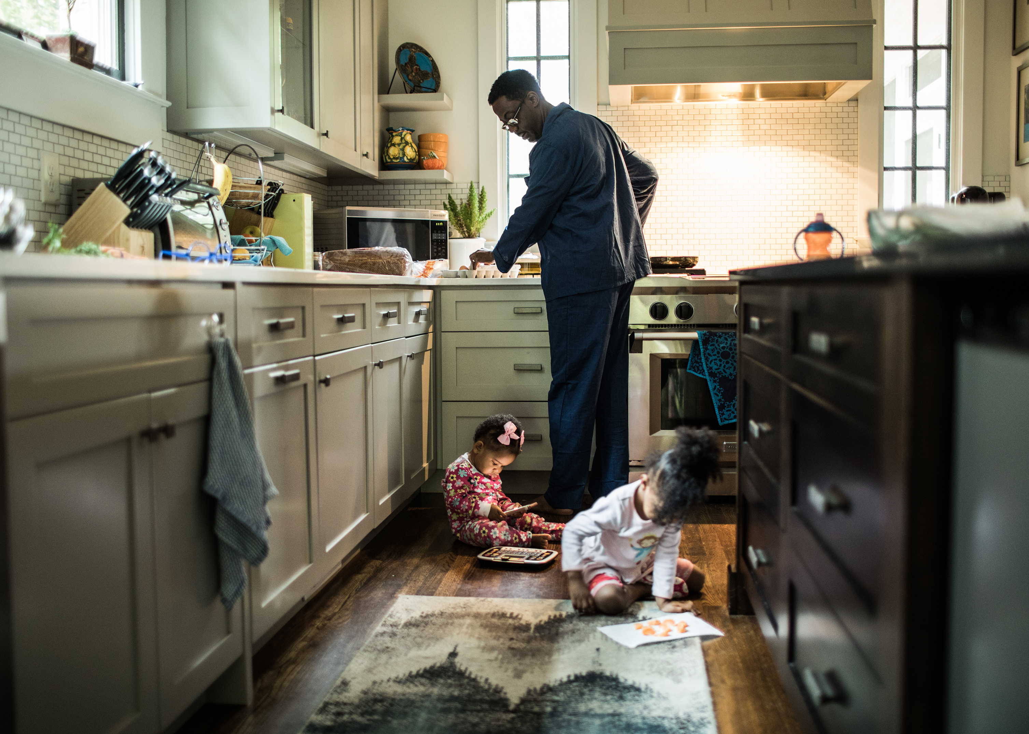
Developmental Stage: Toddler
Life with toddlers is rarely dull. Their new abilities make them both exciting and frustrating for parents.

Slide 11
What Can toddlers Do?
Physical Development
Although growth in the second and third years is slower than infancy, it still occurs at a rapid pace.
Gross Motor Skills
12-24 months
25-36 months
Can usually walk backward.
Loves to carry things, especially big things.
Likes to push or pull toys
Loves to throw things.
Seats self in child’s chair.
Moves to music.
Runs, jumps, climbs.
Stands on chair, walks upstairs, crawls downstairs backward.
Kicks at ball, loves pounding, tugging, lugging, and dumping.
Climbs small ladder.
Walks on tiptoes.
Stands on one foot with aid.

Slide 12
What Can toddlers Do?
Physical Development
Although growth in the second and third years is slower than infancy, it still occurs at a rapid pace.
Fine Motor Skills
12-24 months
25-36 months
Combines use of several objects.
Begins to use spoon to eat; can drink from a cup.
Turns several pages at a time.
Make a straight stroke with pencil or crayons instead of just a scribble.
Turn a door knob.
Build a tower of many blocks.
Turns single pages.
Drinks from a cup without help.
Removes shoes, pants, socks, sweater, unzips large zipper.
Snips with scissors.
Holds crayons with thumb and fingers instead of fists.
Paints with wrist action.
Uses one hand consistently in most activities.

Slide 13
What Can toddlers Do?
Intellectual Development
Increased exploration leads to activities that expand the child’s understanding of the world.
Toddlers begin to understand that each object has an individual use.
Such understanding leads to exploration of objects and how they work.
Toddlers at this stage have been referred to as “little scientists.”
12-24 months
25-36 months
Curious about textures.
Imitates the actions and words of adults.
Attracted to water and to toilets and enjoy playing in the bathroom.
Recognizes difference between the concept of you and me.
Has limited attention span; accomplishes primary learning through exploration of the environment.
Responds to simple directions such as, “Give me the block,” or “Get your shoes.”
Recognizes self in mirror; can talk briefly about what he is doing.
Has limited sense of time; vaguely knows idea of past and future and knows such terms as “yesterday” and “tonight,” although they may be used incorrectly.

Slide 14
What Can toddlers Do?
Language Development
Babies begin to produce a few basic words at about one year of life.
By 24 months, most children are speaking phrases and have a wide range of words.
A two year old has a vocabulary of perhaps 50 words, which increases to about 900 words by the time the child is three.
Many factors contribute to the development of language in a child:
A strong, emotional relationship with the parents.
The amount and quality of time spent together.
The amount of talking, asking questions, and responding to what the child says.
12-36 months
Says first meaningful words.
Uses single word plus a gesture.
Refers to self by name; uses “my” or “mine” to indicate possession.
Likes to talk to self; replaces baby talk with sentences; likes to repeat words.
Joins words together in two-word phrases.
Asks “what” and “where” questions.

Slide 15
What Can toddlers Do?
Social/Emotional Development
Parents of toddlers have an challenging job.
The child continues to be dependent, but at the same time is developing into an independent person.
The second and third years of a child’s life focus on the emergence of autonomy.
This autonomy is built upon the child’s new motor and mental abilities. The child takes pride in his new accomplishments and wants to do everything himself.
It is important during this stage to allow the child to express autonomy.
12-36 months
Toddler likes to say the word “no” to express autonomy.
Toddler wants to do things by himself, such as eat or dress.
Begins to show interest in using the toilet like adults.
Likes to play near other children even though they may not play together.
Likes to play dress-up to imitate parent’s behavior.
May want to hold a favorite toy or blanket or suck thumb to comfort self.
May have an imaginary friend.

Slide 16
Toddler Special Problems
Separation From Parents
Crying at separation is normal, but tantrums may be be a sign of problems.
Children feel fear that can turn into panic during actual separation.
Feelings of security need to be developed, and assurances that the parent will not abandon the child need to be expressed.
Sometimes children are comforted by having a picture of the parent or an item belonging to the parent to hold until the parent returns.
Some children may comfort themselves with a favorite blanket, toy, or their thumb.
Never threaten to leave a child as a form of discipline.
Be sure to say goodbye to your child before you leave. Do not “sneak out” to avoid upsetting the child. This only makes the child fearful

Slide 17
Toddler Special Problems
Assertiveness
As the toddler becomes independent, the child will become more assertive.
“No” becomes a common word. “I want,” “I need,” and “More” are other phrases and words frequently expressed in the toddler years.
Toddlers may feel frustrated and angry when he or she cannot accomplish a goal.
When parents set limits, toddlers may express their anger by yelling, crying, having a temper tantrum, holding their breath, or throwing objects.

Slide 18
Challenging behaviors
Have appropriate expectations. Remember, they are still new! They can’t sit still, stay quiet, pick up after themselves, or any other things that a five or six year old may be able to do.
Find the good. Immediately praise or reinforce your toddler accomplishments. High fives, clapping, positive words, and affection are all great ways to acknowledge your toddler’s positive behavior.
Set clear expectations. Let your toddler know what is expected. Use the phrase “First...then…” to simplify directions. For example, if your toddler wants to have a treat before finishing lunch, you can say, “First eat your put on your shoes, and then we can go outside.”
Help them with their words. As they are learning to speak, toddlers often struggle with finding the words to say what they want or feel. You can help by giving your toddler a “script” of what to say in specific situations. For example, if your toddler is grabbing toys from others at the park, you can say, “I see you want to play with those toys. You can ask, ‘May I have that toy please?’” This can be practiced in the moment when your toddler needs the right words to say.
Teach routines. Routines help toddlers (and you!) get through the expected parts of the day more smoothly.

Slide 19
Challenging behaviors
Give time. Parents often expect toddlers to act or respond right away, but they need time to process and understand – let alone get the task done! Try giving one direction at a time, and before you repeat yourself, count to ten in your head.
Stay calm. Keep your voice calm and steady. If you get upset, your toddler is more likely to get upset.
Maintain eye contact and get down to their level. Get down to your toddler’s level and give them eye contact when you explain instructions or model behaviors. This will help your child know you are talking to them can also help improve listening skills.
Give them things to do. Assigning small “jobs” – or even just choices – can help motivate your toddler. For example, when it’s time for clean-up, ask your toddler: “Would you like to put the blocks or puzzle away first?
Make things fun. Toddlers are all about play. If you turn everyday tasks into games, your toddler is more likely to want to join in on the fun. So, instead of “Go brush your teeth!” ask your toddler, “How many teeth do you have? Let’s count them while we brush them!”

Slide 20
