Slide 1
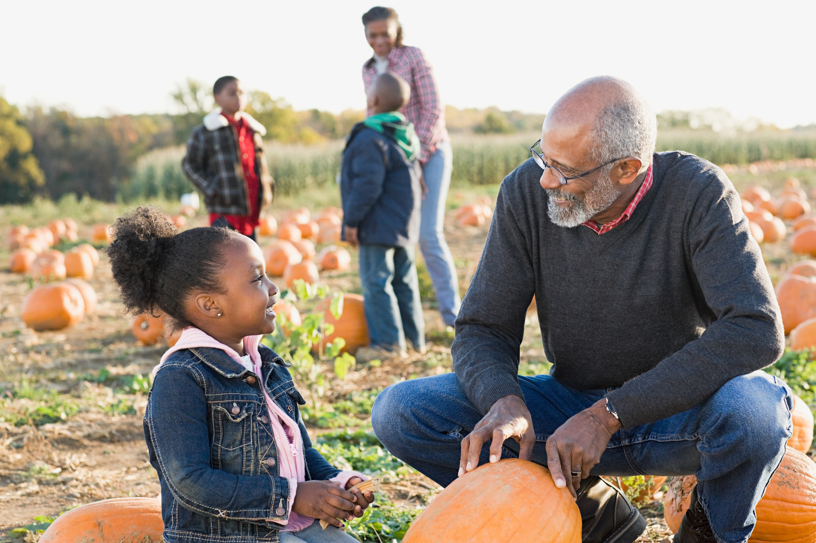
The Philosophy and Practices of Nurturing Parenting
Family Development Resources, Inc.

Slide 2
Nurturing Parenting
Nurturing is a critical skill for all life forms on the planet.
It is important for all of us to treat others and ourselves with respect, compassion, caring and dignity.
Nurturing comes from the Latin word Nu tri tura that means to nurse, to nourish and to promote growth.

Slide 3
Nurturing Parenting
Nurturing Parenting emphasizes:
Raising children in a warm, caring and trusting home.
Helping children be respectful, caring and cooperative.
Children who are cared for and treated respectfully will treat themselves, others and the environment in the same manner.

Slide 4
Reasons to be Nurturing
If parents practiced nurturing most of the time:
Children would develop a very “nurtured” part of their personality.
Children would develop very “nurturing” ways of treating others.
However, If hurting parenting is practiced often:
Children develop the “victim” part of their personality and come to believe that being “victimized” is a natural and frequent part of life.
Life as a victim gives birth to life as a perpetrator.

Slide 5
The Philosophy of Nurturing Parenting
The philosophy of Nurturing Parenting is founded of seven principles

Slide 6
Feelings of Attachment
Attached parents:
Express joy in being with their children.
Create a safe home to explore.
Promote a sense of safety and security.
Nurturing lessons focus on teaching parents how to:
Really listen to the thoughts and feelings of children.
Use praise to promote cooperation.
Have fun as a family.

Slide 7
Empathy
Parental empathy is the ability to recognize children’s emotions and to understand the motives of their behavior.
Research clearly shows that children whose parents have empathy do better in school; are socially well adjusted; and are more emotionally stable.
Nurturing lessons focus on:
Teaching parents and children to care for themselves, others, and their environment.
Avoiding the dangers of drugs, alcohol and other self-injurious activities.

Slide 8
Nurturing Oneself
Parents who take time each day getting their own needs met are more capable of understanding and helping children get their needs met.
Nurturing lessons focus on:
Helping parents recognize the basic needs of adults and children.
Understanding the importance of meeting basic needs.
Helping children make good choices to enhance their own personal self worth.

Slide 9
Gentle Touch
Gentle touch contributes to:
Positive brain development.
The ability to form trusting relationships throughout life.
A healthy body image.
Nurturing lessons teach parents:
The positive impact gentle touch has on children’s overall development.
Ways to use gentle touch to enhance parent-child relationships.

Slide 10
Discipline
Critical aspects of Nurturing Parenting include:
Setting limits through family rules.
Teaching right from wrong, respect and self-worth
Discipline cannot be imposed, beaten into, or forced on children.
Discipline develops best by children modeling parents whose example they admire.
Nurturing lessons help parents learn:
Alternatives to hitting, spanking, and yelling.
Positive, nurturing disciplinary strategies and techniques.

Slide 11
Expressing Feelings
Emotional competence is the ability to:
Identify and appropriately express personal feelings.
Recognize and appropriately respond to the feelings of others.
Nurturing lessons teach parents and children:
The difference between feelings of comfort and discomfort.
Healthy ways to express emotional energy.
Ways to manage and reduce feelings of stress and anger.

Slide 12
Expectations and Self-Worth
Children’s overall feelings of worth are lowered when parents:
Make demands on children that they are unable to meet.
Have no expectations.
Nurturing lessons help parents learn:
Appropriate stages of development.
Ways to build self-worth in children.
The importance of understanding neurological development in children.

Slide 13
Nurturing as a Lifestyle
Nurturing is the ability to care. To nurture is to promote the growth and development of all positive traits, qualities and characteristics.
To nurture is to:
Treat oneself with caring, kindness, and respect.
To keep ourselves physically and emotionally healthy.
To make good choices.
To be our own best friend.

Slide 14
Why Don’t We Nurture Ourselves?
Parenting and caregiving can be a stressful job that takes time and sacrifice.
We mistakenly believe that focusing on others 100% of the time is the right thing to do
Nurturing does not come naturally to all adults and nurturing practices can be learned.

Slide 15
Why Yourself Nurturing is Important
When you do not nurture yourself, it is impossible to nurture others.
It is important to set an example of nurturing for children by nurturing yourself.
When adults nurture themselves by having their own needs met, they are more able to meet the needs of their children.

Slide 16
Ways to Nurture Yourself
Make it a habit to tune into yourself as often as possible throughout your day.
Every time you notice you're getting resentful or irritable, stop. Ask yourself "What do I need right now to stay in balance?" Then, give it to yourself -- whether your child is there or not.
Notice the challenging times of day and find ways to nurture yourself through them.
Consciously parent yourself.

Slide 17
