Slide 1
Praising Children and Their Behavior
Family Development Resources, Inc.

Slide 2
What is Praise?
Praise can be a compliment, gesture, facial expression, or form of gentle touch like hugs or high fives that promote feelings of self pride, worth and accomplishment in others.

Slide 3
Why is Praising Children Important?
Children who are praised develop a personal sense of self-worth.
Research shows that children with positive self-worth get better grades, don't get discouraged easily, and generally live more productive lives.
Praise is like fuel that powers the self-esteem of children.
Children who sincerely believe they have worth treat themselves and others in positive ways.

Slide 4
Roadblocks to Using Praise
There is a popular myth that if children are praised they will become conceited or believe that they are better than others.
The fact is, children who are praised develop a strong sense of self and do not need to put themselves above others to feel good about themselves. They already do.

Slide 5
Roadblocks to Using Praise
Some parents just expect their children to do what they’re told to do without having to praise them.
Many adults have not had the experience of receiving praise as children, so it makes it hard for them to practice the skill as parents.
Adults who have difficulty accepting compliments from others may feel very uncomfortable in giving praise to their children.

Slide 6
Praise for Being and Praise for Doing
Praise for Being is the highest form of praise anyone can receive. It tells children that they have value and worth.
Praise for Being lets children know you value them for who they are. It is unconditional and given freely at any time.

Slide 7
Praise for Being
When you praise children for Being, they don’t have to do anything to earn it. Praise for Being is a powerful parenting practice for building a positive sense of self-worth in children.
Some Praise for Being statements are:
“I really love you.”
“You’re a beautiful person.”
“What a special child you are.”
“I am so happy you are my son.”
“You’re a wonderful daughter.”

Slide 8
Praise for Doing
Praise for Doing lets children know you appreciate and value their efforts and behaviors.
Praising a child’s behavior can be for something they tried and completed, or tried but didn’t quite succeed or finish. If you acknowledge your children’s efforts, they are more likely to try again.

Slide 9
Praise for Doing
Some Praise for Doing statements are:
“I’m really pleased to see you try so hard.”
“You buttoned all your buttons. Good for you.”
“I’m so proud of the way you cooperated.”
“You’re really doing well in school.”

Slide 10
Using Praise Incorrectly
Many parents unknowingly use praise incorrectly by using Praise for Being and Praise for Doing together. Such statements are:
“What a nice job cleaning your room. You really are a good girl.”
“Daddy really loves you for cooperating with me.”

Slide 11
Using Praise Incorrectly
Such statements tell children you only love or appreciate them when they do something that pleases you. It’s known as “conditional love,” or love that must be earned.
Children quickly begin to resent such love because they know if they don’t “do the right thing,” their parents will not love them.

Slide 12
Promoting Self-Praise in Children
Self-praise is a way children learn the habit of praising themselves and boosting their self-image.
To help a child learn self-praise, parents need to describe how good the act must have made the child feel. For example:
“Tracy, I bet you feel really proud of the nice job you did in cleaning your room.”

Slide 13
Promoting Self-Praise in Children
By promoting self-praise, children learn to be their own best friend and develop self-confidence.
To encourage children to use self-praise, parents should model the behavior for them.

Slide 14
Being Conceited
Some parents worry about their children becoming conceited because they received praise for the people they are or the things they do. Conceit is different from self-worth.
When children feel conceited, they are usually sending the message that, “I’m better than you.”
Contrary to popular belief, it’s children who don’t have a positive self-image that wind up feeling conceited.

Slide 15
How to Use Praise
STEP 1
Focus your attention on the child and the situation-praise deserves your undivided attention.
STEP 2
Move close to the child - praise feels good when given by someone close to you.
STEP 3
Make eye-contact with the child on the child’s level. For example, you must bend down to be at eye level with young children.

Slide 16
How to Use Praise
STEP 4
Gently touch the child- touch is a positive form of communication. Smile or look pleasant-everyone likes to see a happy face.
STEP 5
Praise your child- for Being or for Doing.
STEP 6
Offer a hug-to “seal” the nice words.

Slide 17
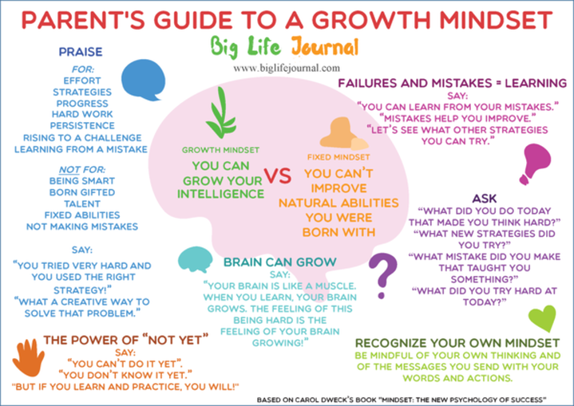

Slide 18
Accepting Praise As An Adult
Praise is fuel for our positive self-worth.
Self-worth is the value we have for our self: our ideas, accomplishments, successes, as well as our appearance, personality and character.
When others praise any of these qualities, they are doing us a big favor-they are recognizing us in a positive way.

Slide 19
Why is Accepting Praise Important?
It sends a message to others that we are worthy of their recognition and deserving of it.
When we accept a compliment, we are building our positive self-worth. Parents with a positive sense of self-worth can help build the positive sense of self-worth in children.
As models, parents show their children that accepting praise is the right thing to do.
Everyone needs recognition. Accepting praise is a positive form of recognition.
When we accept a compliment, we're more likely to send one.

Slide 20
Rejecting A Gift
For a lot of adults, they’ve simply forgotten how to say thank you when they receive a gift of recognition.
Here are examples of how not to receive a compliment:
Compliment: “You look nice today.”
Response: “Well, I feel miserable.”
Compliment: “Nice report, John.”
Response: “Well, if I had more time, I could’ve done better.”

Slide 21
Rejecting A Gift
Clearly we would not respond in the same way if someone were trying to give us a raise.
Compliment: “You have been working very hard. Here is fifty dollars. Have dinner on me.
Response: “No, I don’t deserve it. I’m not that good. In fact, you probably need to decrease my salary.”
What happens to others who offer us a fifty-dollar compliment and we reject it?
You will quit getting any compliments at all.
When that happens, the fuel supply to your self-worth will be drastically cut short.

Slide 22
How to Accept A Compliment
Look pleasant. Let the person sending the compliment see you enjoy being recognized.
Say, “thank you.” Do not reject or send the compliment back (“Well, you look nice/work hard too.”) Be gracious and accept your gift.
Use gentle touch. A touch on the arm or a handshake conveys your true appreciation.

Slide 23
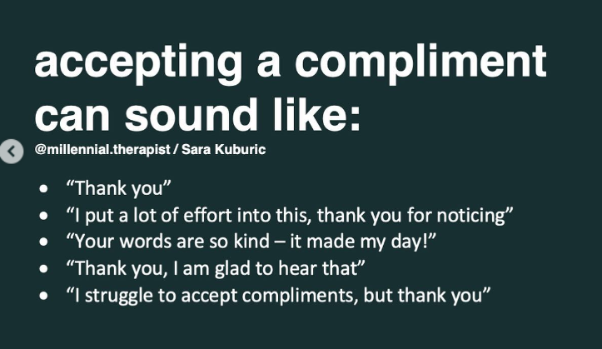
How to Accept A Compliment

Slide 24
Why we Praise Children

Slide 25
