Slide 1
Understanding Feelings
Family Development Resources, Inc.

Slide 2
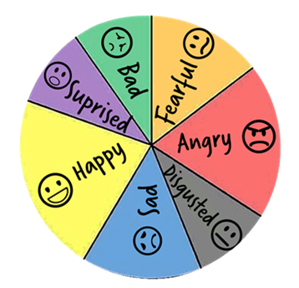
Feelings
Most people have learned that there are two types of feelings: Good and Bad.
There is no such thing as a bad feeling since all feelings are an expression of an experience.
When we categorize feelings as good or bad, we also categorize the people who have them as good or bad.

Slide 3
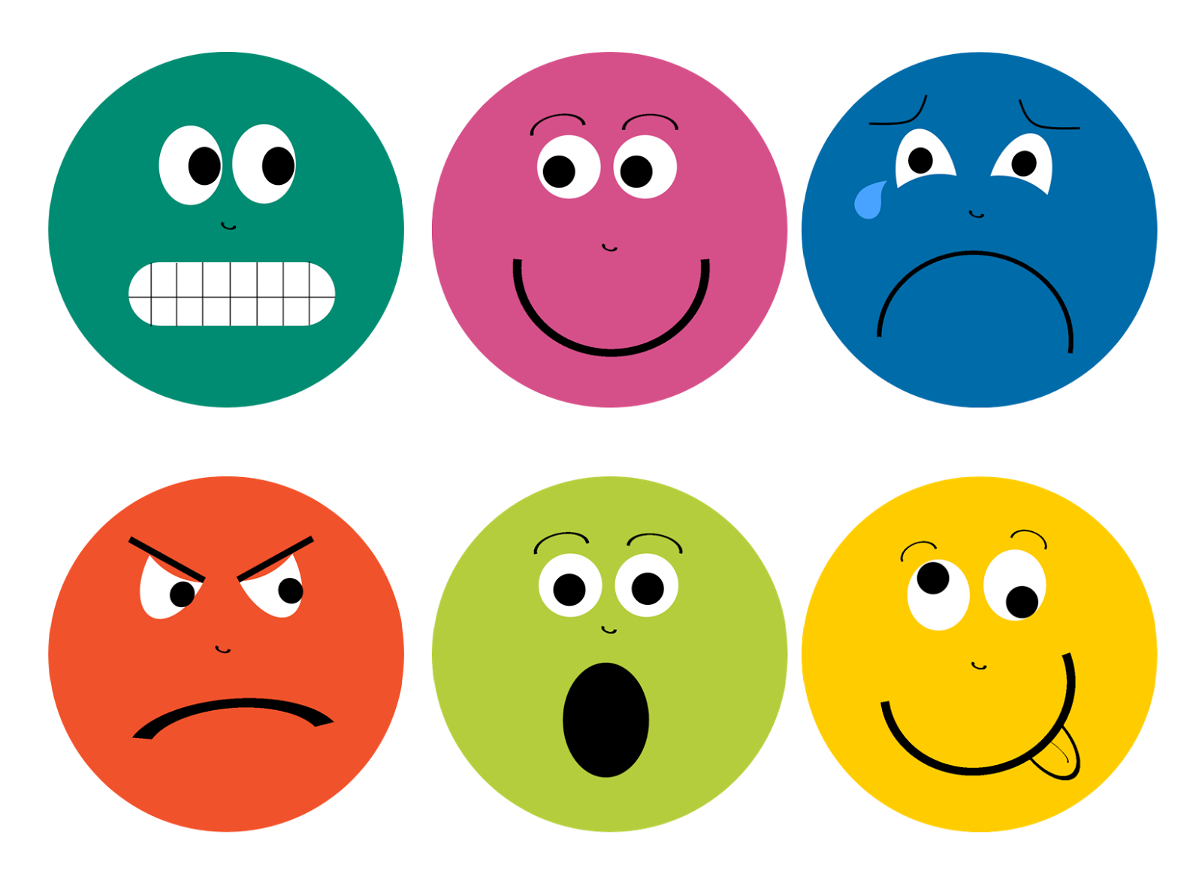
Feelings
Instead of referring to feelings as good or bad, we can group them into feelings of comfort, and feelings of discomfort.
That way it’s the feelings we are labeling, not the people who have the feeling.

Slide 4
Feelings of Comfort & DISCOMFORT
Feelings of comfort
Love
Peace
Joy
Contentment
Happiness
Satisfaction
Closeness
Feelings of discomfort
Hate
Envy
Jealousy
Anger
Frustration
Sadness
Rejection

Slide 5
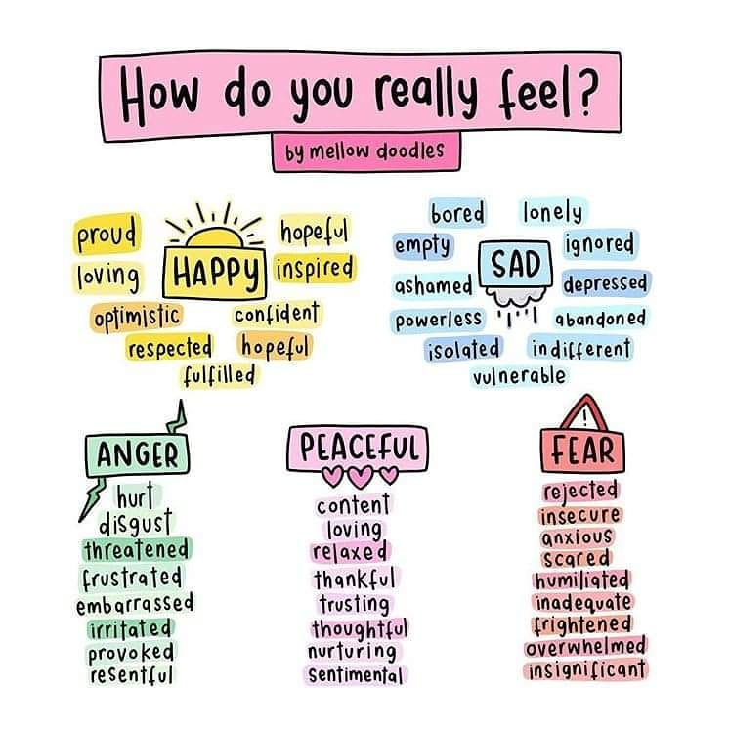

Slide 6
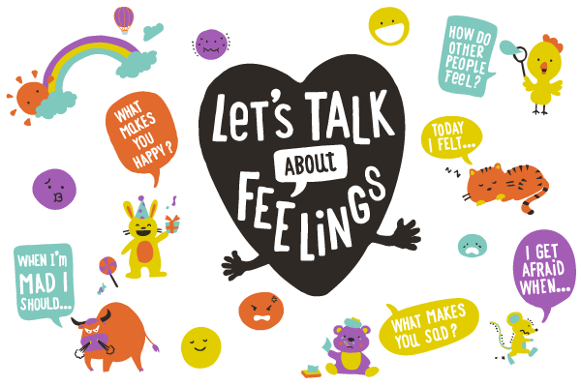
Feelings of Discomfort
The goal is not to deny feelings of discomfort.
The goal is to manage the feelings so the feelings do not take over your life.

Slide 7
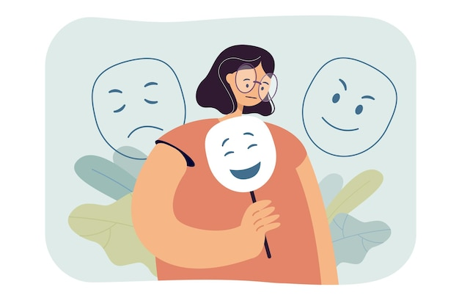
Hiding Your Feelings
We learn very early in life not to deal with pain or other feelings of discomfort.
When past experiences in our lives have been very painful, there is a tendency for many of us to avoid dealing with the pain.
We will either try to forget the experience altogether, or we will attempt to get rid of the painful feelings by stuffing them inside.
Neither works very well in the long run. The painful feelings do not go away; they are just out of sight.

Slide 8
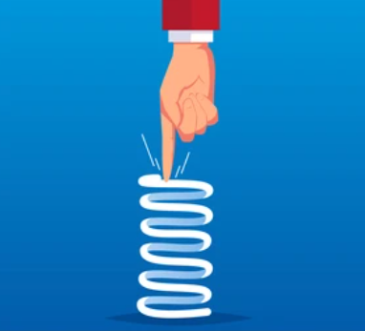
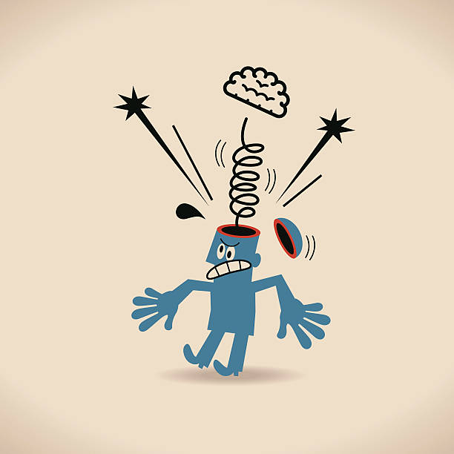
Letting Go of Past Pain
An unpleasant experience we have had that we are unwilling or unable to deal with acts as a giant spring.
We have to squash by applying pressure to it. The moment we let up on the spring, it becomes fully extended.
This is just like the painful feelings that come leaping into our mind. When that happens, we relive the experience again.

Slide 9
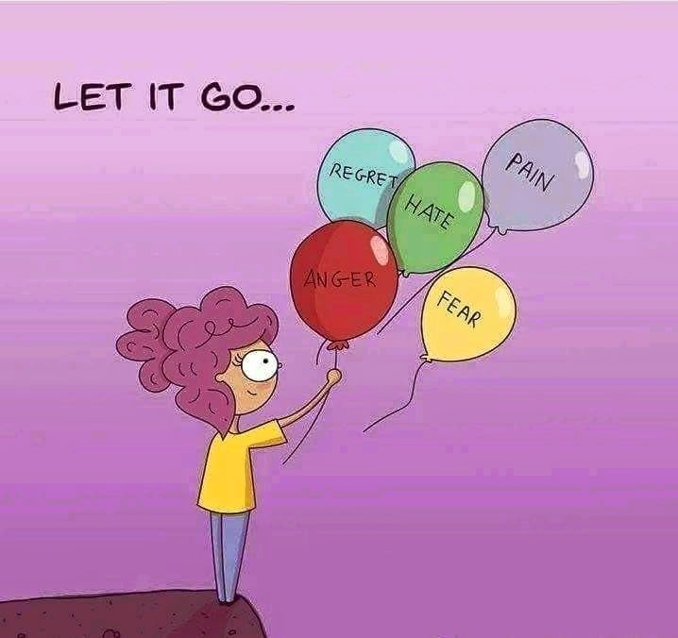
Letting Go of Past Pain
The first step is to use healthy strategies to express your feelings of discomfort, and not hide them.
The effort involved in feeling free and being able to nurture yourself and others may not be easy, but it is certainly worth it.

Slide 10
How To Manage Feelings
Awareness
Acceptance
Communication

Slide 11
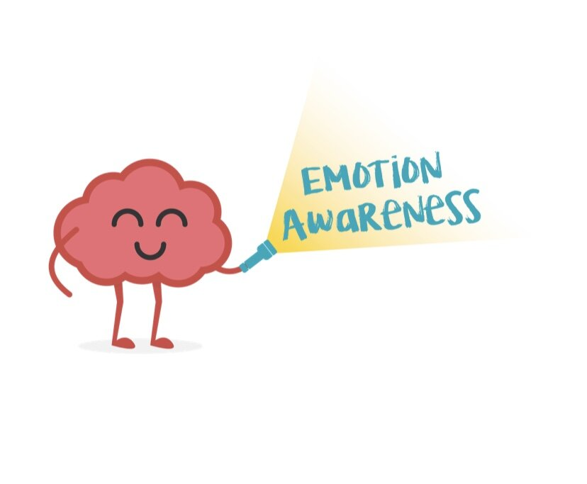
How To Manage Feelings
Awareness
The way your body responds to a feeling.
The name you give the feeling.
Awareness of the situation or similar situations that generate specific feelings.

Slide 12
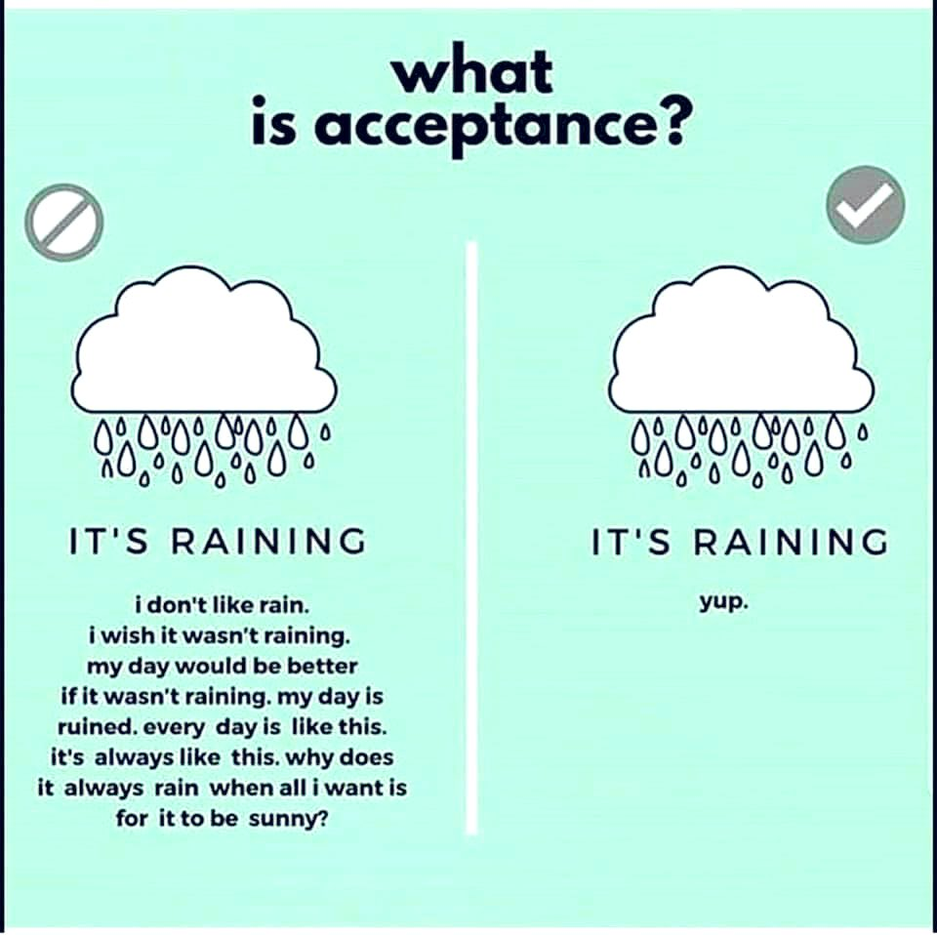
How To Manage Feelings
Acceptance
The second step in managing feelings is a general acceptance that whatever you are feeling is OK, and that you are not a bad person for having such feelings.
Instead of accepting a feeling, many people deny, pretend or mask the feeling.
Notes:
.

Slide 13
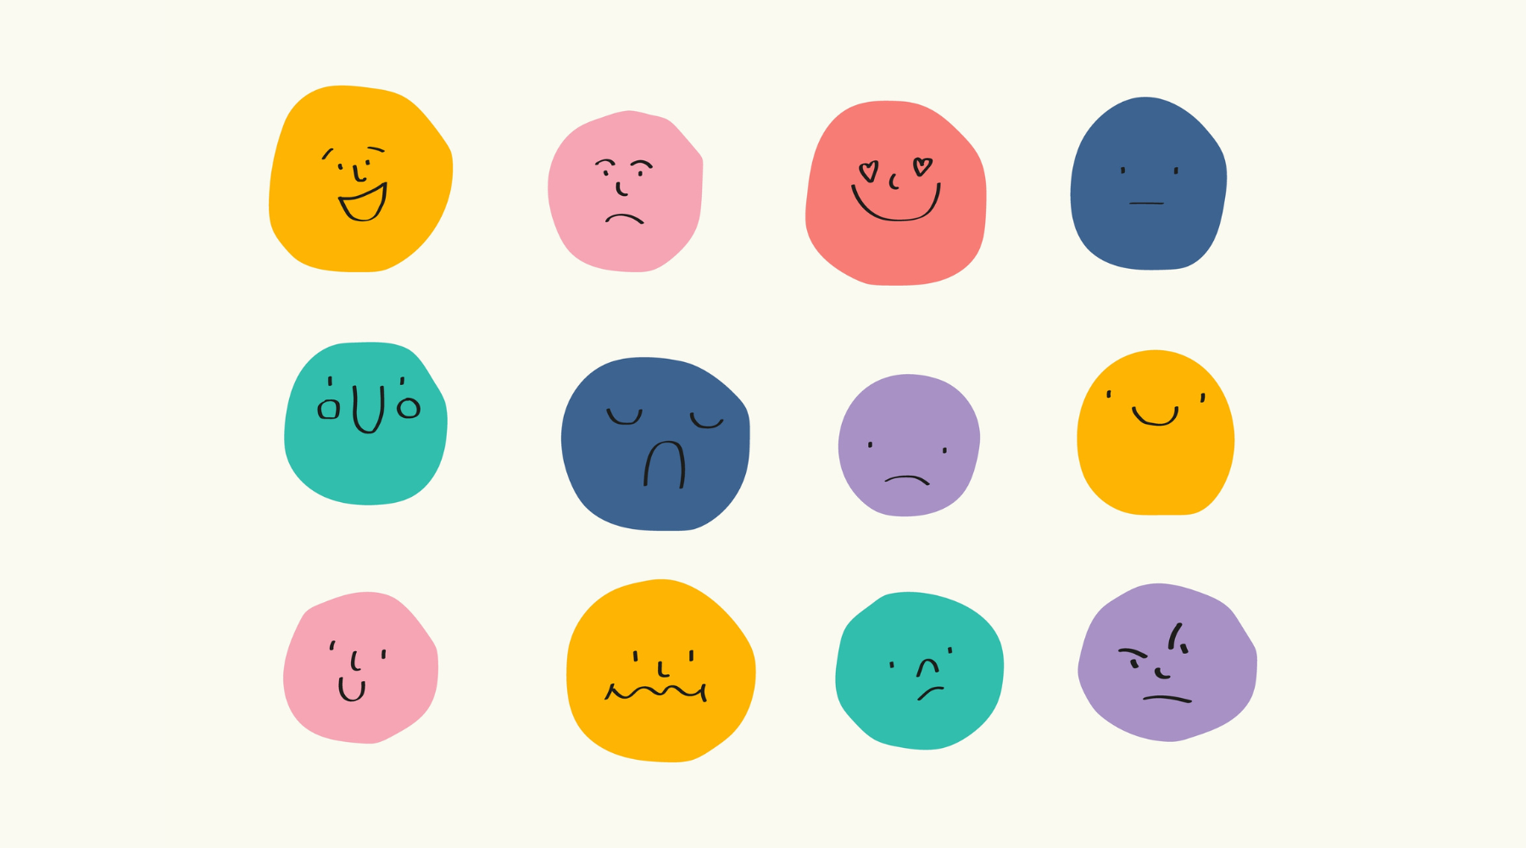
How To Manage Feelings
Communication
When it comes to expressing feelings, such communication can either be verbal or non-verbal.
All feelings have energy which gives the feelings life.

Slide 14
How To Manage Feelings
Three helpful rules in expressing energy are:
Respect yourself - don't hurt others.
Respect others - don't hurt others.
Respect the environment - don't destroy property, animals, or nature.

Slide 15
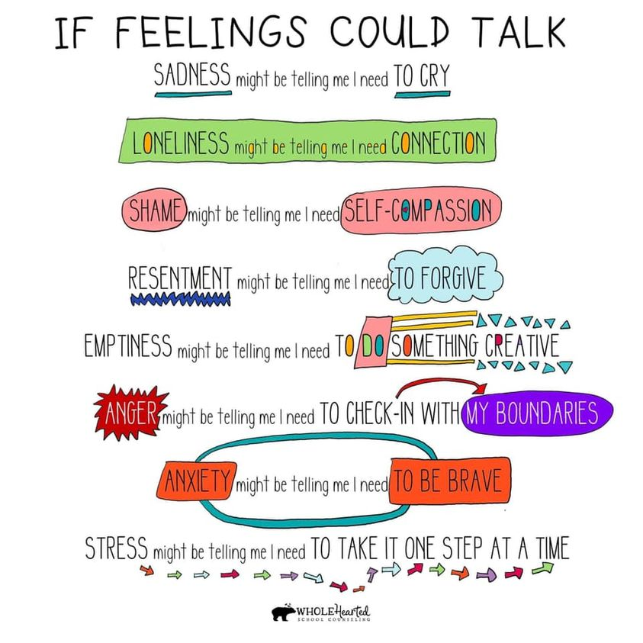

Slide 16
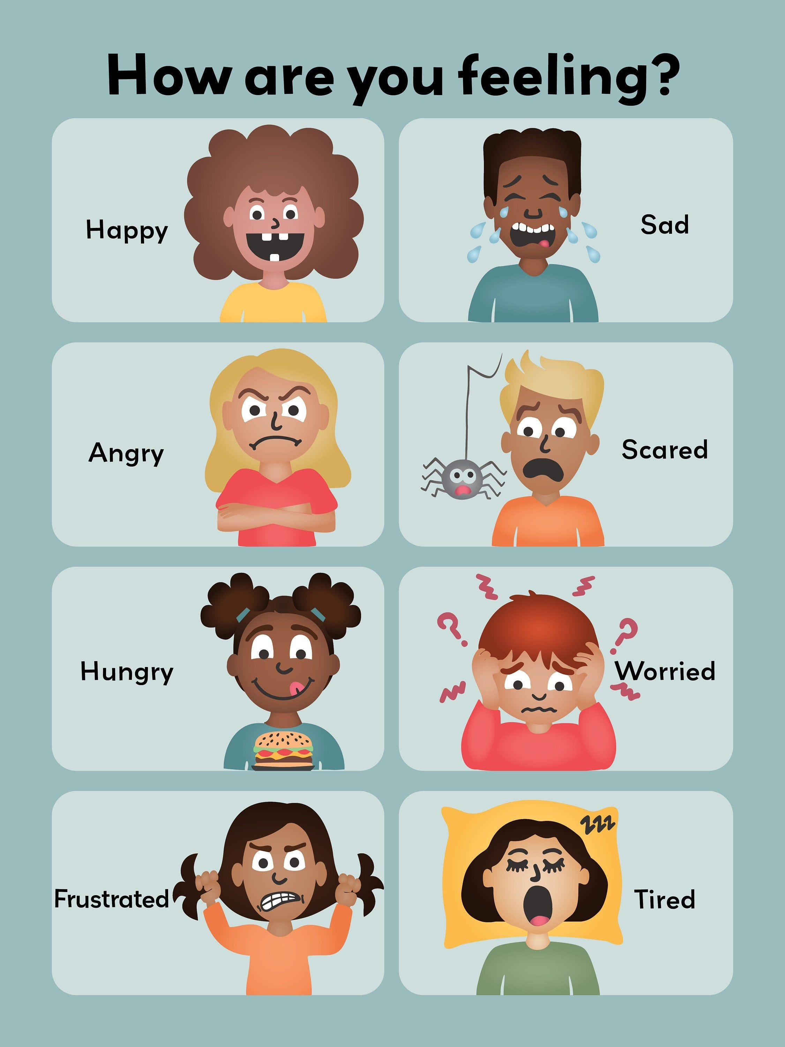
Helping Children Handle Their Feelings
How we prepare our children to handle their feelings will affect the quality of their life more than any other element of parenting.
Children that learn to handle their feelings develop a sense of competence. Emotional competence is the ability for parents and children to be able to recognize and express their feelings in appropriate ways.

Slide 17
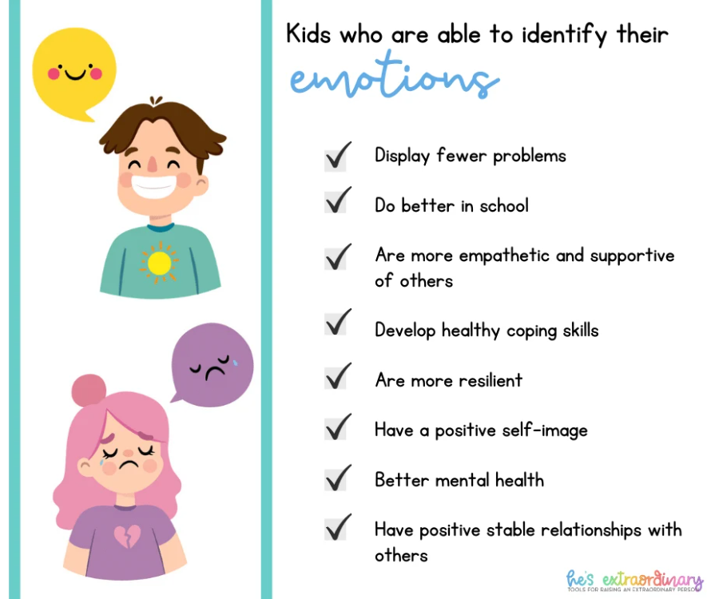

Slide 18
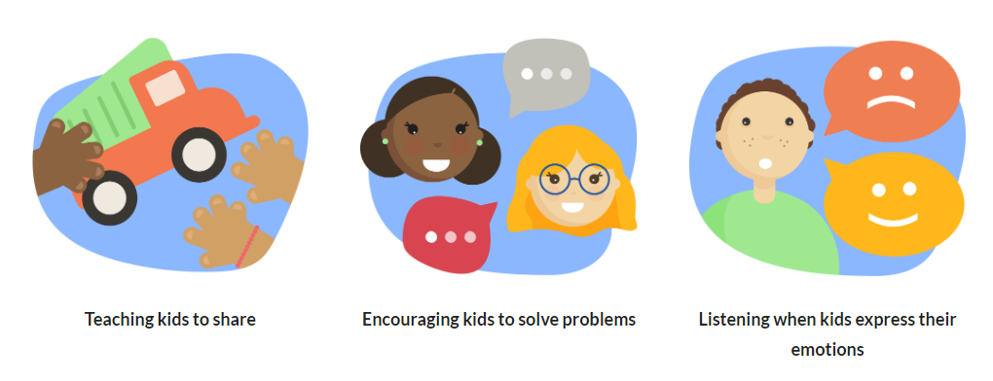
Helping Children understand Feelings can look like

Slide 19
Ways to Build Emotional Competence
Let children know all feelings are OK.
Children have to believe that all feelings are good and useful in communicating.
It is HOW the feelings are communicated that can either be OK or not OK.
However, it is OUR job to teach them how to communicate – not punish them for communicating in undesirable ways.

Slide 20
Ways to Build Emotional Competence
Label the feeling you see or think you see.
For example, “You look “happy.”
This will give the child a feeling of being believed and respected.
You can also talk about your own feelings, and label those as well. “I’m feeling frustrated that I can’t find the book I was reading.”
Another great way to help children understand feelings is through books and TV shows. Pause to ask “how do you think that character feels right now?”. Then discuss.

Slide 21
Ways to Build Emotional Competence
Encourage their curiosity around their feelings. Ask the question, “Why?” For example:
“Why do you think he is feeling that way?”
“Why are you feeling so sad?”
Do not dominate the conversation.
Let the child do the talking.
Brainstorm with the child what, if anything, needs to be done.
Sometimes comforting a child is all that needs to be done, or simply just listening.
Sometimes they may need help solving a problem.

Slide 22
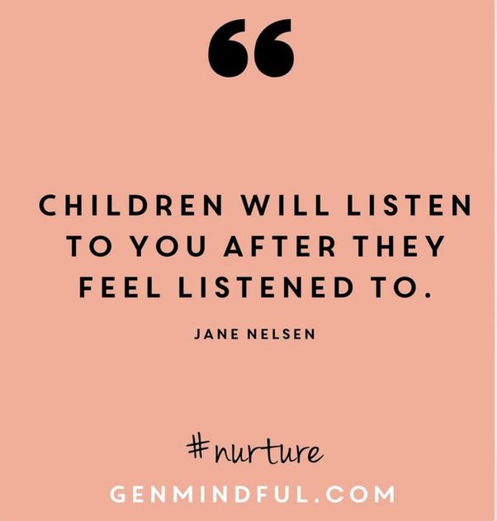
Ways to Build Emotional Competence
When a child wants something, honor their desire.
Children feel you understand and appreciate their desires.
You don’t need to understand it – you just need to understand that it’s important to them.
Once children realize that their feelings are honored, they are more open to listening to the logic why they cannot have what they want.

Slide 23
Ways to Build Emotional Competence
Teach children how to express their emotional energy.
All feelings have energy that need expression.
Kids need to learn that just because they feel angry doesn’t mean they can hit someone.
Brainstorm a list of physical things children can do to release their energy.
Some kids may need time alone (by choice) to calm down.
Others may prefer to have company while they work through their feelings.
Teach your child how to feel with sad feelings as well – often those who don’t become aggressive or physical.

Slide 24
Ways to Build Emotional Competence
Reinforce!
When children are expressing their feelings appropriately, let them know you like what you hear.
Remember, the behaviors you pay attention to are the behaviors that are being reinforced. Catch your children behaving well.
Model!
If you tell your child to use their words when they're angry but they witness you throw your phone after a dropped call, your words won't be effective. Model healthy ways to deal with uncomfortable emotions.
Point out times when you feel angry or frustrated and say it out loud. Say, “Wow, I’m angry that car just pulled in front of me.” Then take some deep breaths or model another healthy coping skill so your child can learn to recognize the skills you use when you feel angry.

Slide 25
