Slide 1
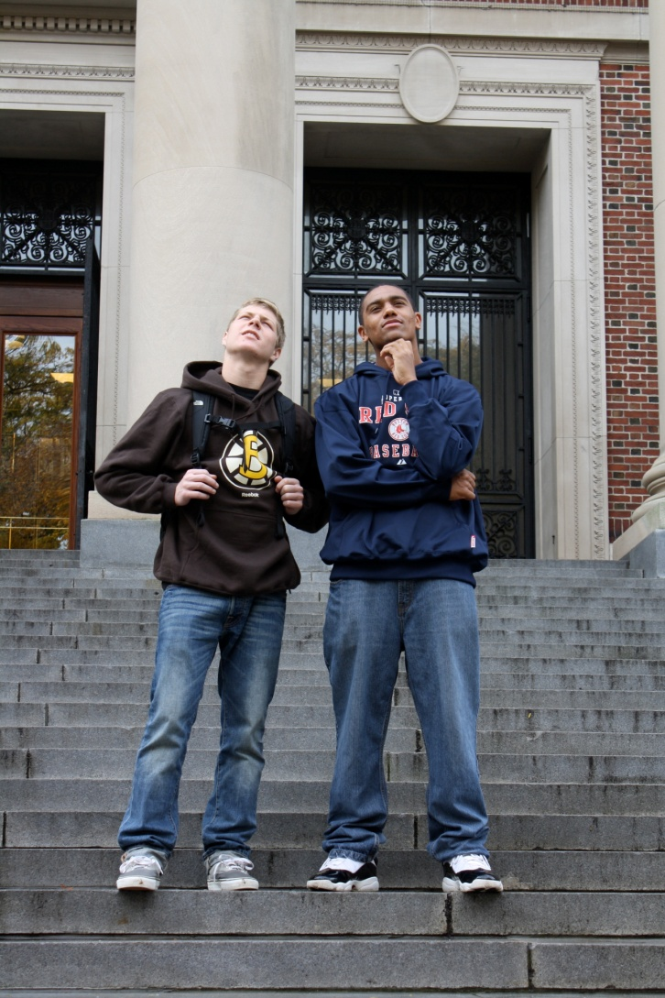
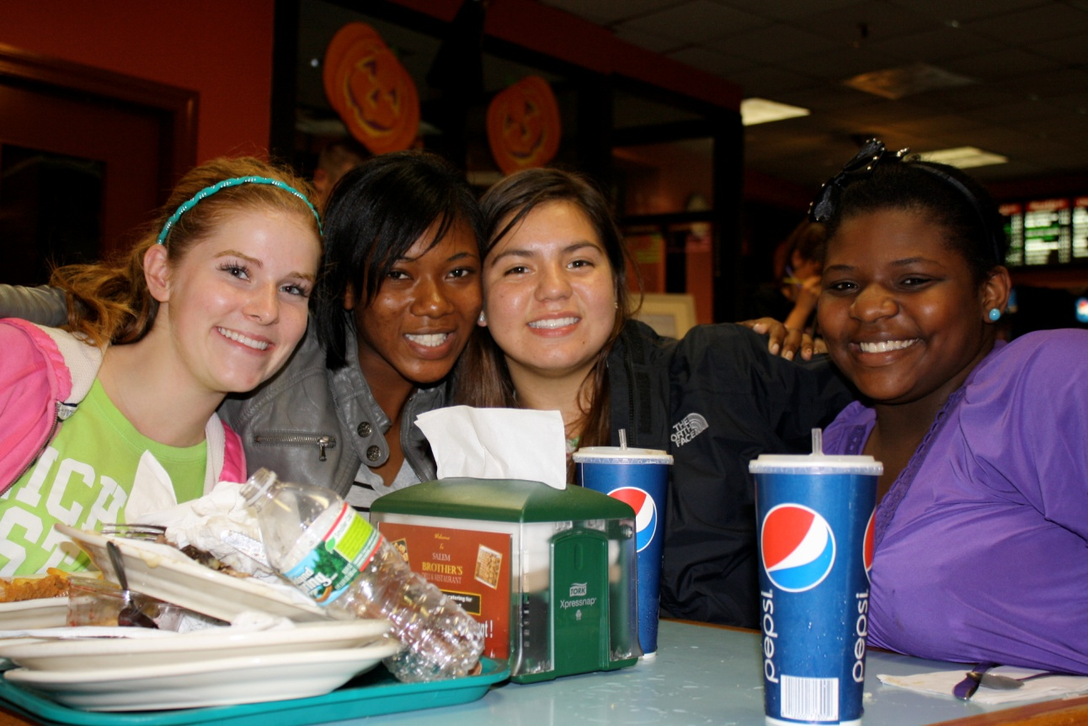
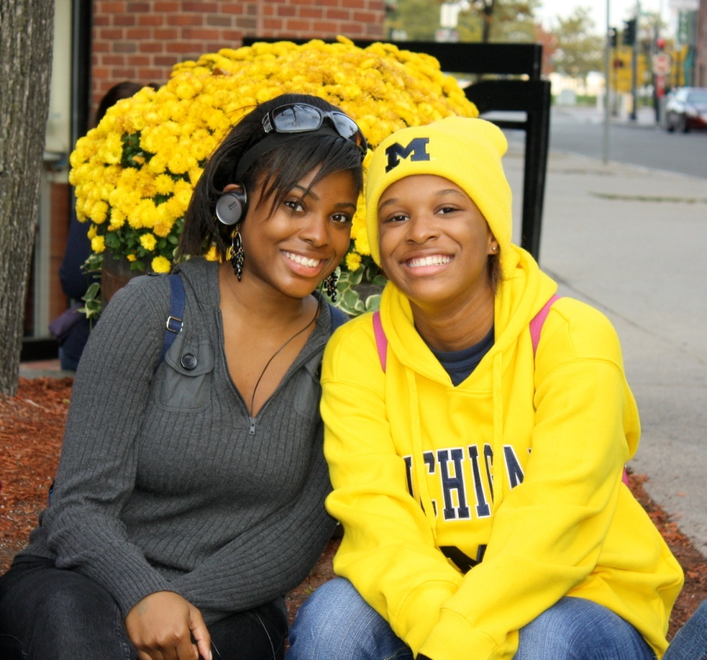

Slide 2
The Middle Years Programme leads to DP
What needs to be done?
  Contact your School Counselor & IB Coordinator
  Electives that need to be taken – PE, Health, Computers, Fine Arts, Government & Economics
  A personal curriculum &/or “testing out” may need to be completed for the student
  Application, Essay & Teacher Recommendation January 2011

Slide 3
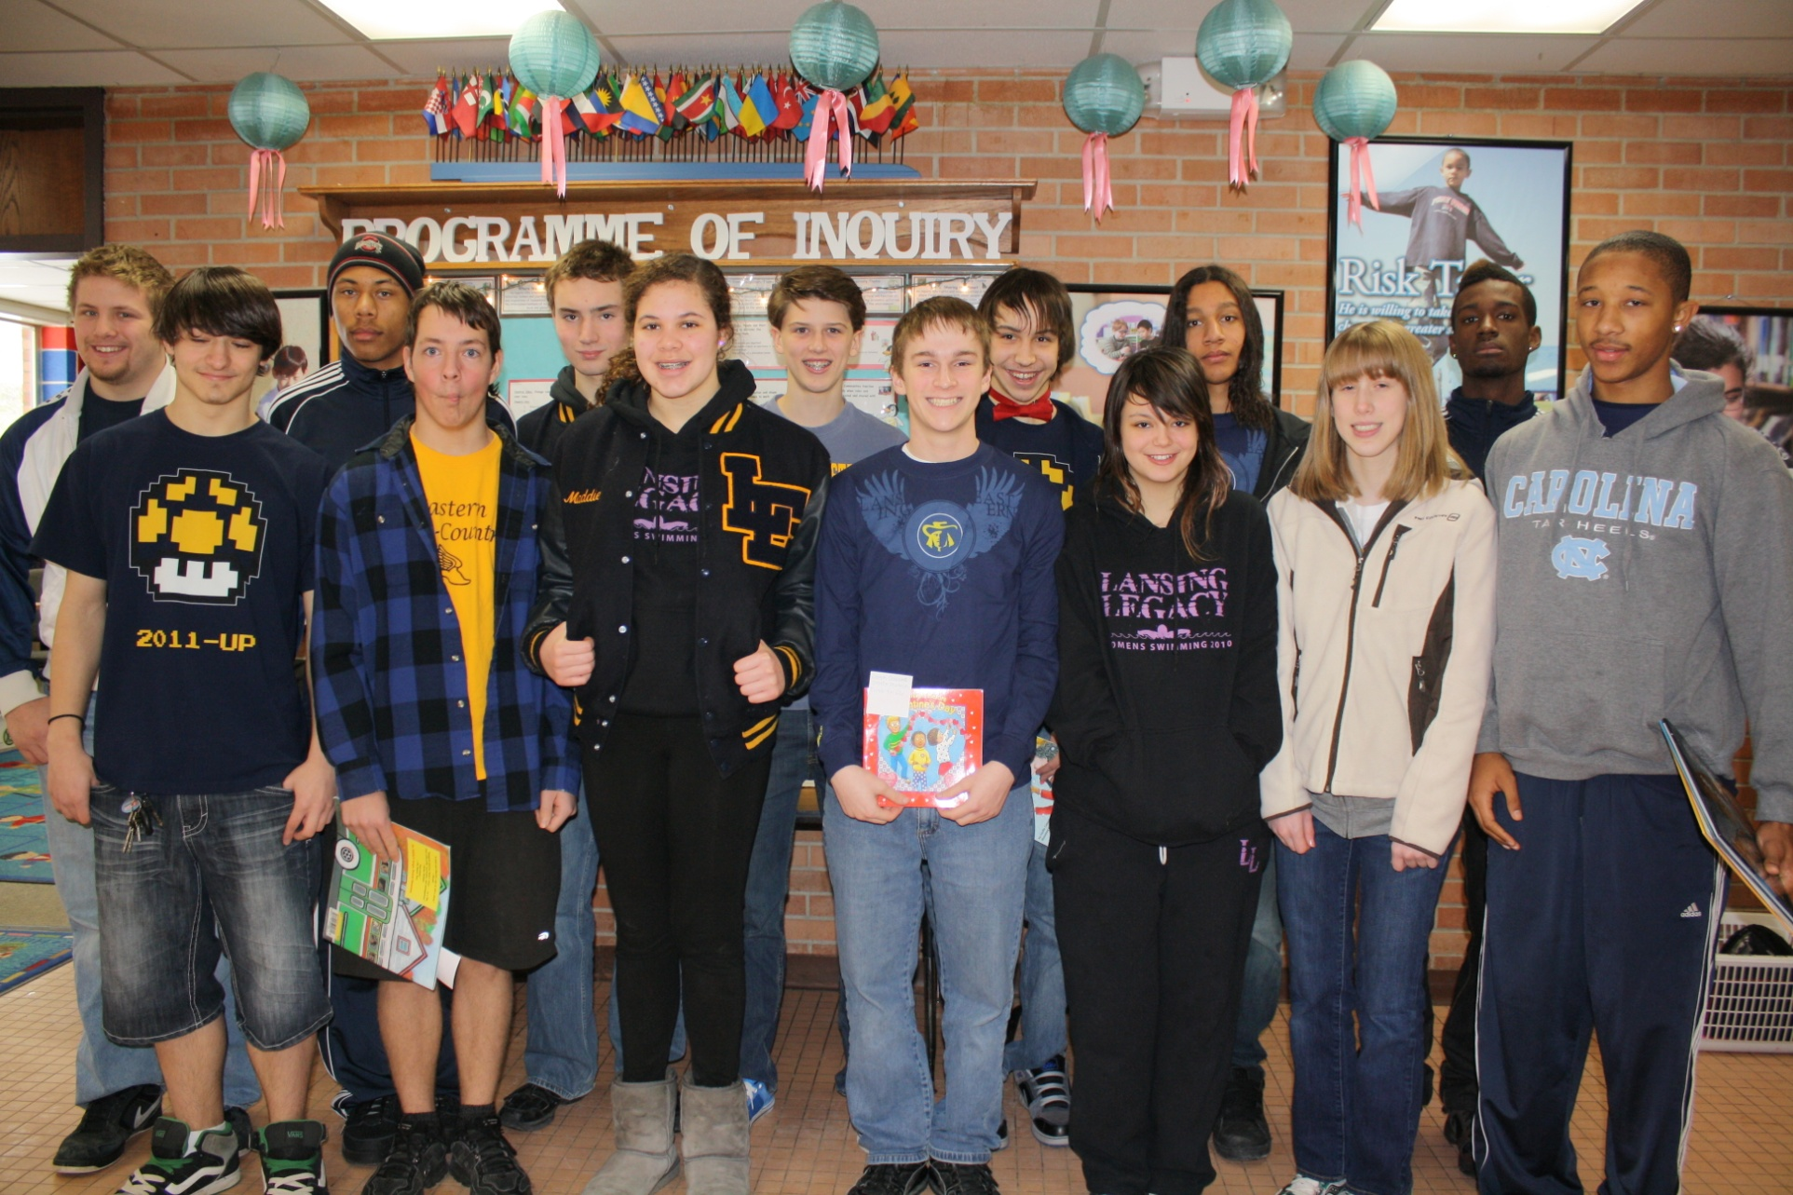

Slide 4
Diploma Programme
For 11th & 12th Grade Students
6 IB Classes between the two years
3 Core Components - Theory of Knowledge course, Extended Essay & Creative/Action/Service Project
Prepares students for the University setting & for the International Community
How is IB – DP similar/different from other academically rigorous programs?

Slide 5
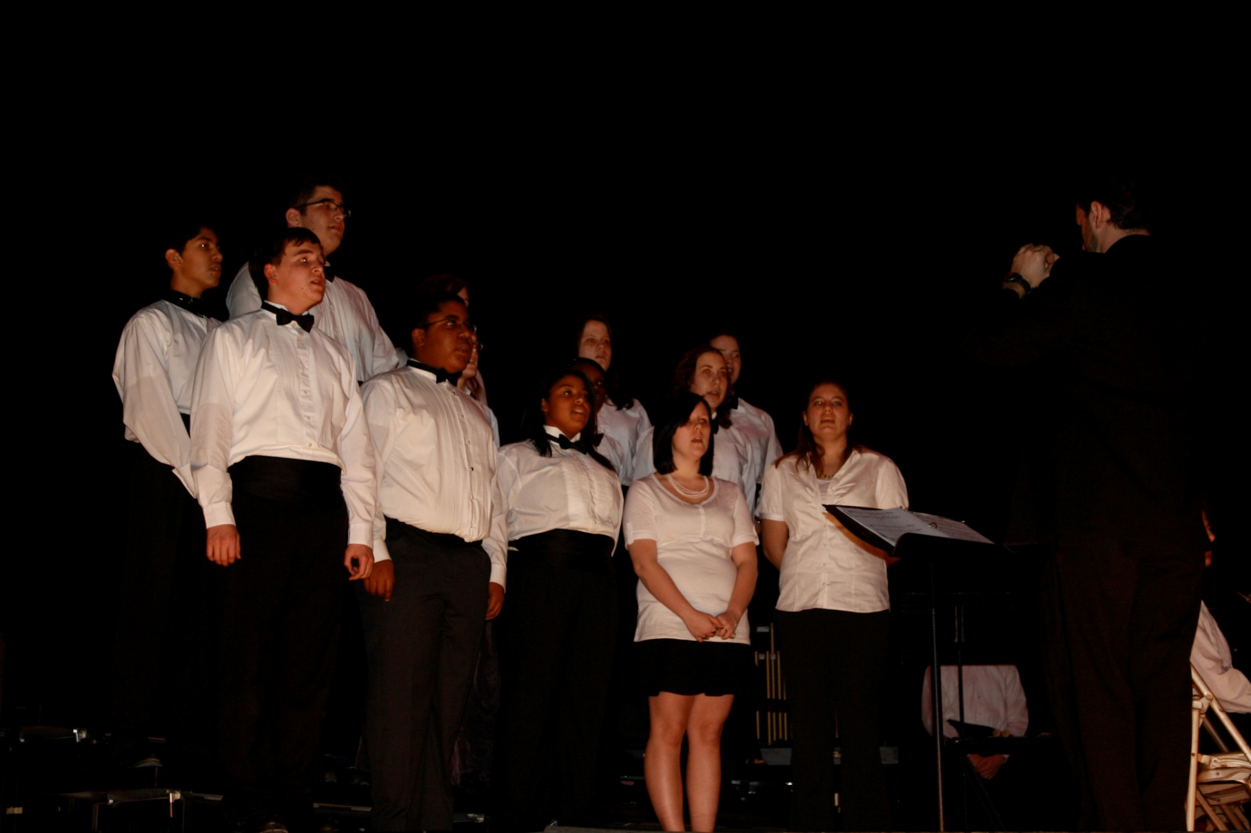

Slide 6
Course Work
HL = Higher Level
  English, Biology, History, Visual Art, Music Theory
SL = Standard Level
  Environmental Systems & Societies, Chemistry, Visual Arts, Music Theory, Math Studies, French, German, Spanish
Full Diploma students must take 3 HL courses + a mix of SL & HL = 6 IB Classes over 2 years
Exams are taken in April/May every year

Slide 7
