Slide 1
Course Work
Summer Course Work – IB English Assignment, Oral Recordings for French, German & Spanish
Internal Assessments – Done in 11th & 12th
IOP & IOC, Labs, Conversation in Fr, Ger, Sp, Historical Investigation, Musical Investigation, Art Workbook, Math Studies Project
ToK, Theory of Knowledge is a “0” Hour course 2nd Semester Junior Year & 1st Semester Senior Year

Slide 5
Heart of the Hexagon
Theory of Knowledge
M-W @ 7 a.m. & every other Monday night @ 6-8 p.m.
Course
Essay, Presentation, Attendance/Discussion
Extended Essay
Your 1st Research paper w/ a max of 4,000 words
Quaker Teaching Staff Mentor, Your choice
Creative, Action & Service – CAS Project
How will students get involved? Individual, group, community projects to be an active member of society

Slide 6
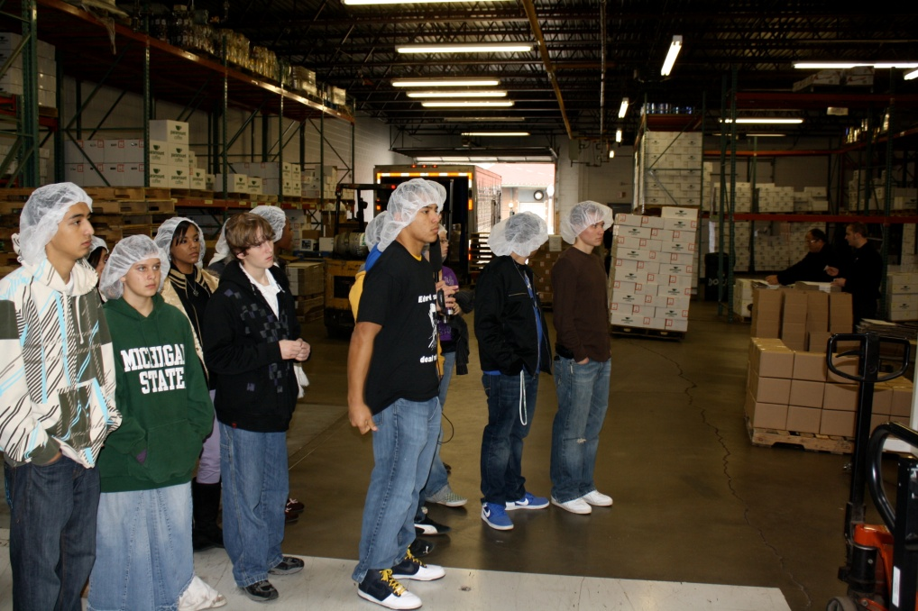
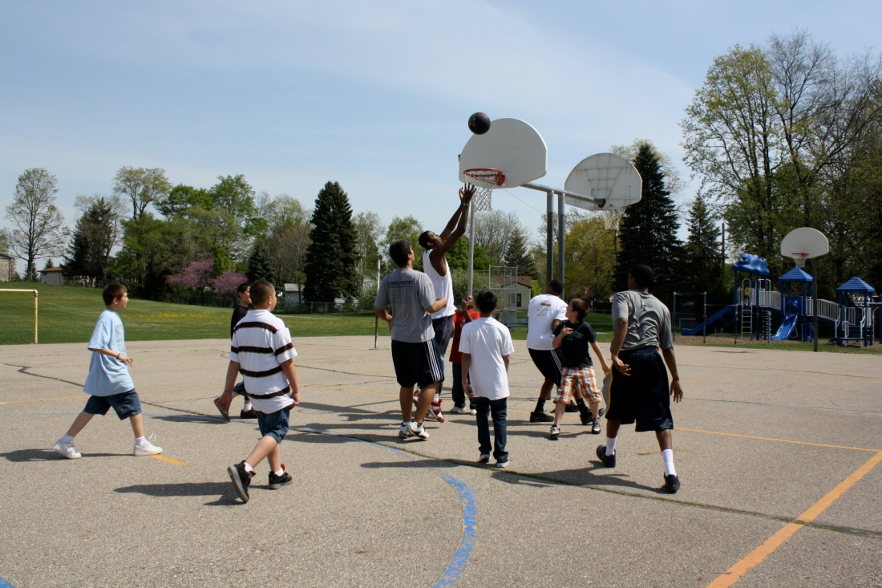

Slide 7
IB Costs
$141 May 2011 Exam Registration Fee
$96 May 2011 Exam Fee
Exam Fees are due the 3rd Week of October
All IB Full Diploma Students pay a one-time Exam Registration Fee
All IB Certificate Students pay a Registration Fee every year they test
Amanda G. & comparing Exam Fees to a college class

