Slide 1
eFinance
Human Resources

Slide 2
Applications

Slide 3
Employee Information

Slide 5
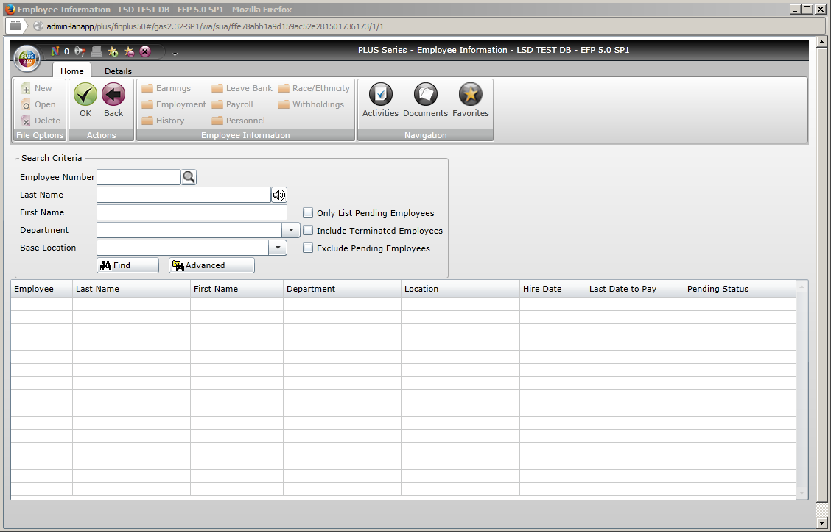

Slide 6
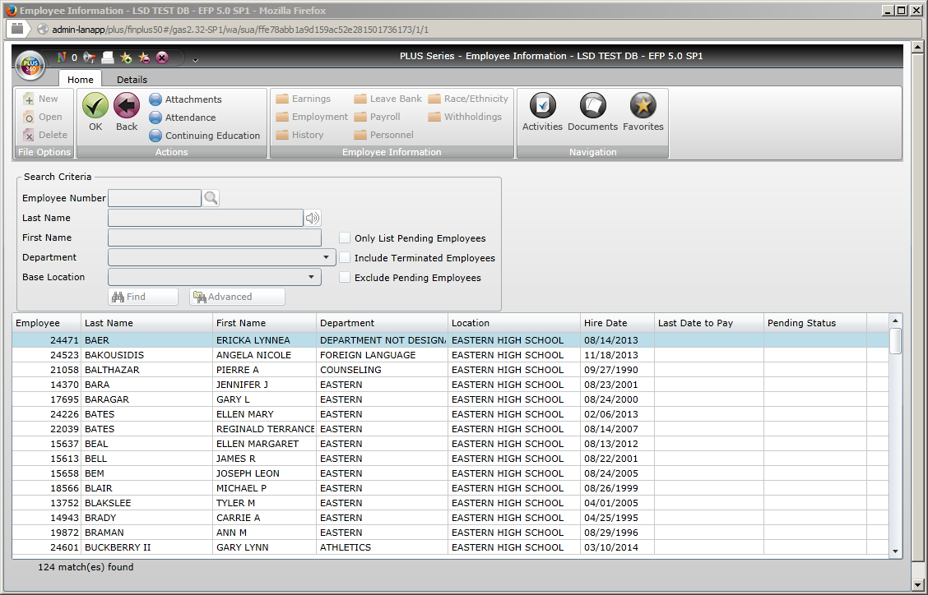

Slide 7
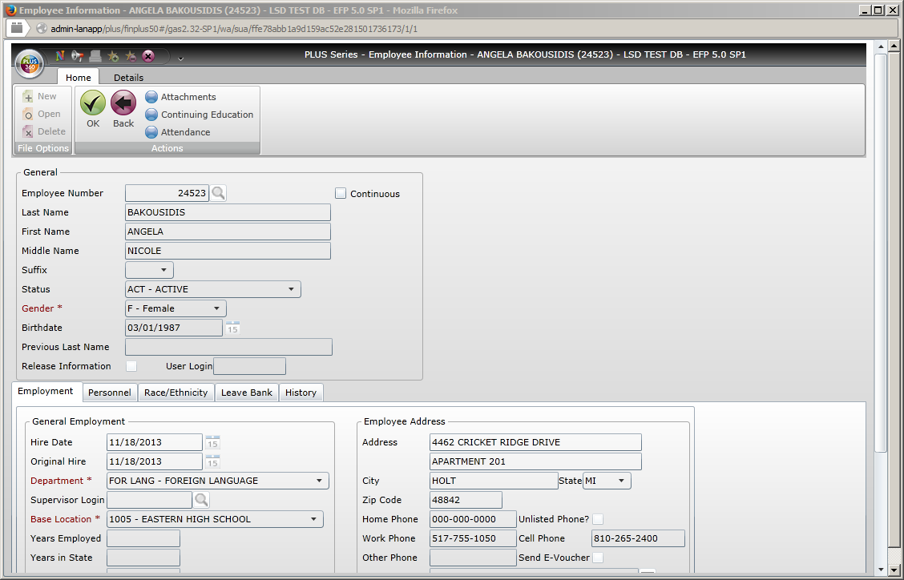

Slide 8
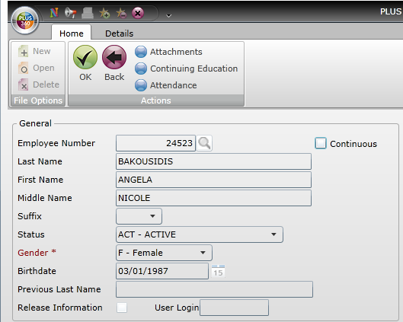
The top left ¼ of the employee information screen.

Slide 9
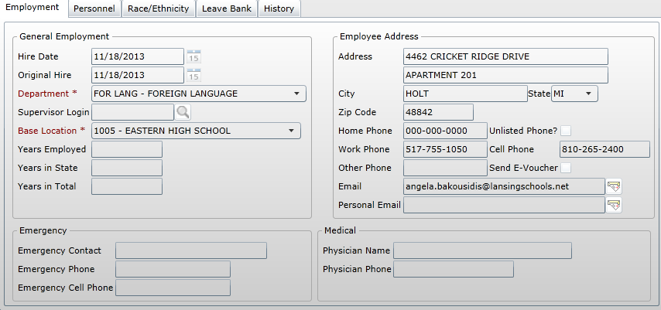
Bottom half of employee information screen.

Slide 10
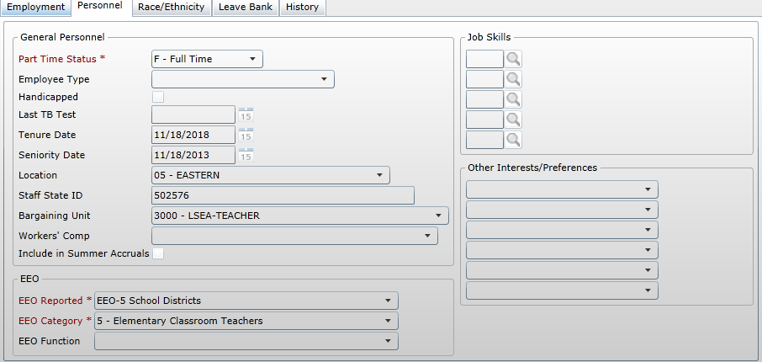
Bottom half of employee information screen.
This is the state ID/PIC.

Slide 11
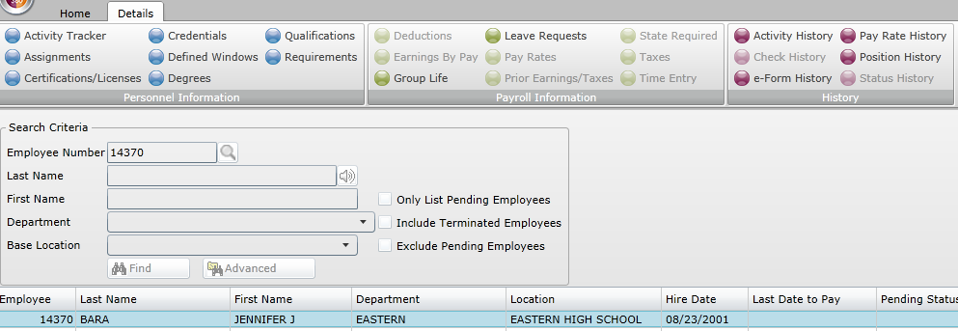

Slide 12
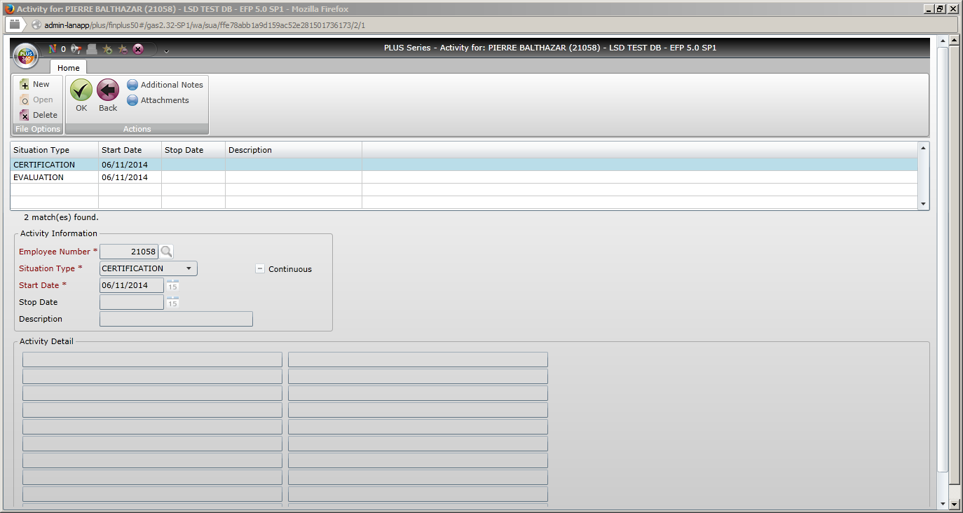

Slide 13
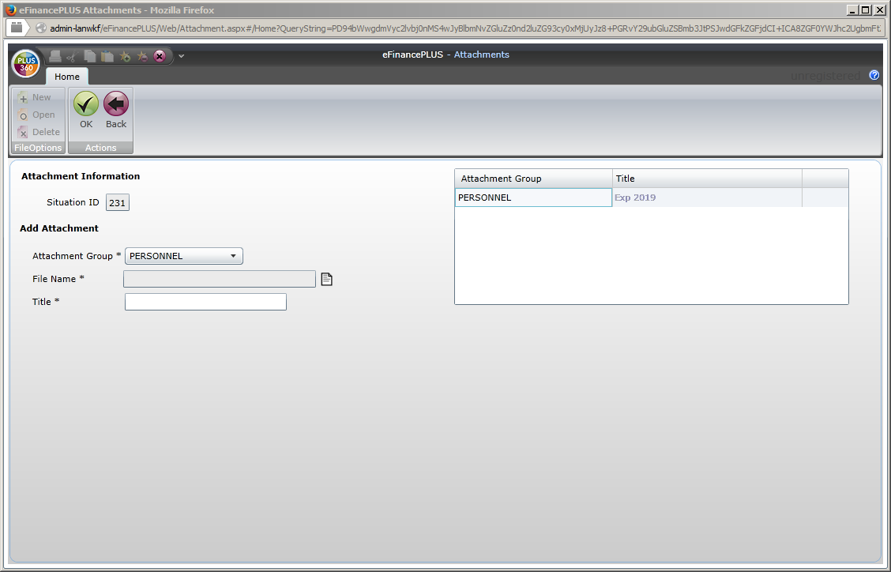
Click the title to open the file.

Slide 14
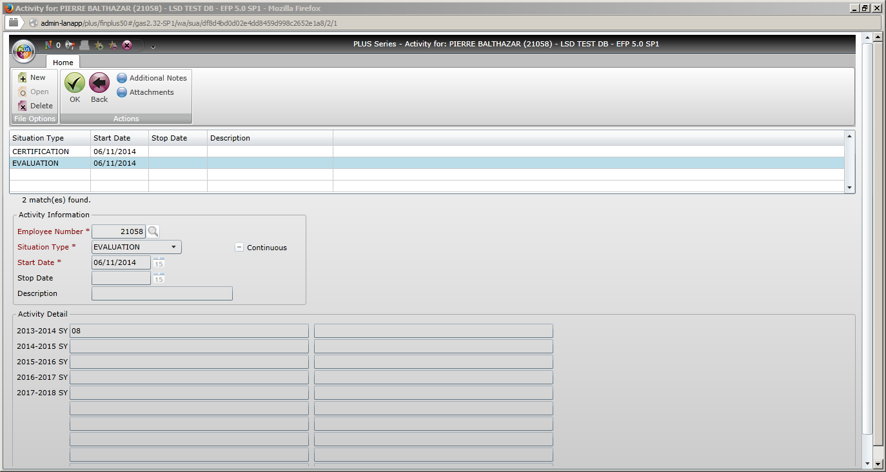

Slide 15
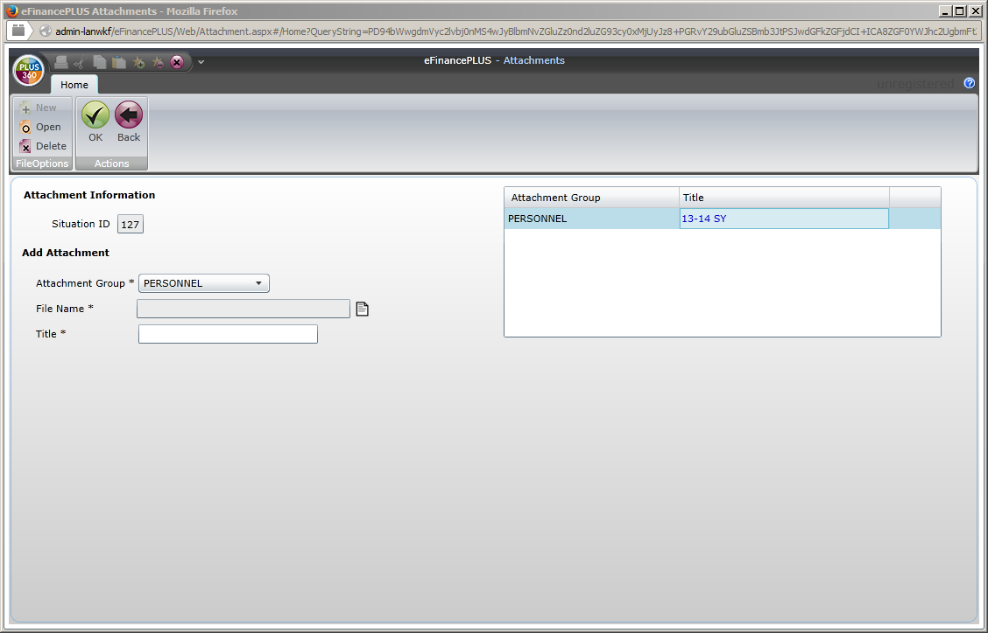
Click the title to open the file.

Slide 16
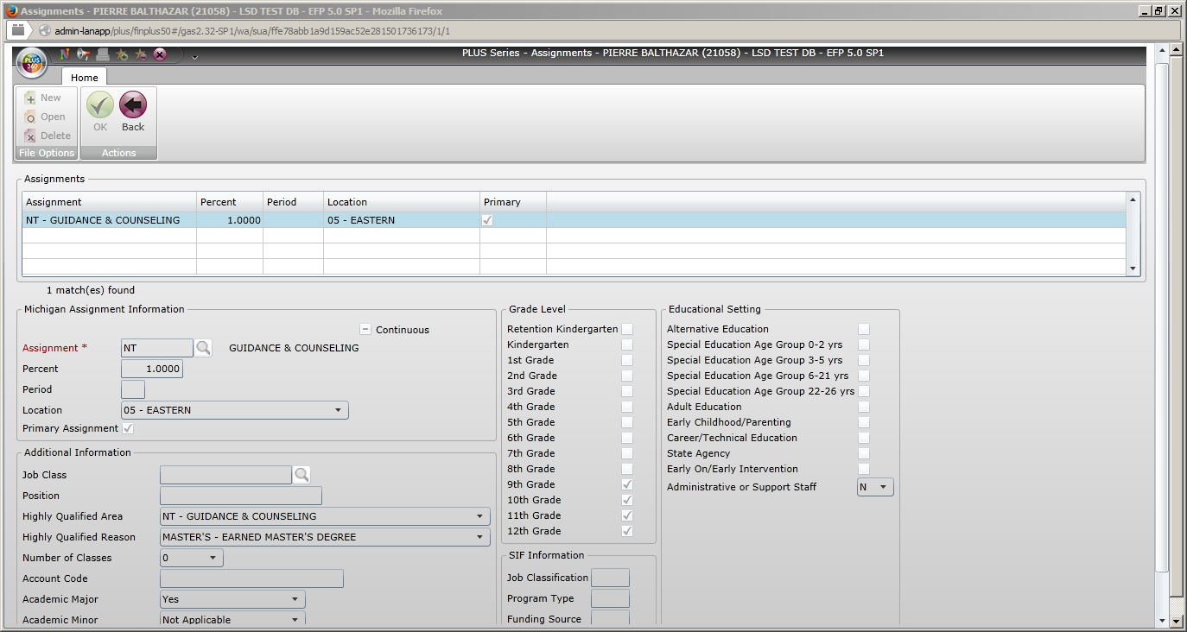
This page required for REP, state reporting.

Slide 17
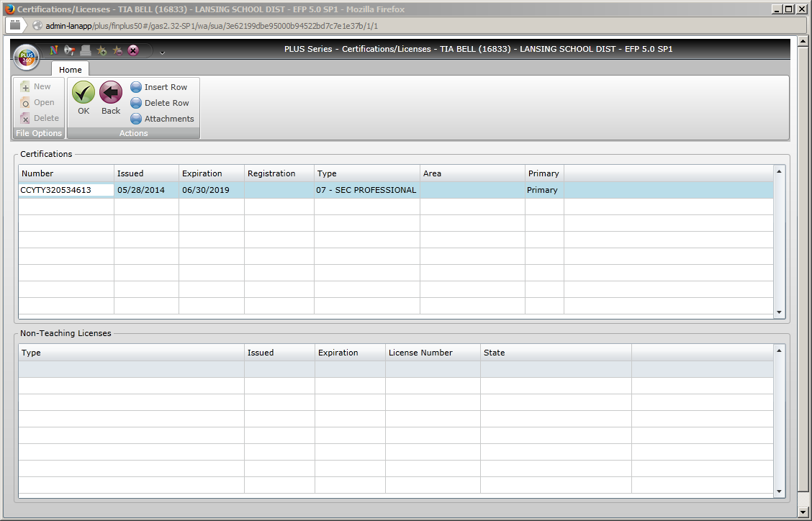

Slide 18
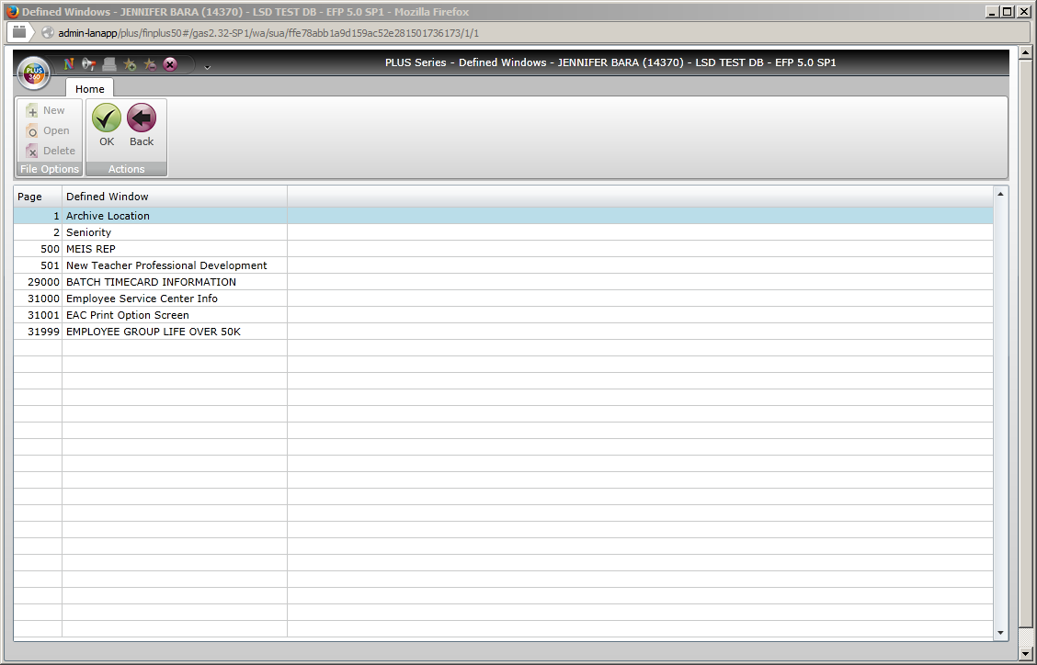
These pages were created by/for District use. If there is information you think would be useful that is not already in the software, send email to Becky Casanova.

Slide 19
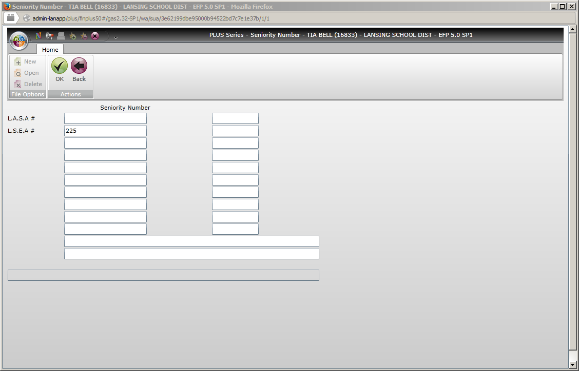

Slide 20
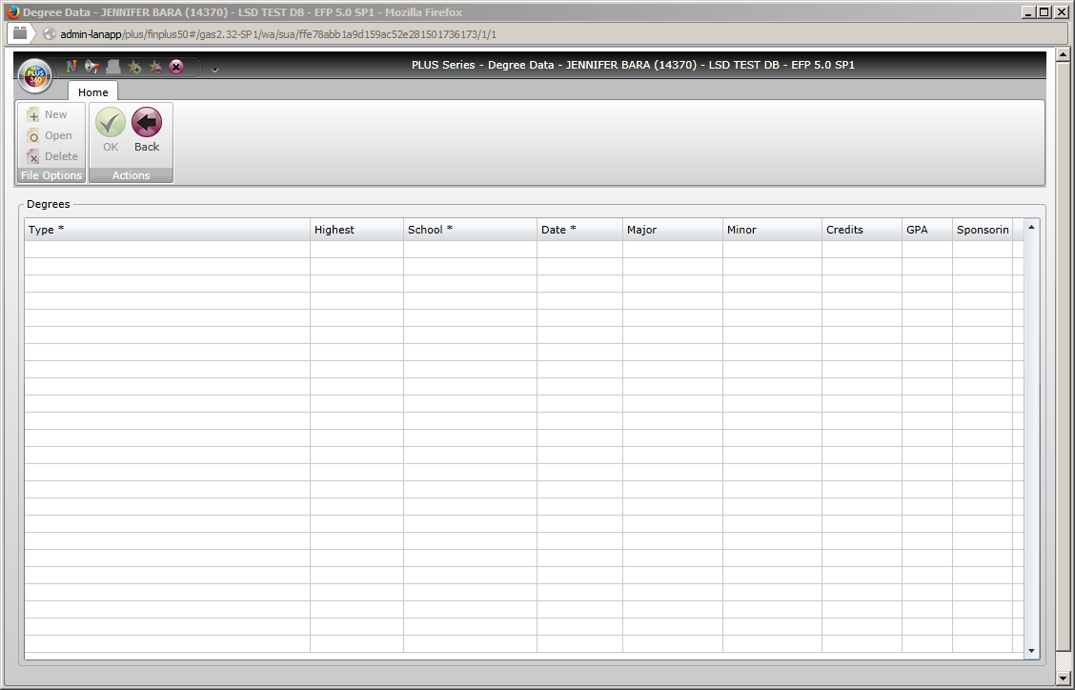
We are working on getting this information entered.

Slide 21
Position control

Slide 22
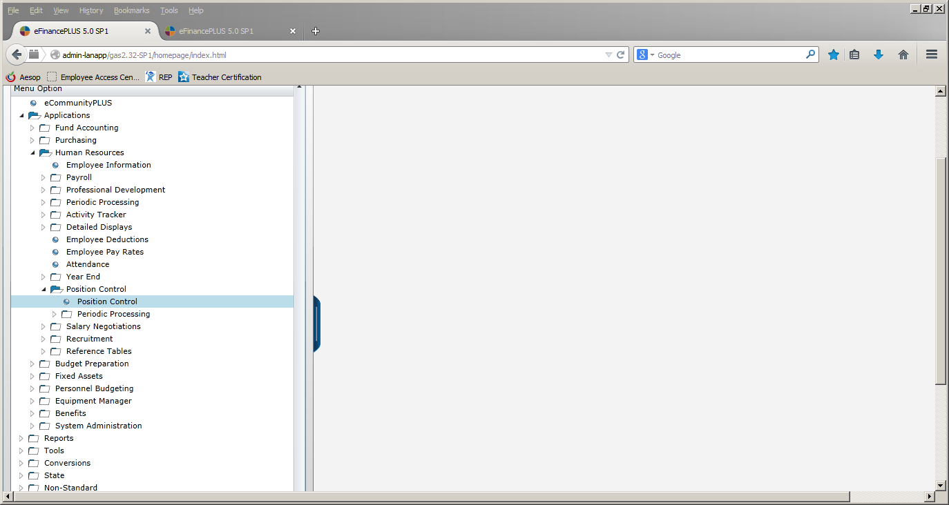

Slide 23
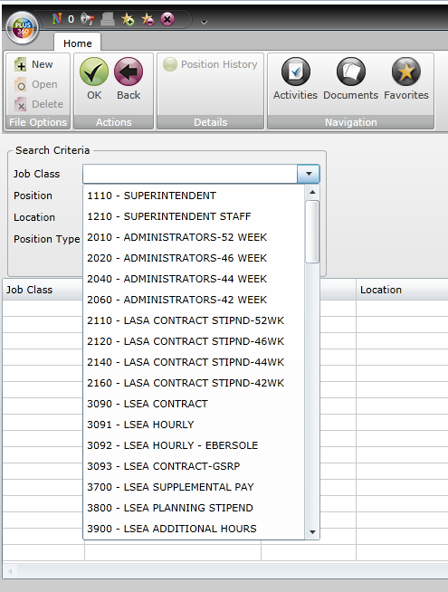
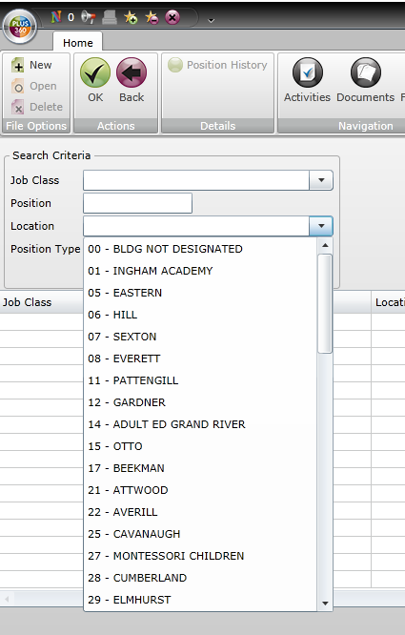
If you want to view all positions, select your school and then click “Find”.
If you want to look at only certain positions, select the appropriate group and then click “Find”.

Slide 24
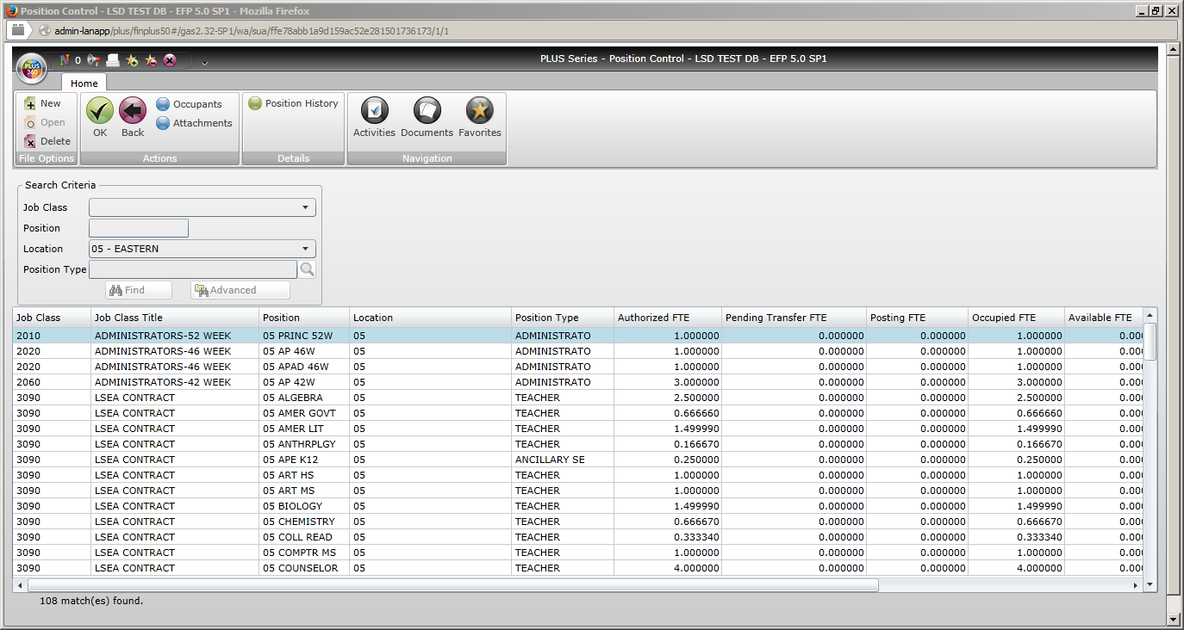
There will not yet be any position history.

Slide 25
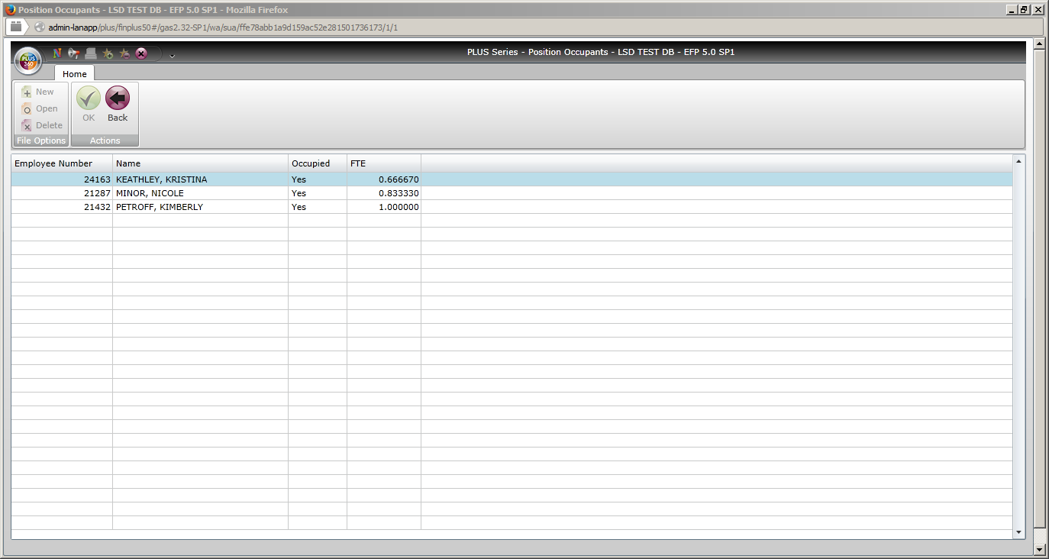

Slide 27
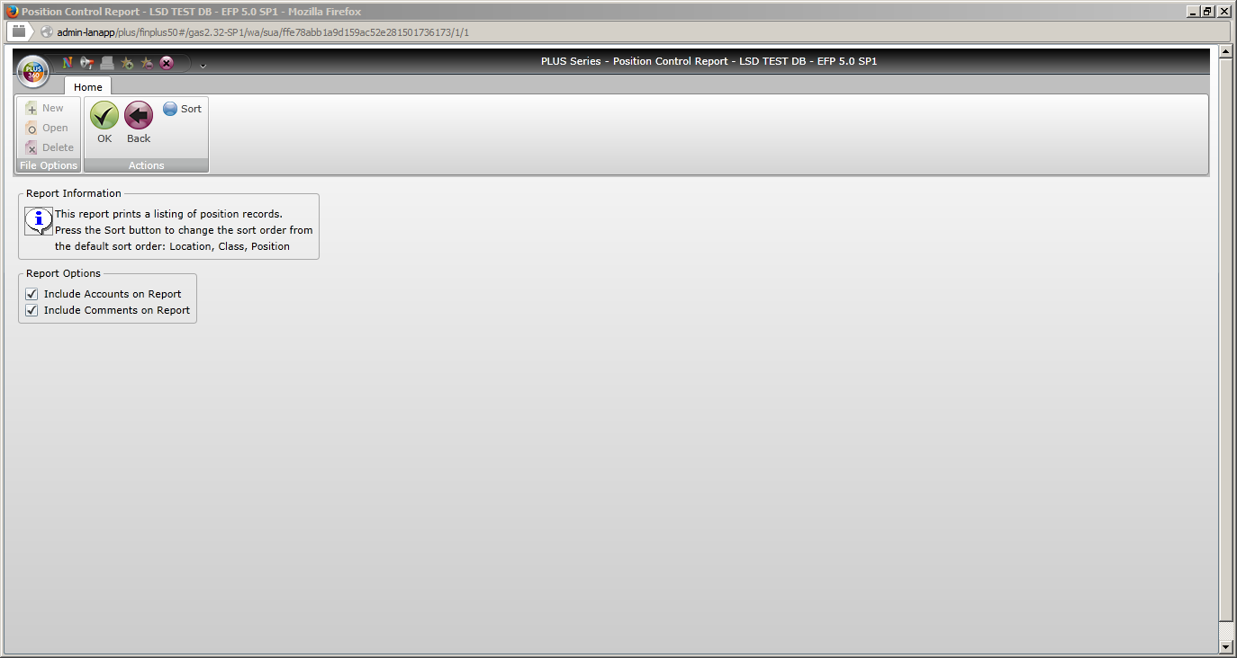
You can also include accounts and/or comments for each position on your reports.

Slide 28
You can sort your report by location, class, position or any combination of them.

Slide 29
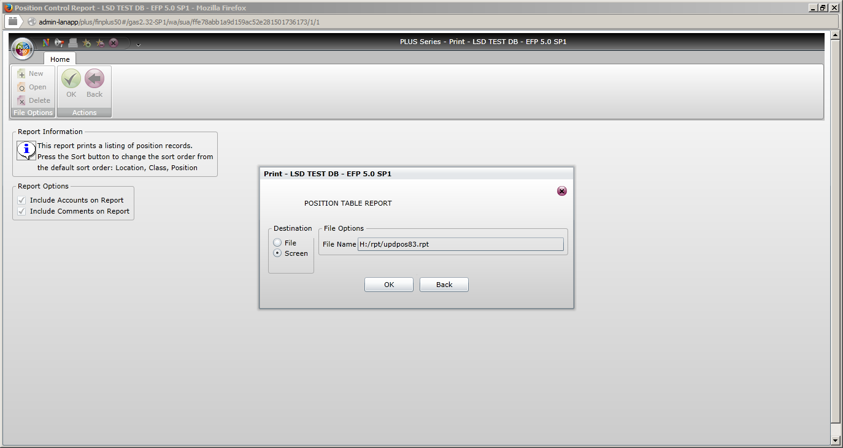
You can run the report to file or screen. After running the report to file or screen, you can run it to export to Excel.

Slide 30
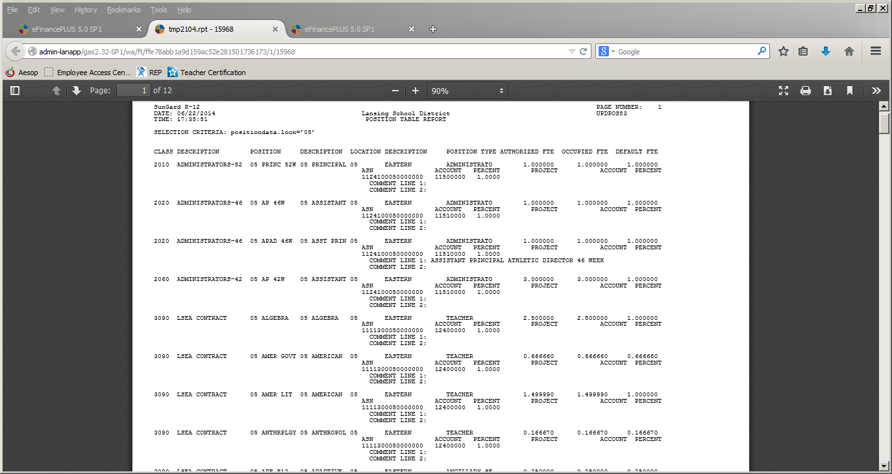
This is what the report looks like when printed to screen.

Slide 31
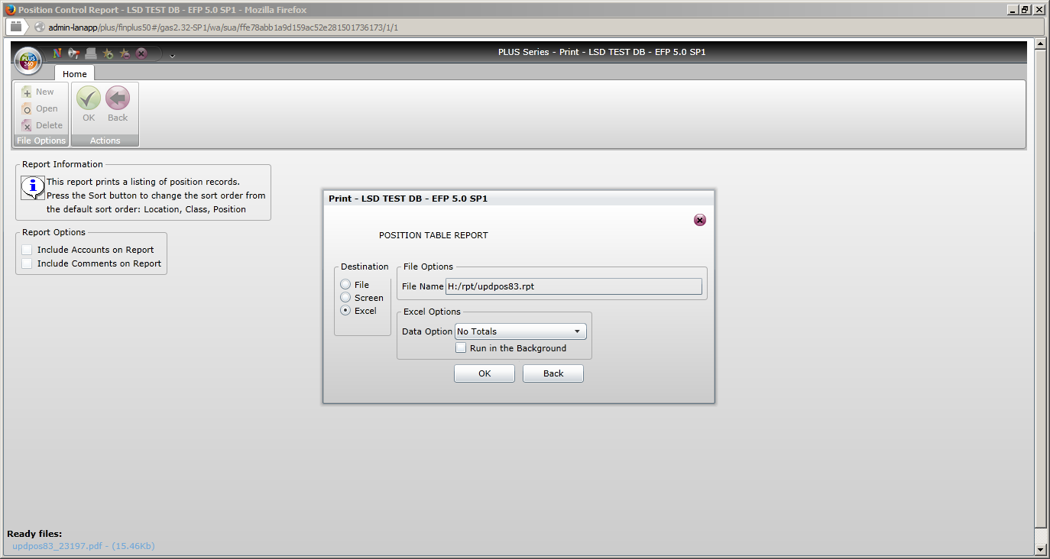
Again, you can select to include accounts and/or comments on the report.
You now have the option to print to Excel.

Slide 32
This box will always appear when printing the report to Excel. Click yes and the file will open.

Slide 33
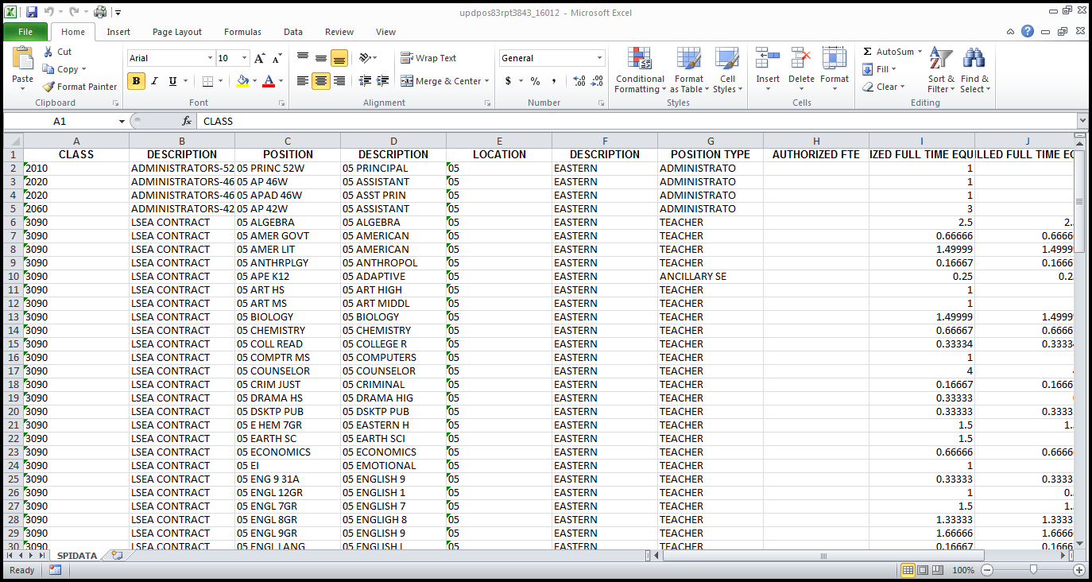
This is what the file looks like when printed to Excel. You can now format and manipulate the data as you need.

Slide 34
Reports

Slide 35
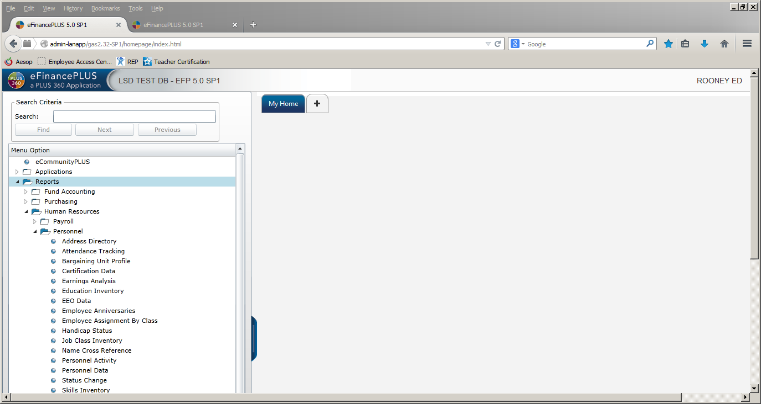

Slide 36
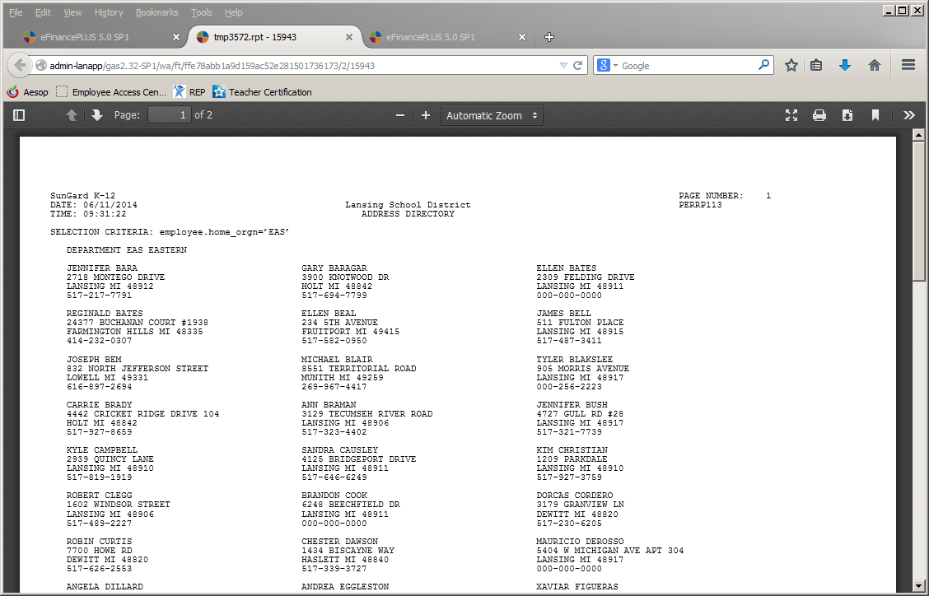

Slide 37
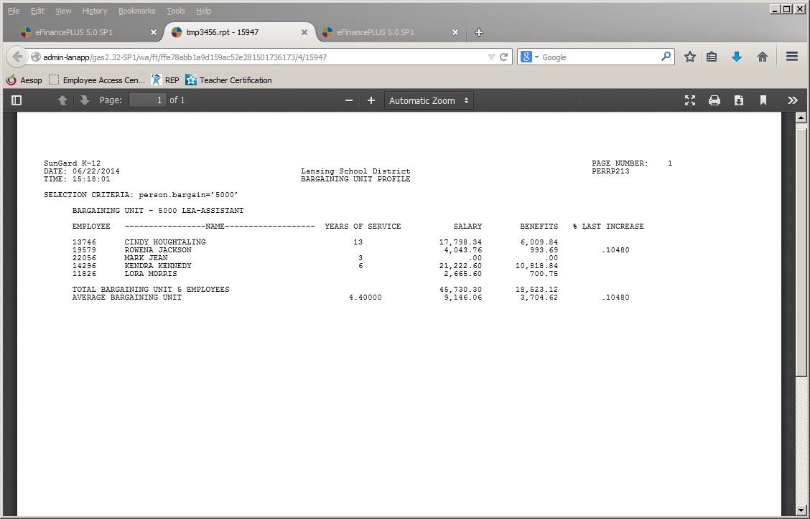

Slide 38
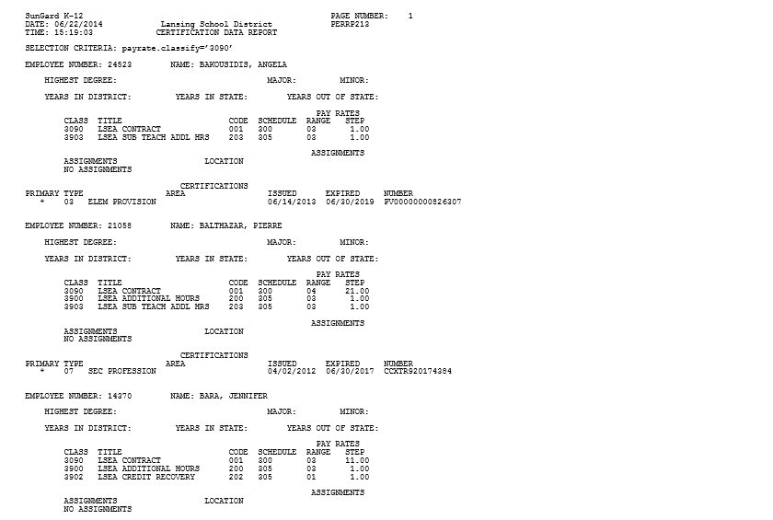

Slide 39
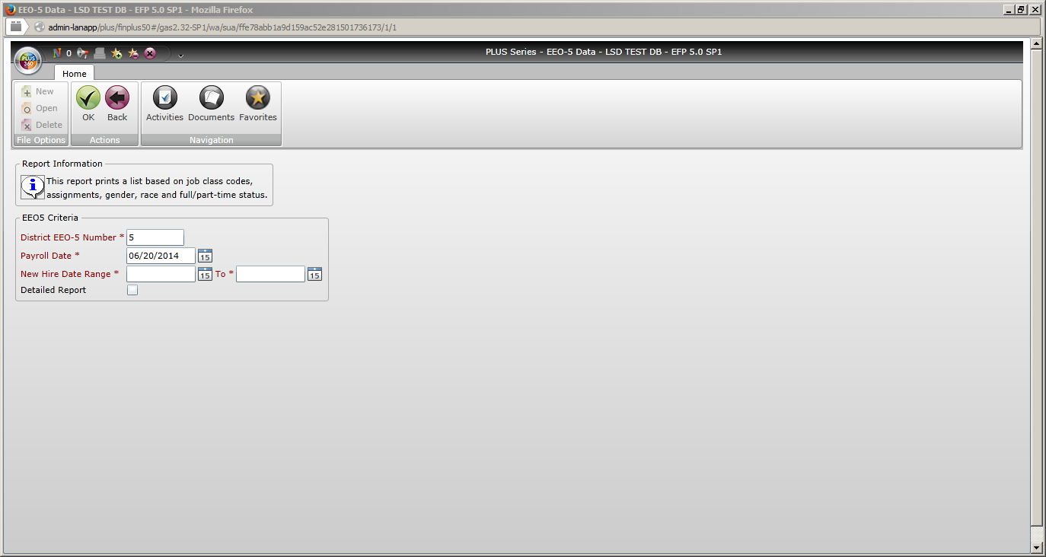

Slide 40
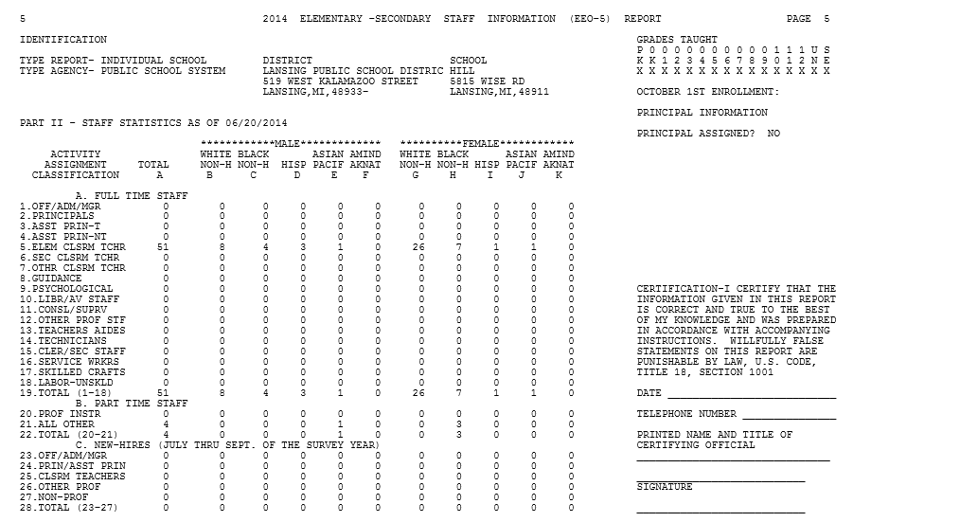

Slide 41
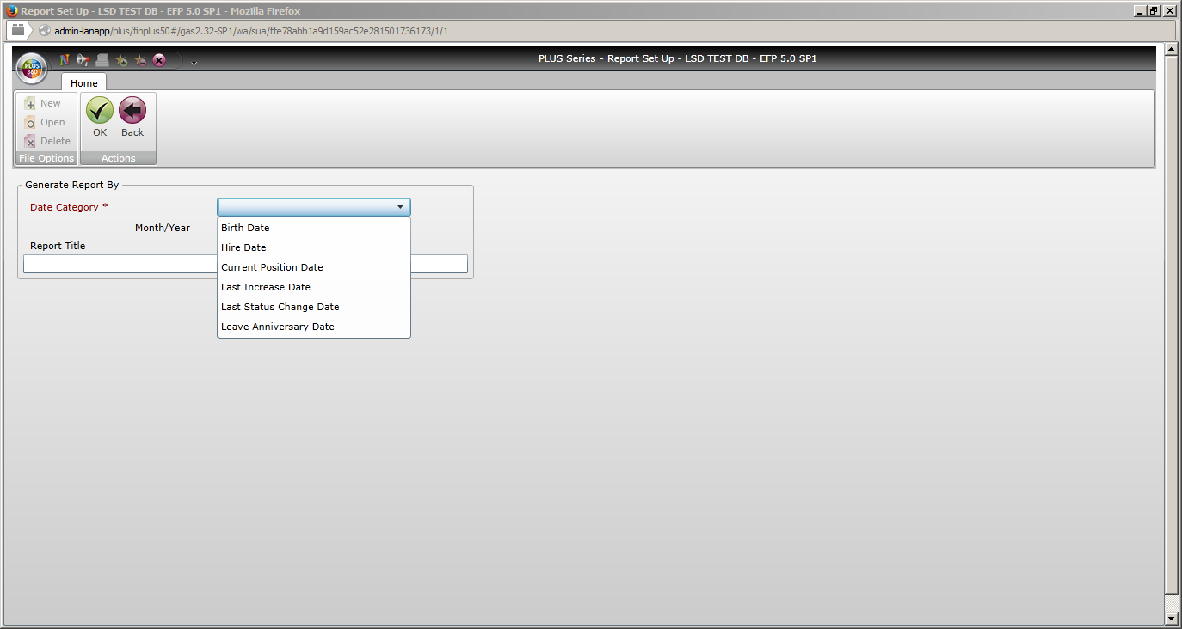

Slide 42
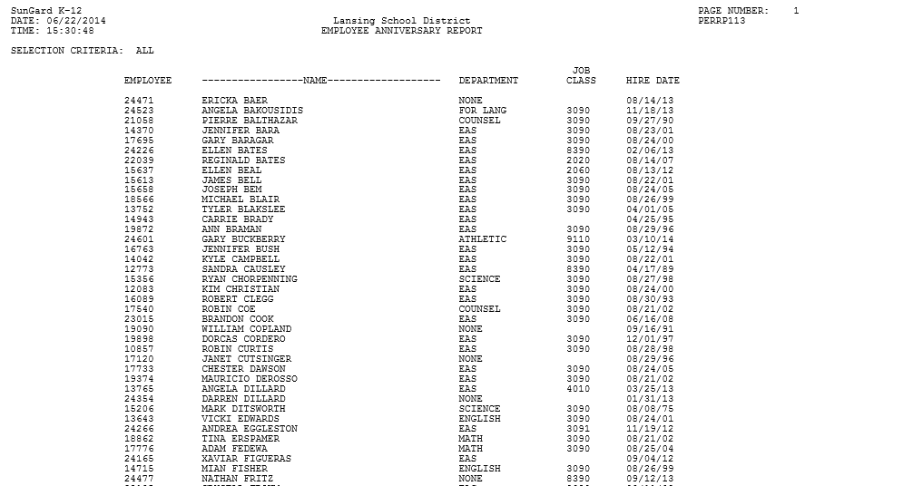

Slide 43
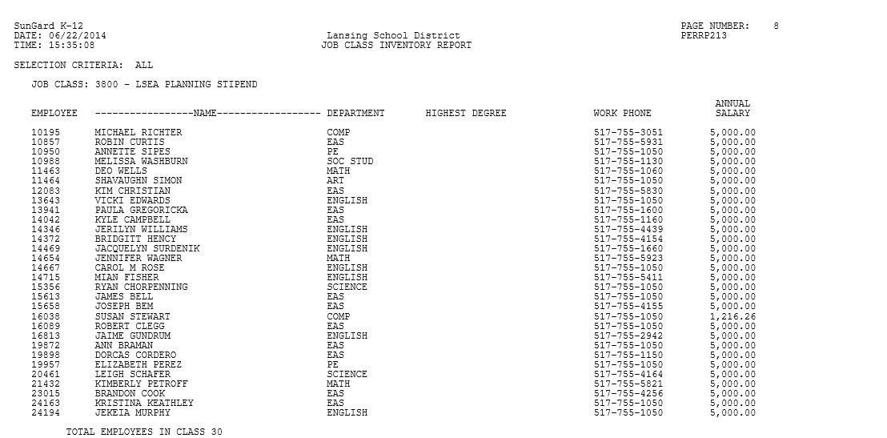

Slide 44
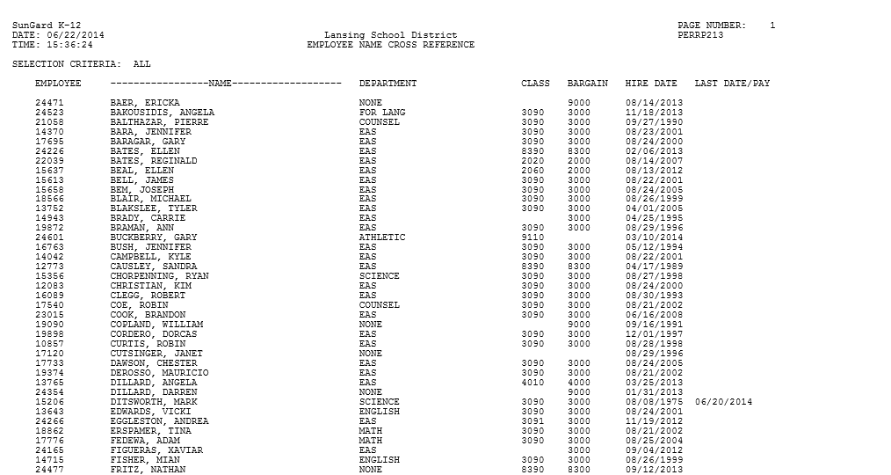

Slide 45
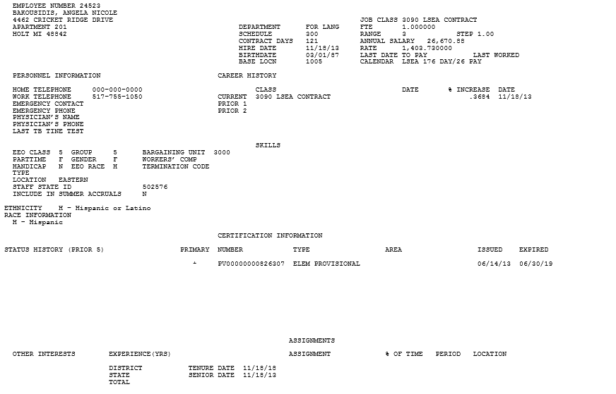

Slide 46
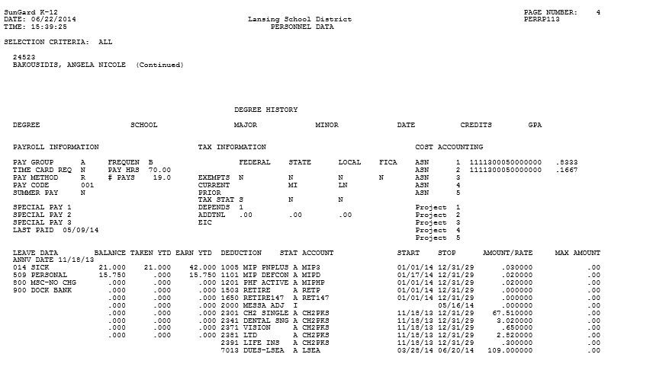

Slide 47
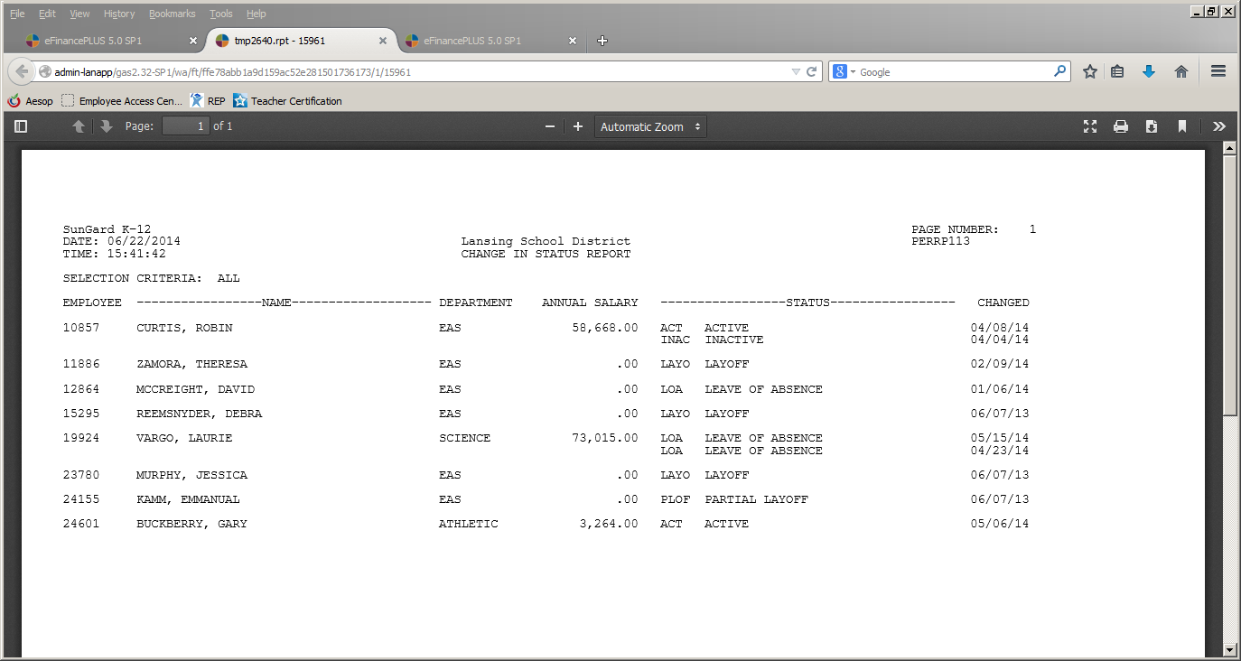

Slide 48
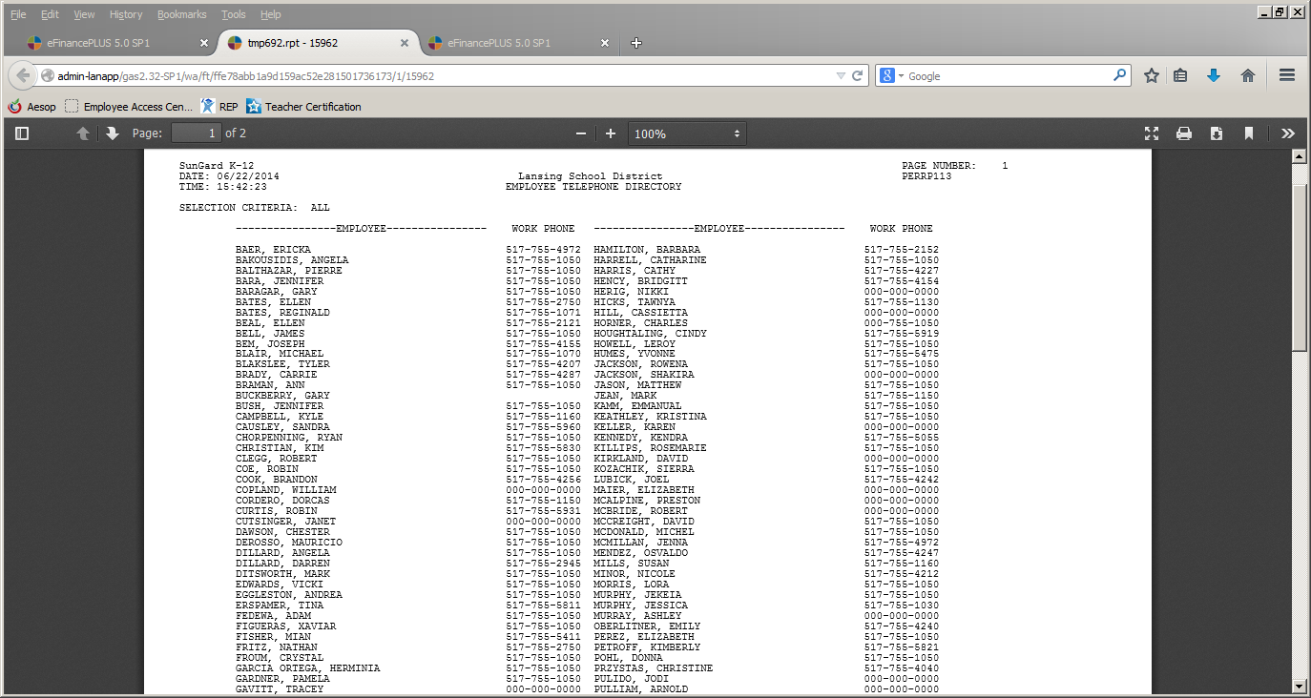

Slide 49
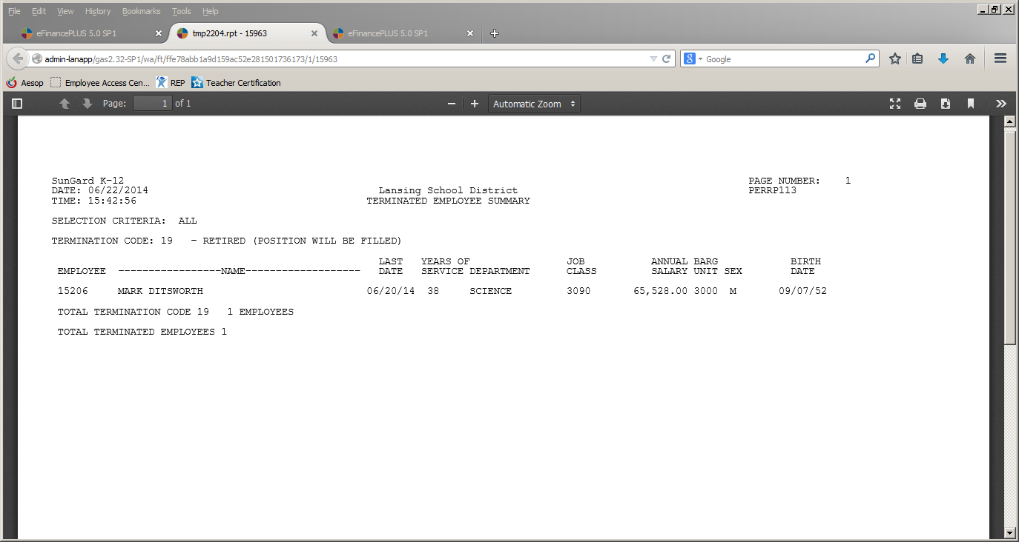

Slide 50
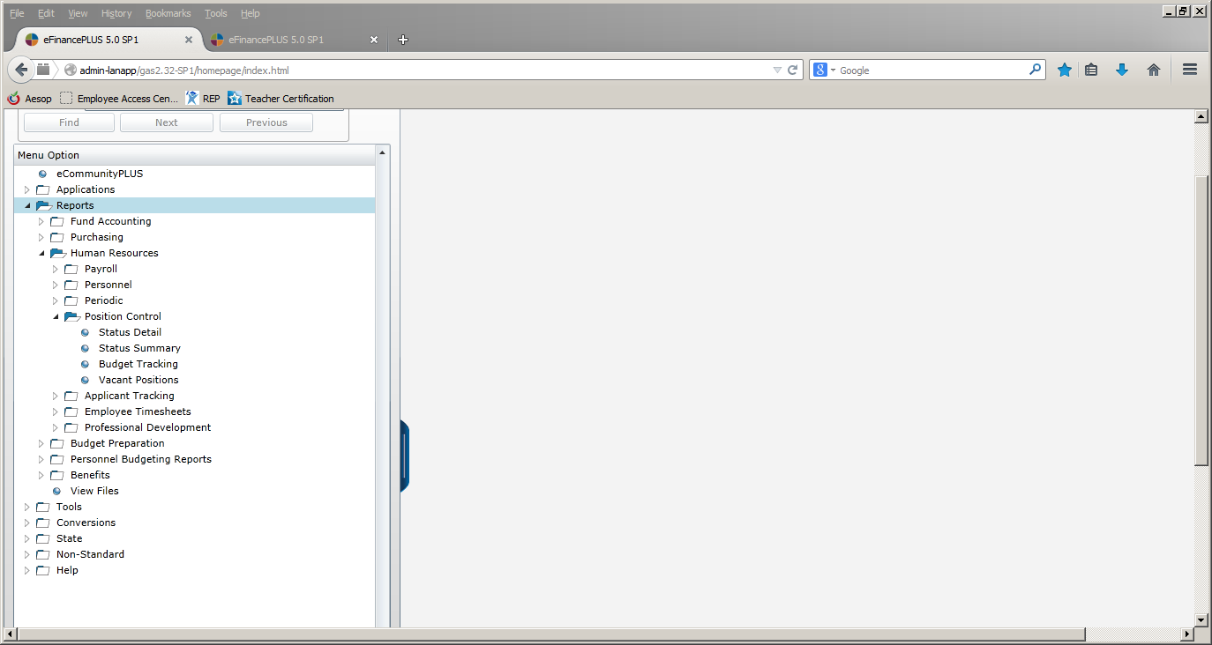

Slide 51
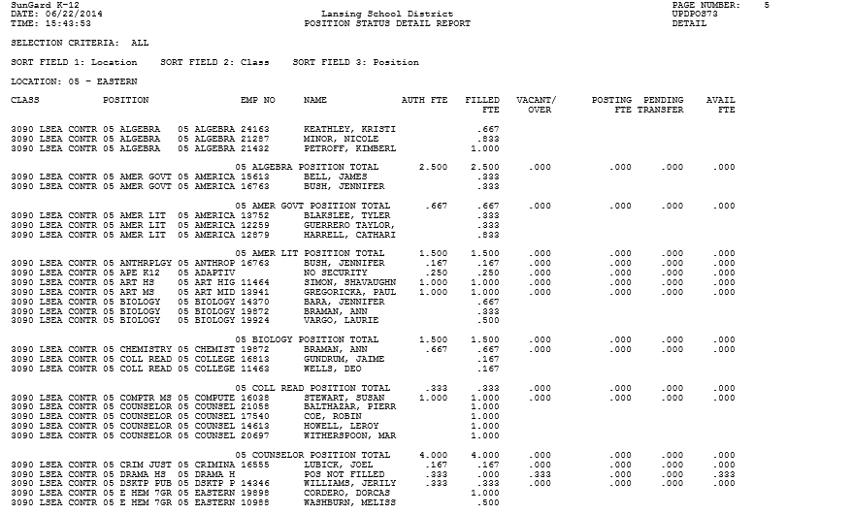

Slide 52
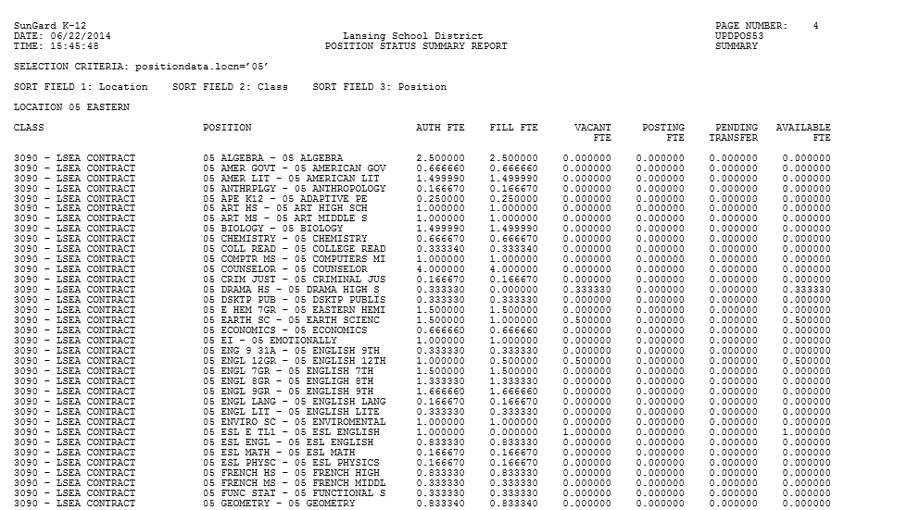

Slide 53
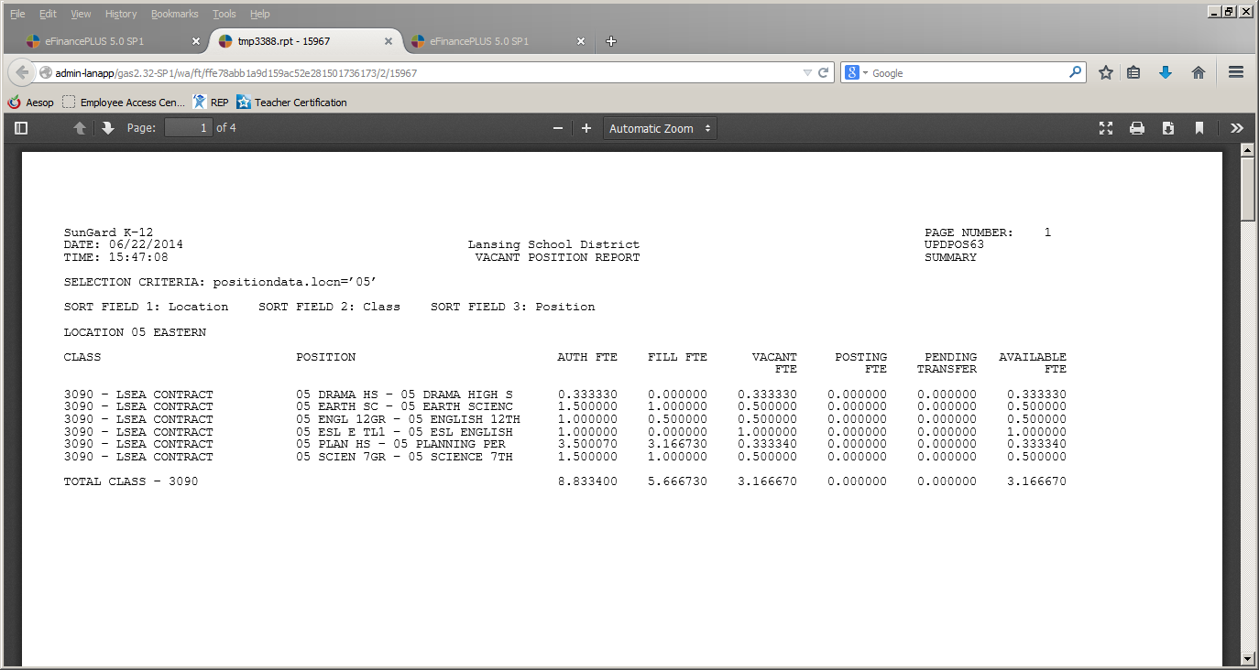

Slide 54
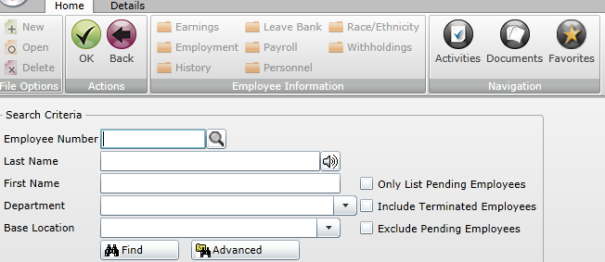

Slide 55
